Slide 1
The Discipleship Journey
How to Effectively Communicate the Gospel
Saturday June 17, 2023 10:00 AM
Discovering my Life Mission
Focus on Sharing
Brent Hunter

Slide 2
The Discipleship Journey
Tips/Tools for Spiritual Fishing
Discovering my Life Mission
Focus on Sharing
Brent Hunter

Slide 3
Spiritual Fishing for men
Thesis:
-Hunting vs. Fishing
-Three Keys . . .
- Building a friendship bridge
-What are my next steps?

Slide 4
FISHING IN MY POND
DISCIPLESHIP 401 : Communicating God’s Story

Slide 5
FISHING IN MY POND
Jesus called out, “Come, follow me, and I will make you fishers of men!”
MATTHEW 4:19 (NIV)

Slide 6
FISHING IN MY POND
Introducing people to Christ is like fishing, not hunting.

Slide 7
FISHING IN MY POND
Salesmanship vs. Matchmaking
DISCIPLESHIP 401 : Communicating God’s Story

Slide 8
FISHING IN MY POND
Introducing people to Christ is like fishing, not hunting.
Hunting
Fishing
vs.
Aggressive
More gentle

Slide 9
FISHING IN MY POND
Introducing people to Christ is like fishing, not hunting.
Hunting
Fishing
vs.
Based on
confrontation
Based on
attraction

Slide 10
FISHING IN MY POND
Introducing people to Christ is like fishing, not hunting.
Hunting
Fishing
vs.
“Go out there
and shoot them”
“Get them to
nibble on your
bait”

Slide 11
FISHING IN MY POND
Introducing people to Christ is like fishing, not hunting.
Hunting
Fishing
vs.
Uses “one size
fits all” bullet
Allows you to try
all kinds of lures

Slide 12
FISHING IN MY POND
Introducing people to Christ is like fishing, not hunting.
Hunting
Fishing
vs.
Take your best
shot and it’s over
Reeling in fish
requires give
and take

Slide 13
FISHING IN MY POND
Introducing people to Christ is like fishing, not hunting.
Hunting
Fishing
vs.
Scares off the
animal if you miss
You get more
than one chance

Slide 14
FISHING IN MY POND
Introducing people to Christ is like fishing, not hunting.
Hunting
Fishing
vs.
The animal has
no choice
The fish gets
a choice

Slide 15
FISHING IN MY POND
Introducing people to Christ is like fishing, not hunting.
Hunting
Fishing
vs.
Must be a
skilled shot
Anyone can
put bait into
the water

Slide 16
Three Keys to Spiritual Fishing

Slide 17

Three Keys to Spiritual Fishing
Identify my POND.
Notes:
Pexels - activity-adventure-blur-297642.jpg

Slide 18
Three Keys to Spiritual Fishing
Identify my POND.
You will be my witnesses in Jerusalem, in all of Judea, in Samaria, and unto the utter most parts of the earth.
ACTS 1:8
Notes:
Pexels - activity-adventure-blur-297642.jpg

Slide 19

Three Keys to Spiritual Fishing
My circle of influence is “my fishing pond.”
Mark 5:18-20
Jesus . . said, "Go home to your family and tell them how much the Lord has done for you, and how he has had mercy on you." So the man went away and began to tell in the Decapolis how much Jesus had done for him. And all the people were amazed. NIV
MARK 5:19 (NIV)

Slide 20

Three Keys to Spiritual Fishing
Notes:
AdobeStock_185485116

Slide 21

Three Keys to Spiritual Fishing
THINK like the fish in my pond.
Notes:
AdobeStock_132696096

Slide 22
Three Keys to Spiritual Fishing
THINK like the fish in my pond.
To the Jews I became like a Jew, to win the Jews.
To the weak I became weak, to win the weak. I have become all things to all men so that by all possible means I might save some.
I do all this for the sake of the gospel, that I may share in its blessings.
I Cor 9:20-22 NIV
Notes:
AdobeStock_132696096

Slide 23
Three Keys to Spiritual Fishing
MAKE A LIST OF COMMON-GROUND AREAS YOU HAVE WITH THE PERSON MOST ON YOUR HEART TODAY.
Notes:
AdobeStock_132696096

Slide 24
Three Keys to Spiritual Fishing
MAKE A LIST OF COMMON-GROUND AREAS YOU HAVE WITH THE PERSON MOST ON YOUR HEART TODAY.
Common Experiences
Common Interests
Common Needs
Common Hurts
Notes:
AdobeStock_132696096

Slide 25
Three Keys to Spiritual Fishing
NINETY PERCENT OF EVANGELISM IS THE ART OF ASKING QUESTIONS!
Make a list of questions that will show you care and could lead to more conversation with the person most on your heart.
Notes:
AdobeStock_132696096

Slide 26
Three Keys to Spiritual Fishing
LOVES FIRST TASK IS TO LISTEN.
- How are you?
- Listen for problems/hurts.
- If you were to die tonight, do you think you would go to heaven?
- If yes, tell me about your salvation experience.
- If maybe, or not sure . . Politely ask if you could show them how they might know for sure.
Notes:
AdobeStock_132696096

Slide 27

Three Keys to Spiritual Fishing
Remember that fish get HUNGRY AT DIFFERENT TI.
This is called receptivity.
How open are they to the Good News?
Notes:
AdobeStock_7057823.jpeg

Slide 28
Three Keys to Spiritual Fishing
Remember that fish get HUNGRY AT DIFFERENT TIMES.
This is called receptivity.
How open are they to the Good News?
Notes:
AdobeStock_7057823.jpeg

Slide 29
Three Keys to Spiritual Fishing
Remember that fish get HUNGRY AT DIFFERENT TIMES.
Be wise in the way you act toward outsiders (non-believers); make the most of every opportunity. Let your conversation be always full of grace, seasoned with salt, so that you may know how to answer everyone.
COLOSSIANS 4:5 (NIV)
This is called receptivity.
How open are they to the Good News?
Notes:
AdobeStock_7057823.jpeg

Slide 30
THE PARABLE OF SOILS (MATTHEW 13):
FOUR KINDS OF RECEPTIVITY
Notes:
AdobeStock_7057823.jpeg

Slide 31
THE PARABLE OF SOILS (MATTHEW 13):
FOUR KINDS OF RECEPTIVITY
Hard soil = The defensive heart
Shallow soil = The impulsive heart
Soil with weeds = The distracted heart
Good soil = The receptive heart
Notes:
AdobeStock_7057823.jpeg

Slide 32
THE PARABLE OF SOILS (MATTHEW 13):
Fact: Some people are close to making a commitment to Christ, while others have a long way to go!
Key: Effective evangelism relies on assessing how receptive a person is and then helping them take the next step.
Notes:
AdobeStock_7057823.jpeg

Slide 33
Examples of Levels of Spiritual Receptivity from the Bible

Slide 34
Examples of Levels of Spiritual
Receptivity from the Bible
Listen to me, you stubborn-hearted, you who are far from righteousness.
ISAIAH 46:12 (NIV)
Notes:
AdobeStock_7057823.jpeg

Slide 35
Examples of Levels of Spiritual
Receptivity from the Bible
[Jesus with an unbeliever] Realizing that he had answered wisely, He said to him, “You are not far from the Kingdom of God.”
MARK 12:34 (NIV)
Notes:
AdobeStock_7057823.jpeg

Slide 36
Examples of Levels of Spiritual
Receptivity from the Bible
I (Paul) planted the seed, Apollos watered it, but God made it grow. So, neither he who plants, nor he who waters is anything, but only God, who makes things grow.
1 CORINTHIANS 3:6-7 (NIV)
Evangelism is a process
Notes:
AdobeStock_7057823.jpeg

Slide 37

Examples of Levels of Spiritual
Receptivity from the Bible
Notes:
AdobeStock_7057823.jpeg

Slide 38
HOW TO BUILD A BRIDGE OF FRIENDSHIP
Discipleship 401 : Communicating God’s Story

Slide 39
A Plan for Sharing Your Faith

Slide 40

A Plan for Sharing Your Faith
Step 1: Become AWARE of the unbelievers God has placed in your life.
Notes:
AdobeStock_7057823.jpeg

Slide 41
A Plan for Sharing Your Faith
Step 1: Become AWARE of the unbelievers God has placed in your life.
Notes:
AdobeStock_7057823.jpeg

Slide 42
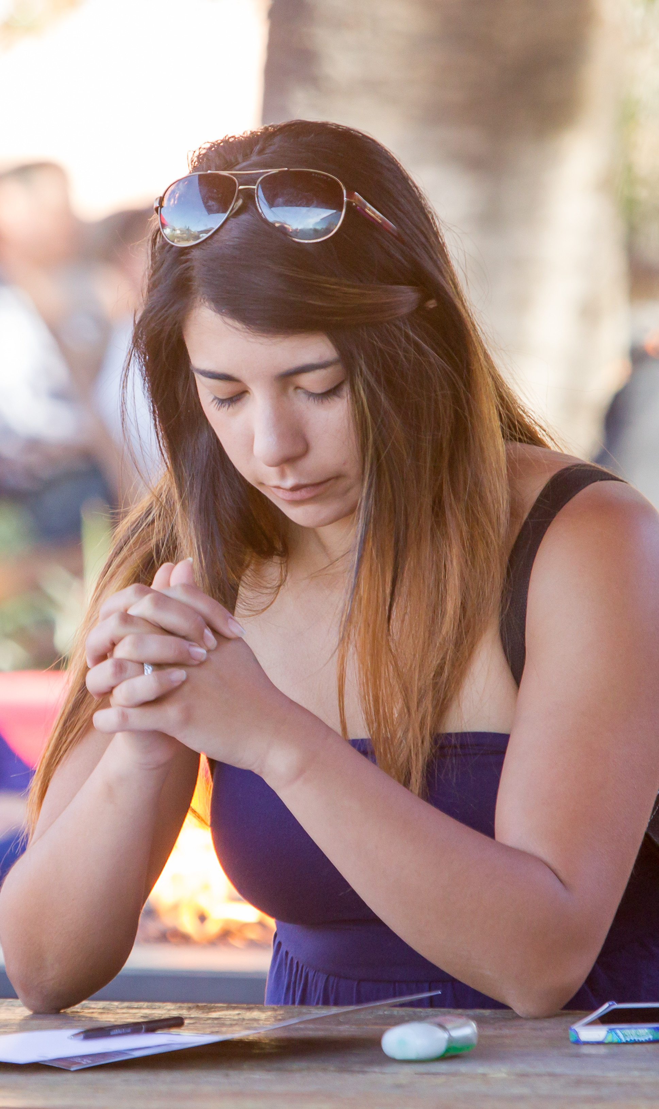
A Plan for Sharing Your Faith
Step 2: Commit to PRAYER.
Notes:
AdobeStock_24267334

Slide 43
A Plan for Sharing Your Faith
Step 2: Commit to PRAYER.
Notes:
AdobeStock_24267334

Slide 44

A Plan for Sharing Your Faith
Step 3: Show you CARE.
Notes:
AdobeStock_24267334

Slide 45
A Plan for Sharing Your Faith
Step 3: Show you CARE.
Notes:
AdobeStock_24267334

Slide 46
A Plan for Sharing Your Faith
Step 4: Be ready to SHARE.
Notes:
AdobeStock_24267334

Slide 47
A Plan for Sharing Your Faith
Step 4: Be ready to SHARE.
Notes:
AdobeStock_24267334

Slide 48

The Truth is…
Notes:
AdobeStock_76487221

Slide 49

The Problem is…
Notes:
AdobeStock_177214151

Slide 50
WHAT THE WORLD
NEEDS NOW
Jesus said to His followers, “The harvest is plenteous, but the laborers are few.”
MATTHEW 9:37

Slide 51
WHAT CAN EACH CHRISTIAN DO?
Session Three: Living on Mission for God

Slide 52

MY PERSONAL
SHARING PLAN
What I can do…
Be prospect conscious! John 4:35
List and pray for three unbelievers.
Pray for Seekers
Seek opportunities to share the Good News.
Start using the congregation’s “Lord’s Business Cards.”

Slide 53

MY PERSONAL SHARING PLAN
What I can do…
Invite others to hear a Big Picture presentation of the gospel.

Slide 54

MY PERSONAL SHARING PLAN
What I can do…
Invite others to hear a Big Picture presentation of the gospel.
Give someone a copy of The Muscle and a Shovel.

Slide 55
WHAT WILL
YOU LIVE THE
REST OF YOUR
LIFE FOR?
Discipleship 401 : Living on Mission for God

Slide 56
WHAT WILL YOU LIVE THE
REST OF YOUR LIFE FOR?
For what is our hope, our joy, our crown of glorying? It is you! Yes, you will bring us much joy as we stand together before our Lord Jesus Christ when He comes back again. For you are our trophy and joy.
1 THESSALONIANS 2:19-20

Slide 57

WHAT WILL YOU LIVE THE
REST OF YOUR LIFE FOR?

Slide 58

PRAYER OF COMMITMENT

