Slide 1
Part one

Slide 2
John 8

Slide 3
How God values life!
What about the science?
“Fearfully and wonderfully made.”
What if it is too late?
An appeal to those who may be considering an abortion.
Thesis:

Slide 4
How God Values Life!
God created us with the breath of life (Gen 2:7).
His Word instructs us in the way of life (Prov 10:17).
He is the author of life (Acts 3:15).
We are to walk in newness of life (Rom 6:3).
He is the sustainer of life (Heb 1:3).
He is the Word of life (I John 1:1).
We will be given the crown of life (Rev 2:10).
Our names are written in the book of Life (Rev 3:5).
We will eat from the tree of life (Rev 22:14).
We will drink from the fountain of life (Rev 22:17).

Slide 5
When does God
take notice of us?
Jer 1:5
Isa 49:1
Ps 22:10

Slide 6
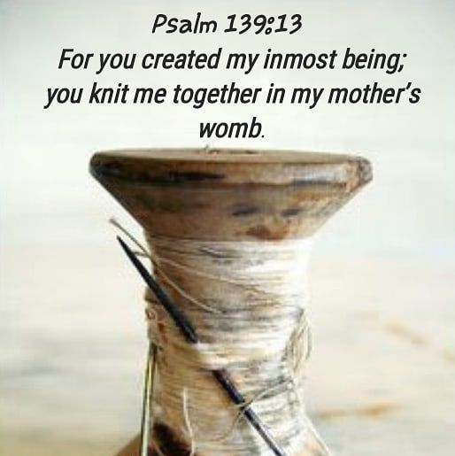
When does God
take notice of us?

Slide 7
What about the science?
New Study: 95% of Biologists Believe Life Begins at Conception.
University of Chicago 2018 study.

Slide 8
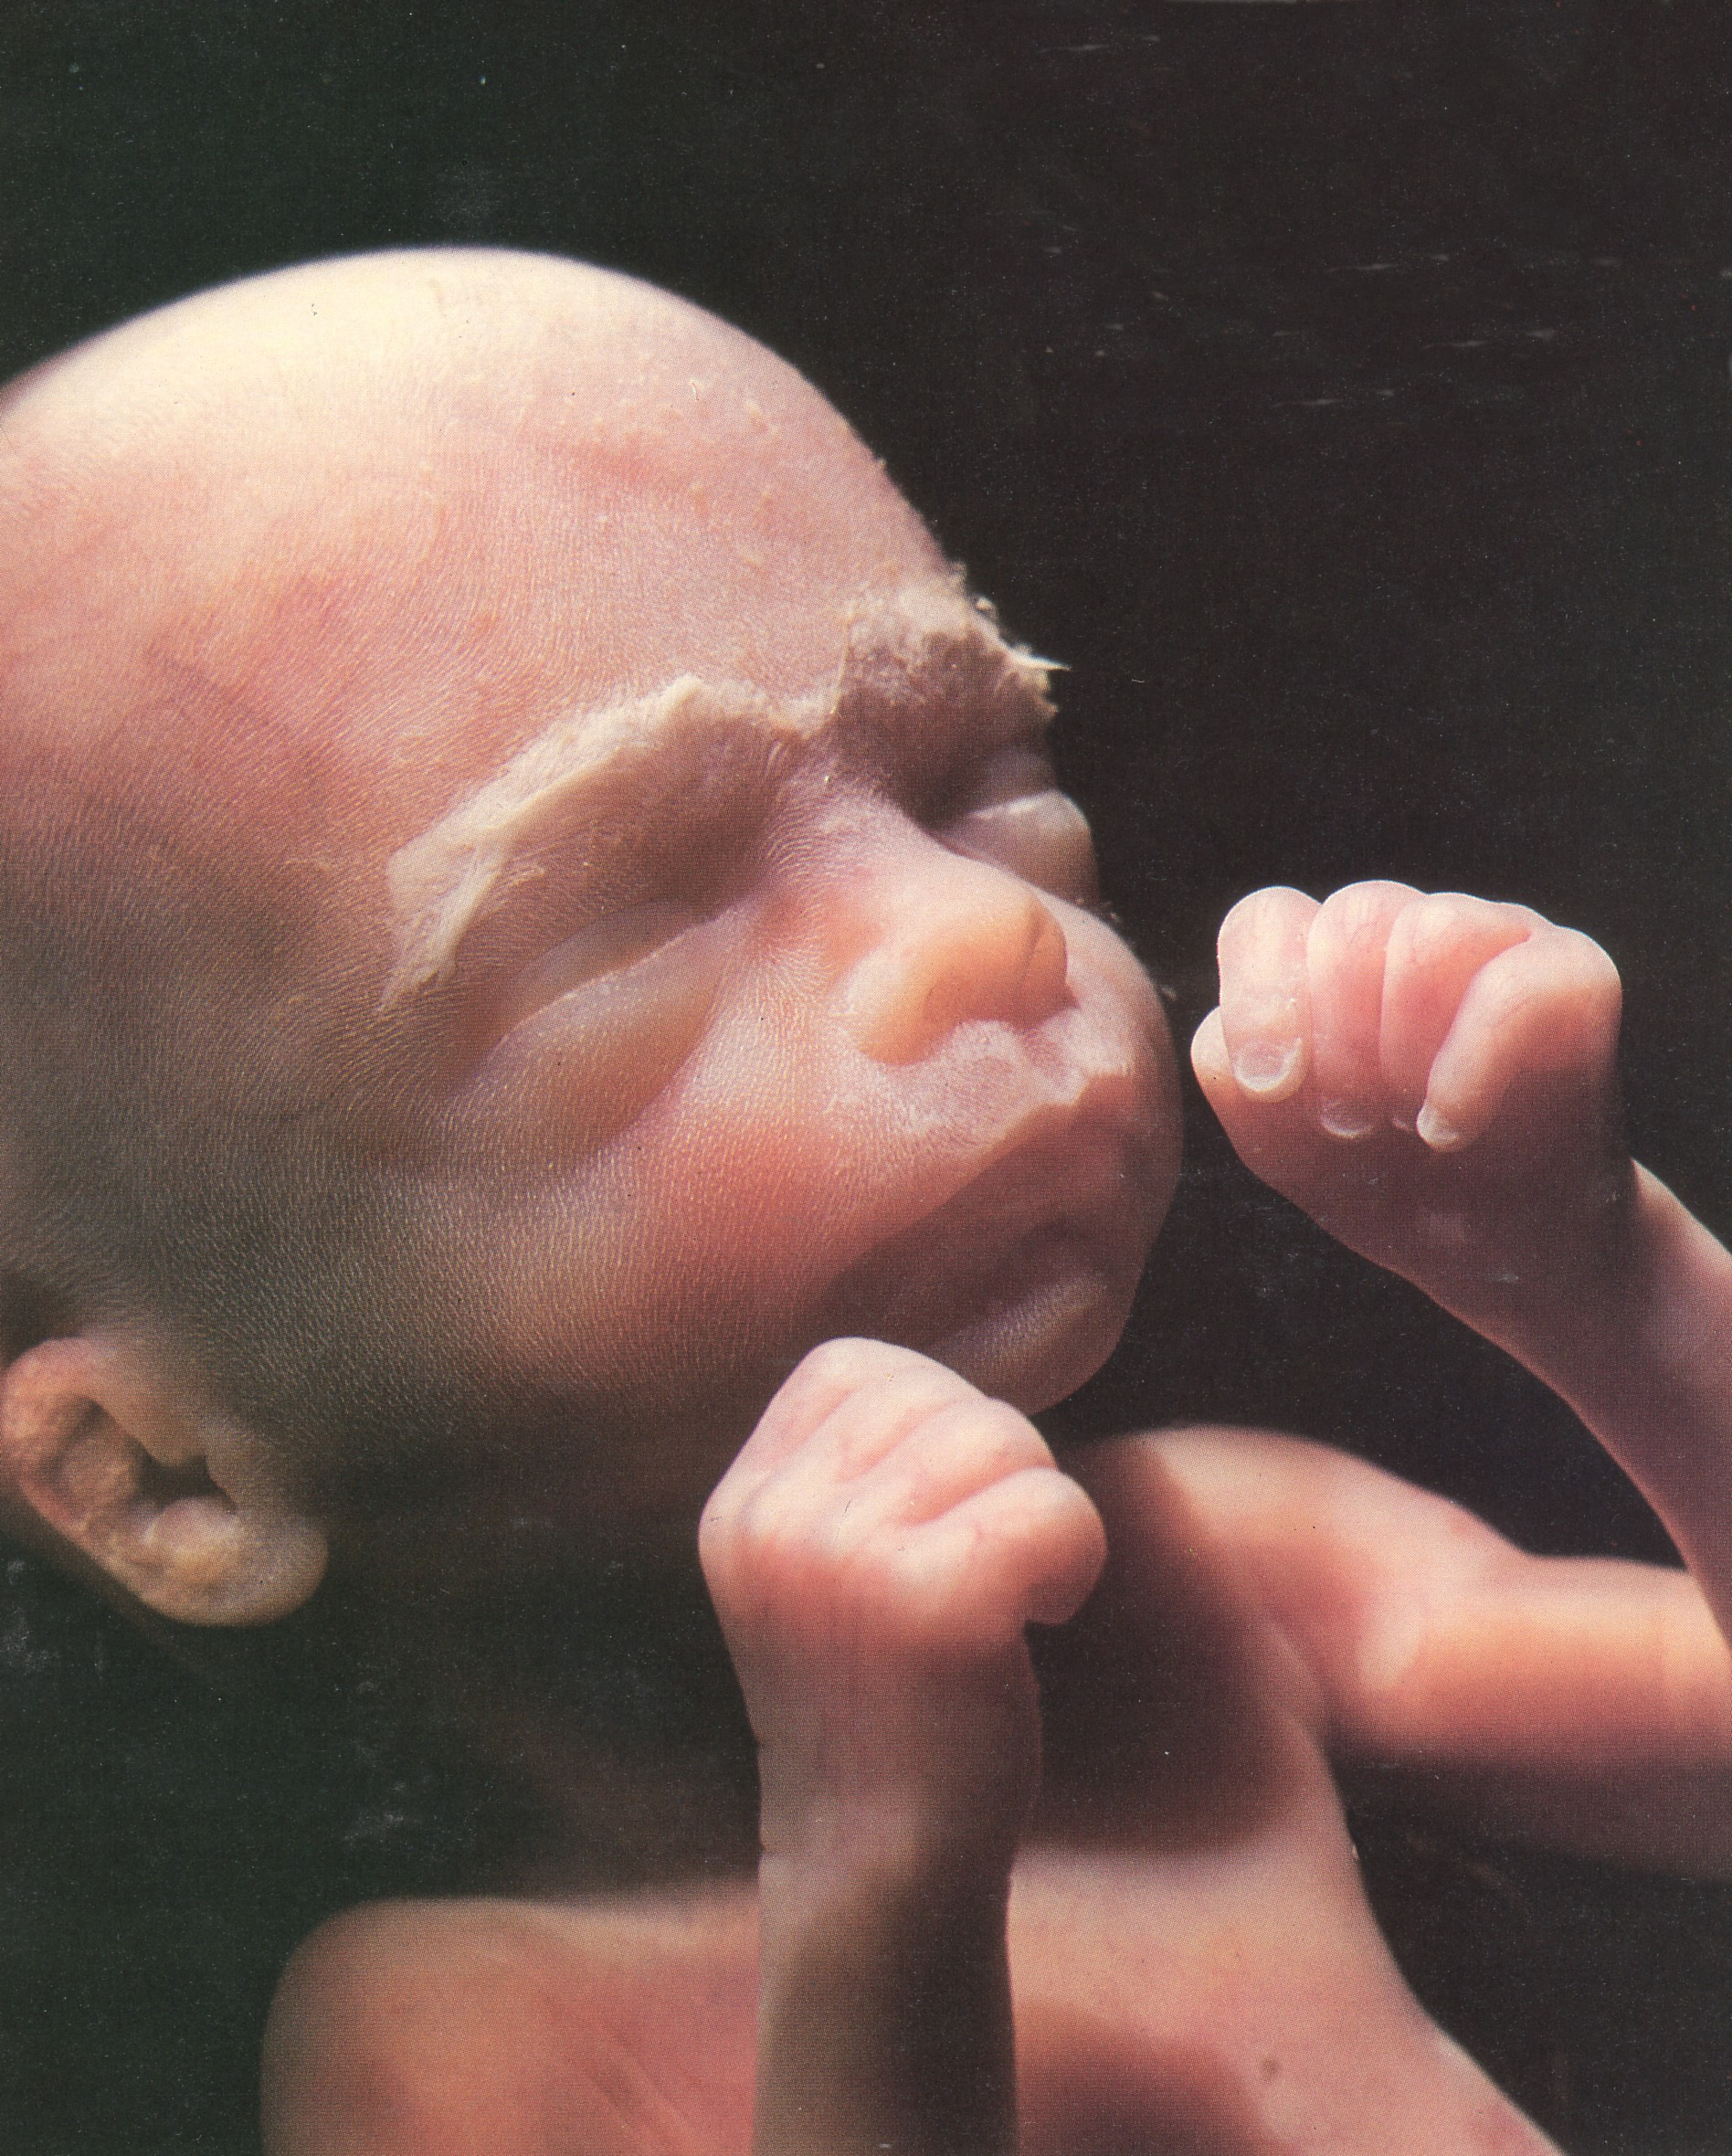
From Conception
Baby only develops and grows

Slide 9
From Conception
Needs only time and nourishment to become an adult!

Slide 10
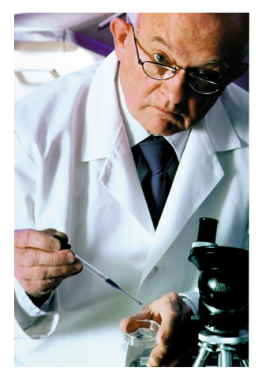
“Rites of Life. The scientific evidence of life before birth.” 1983
“The zygote is a term for a newly conceived life after the sperm and the egg cell meet but before the embryo begins to divide. The zygote is human life.. there is one fact that no one can deny; human lives begin at conception.”
Dr. Landrum B. Shettles
(First scientist to succeed at in vitro fertilization)

Slide 11
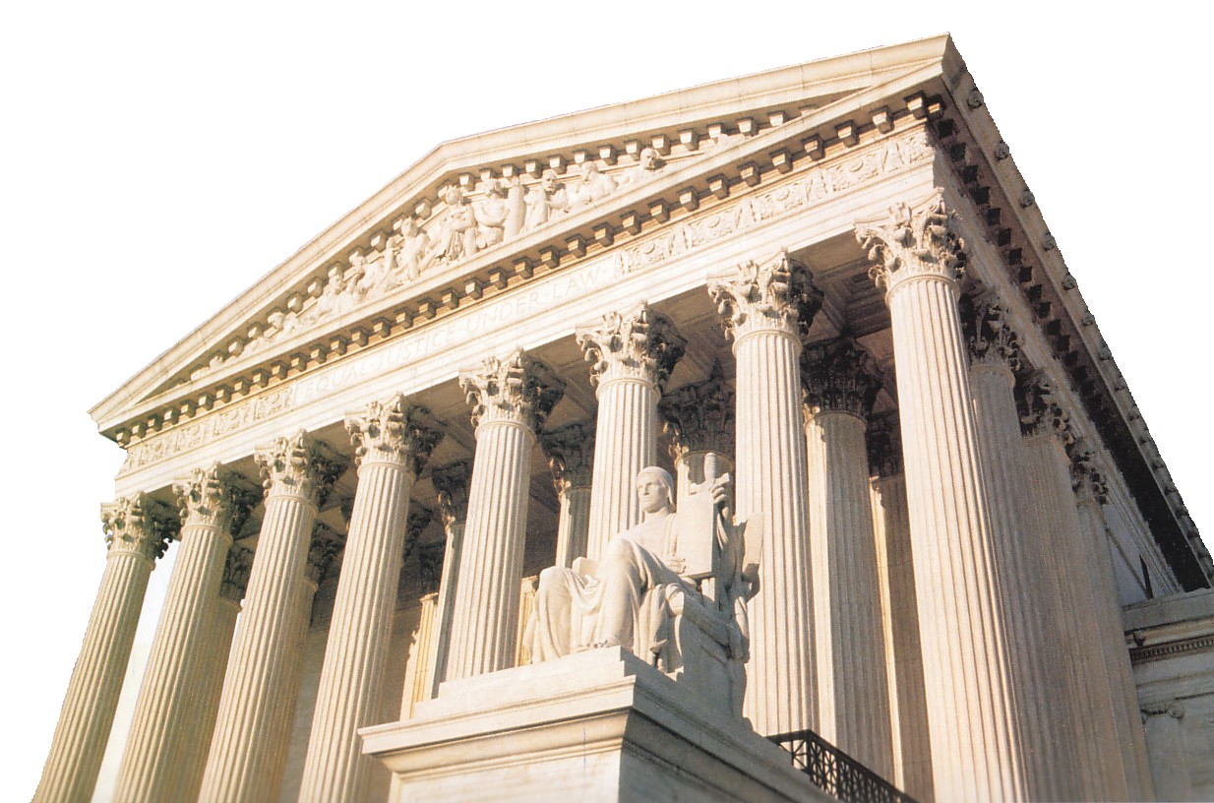
January 22, 1973
When is a human being a human being and entitled to legal protection?
Roe v. Wade

Slide 12
January 22, 1973
The word “person” as used in the Fourteenth Amendment, does not include the unborn.
Roe v. Wade

Slide 13
January 22, 1973
Late term, 3rd trimester abortions, were declared illegal unless the pregnancy threatened the life/health of the mother.
Roe v. Wade

Slide 14
January 22, 1973
Key concept = “Viability”
Problem is this standard is obscure and arbitrary.
Roe v. Wade

Slide 15
January 22, 1973
What about the elderly, the terminally ill, and the handicapped?
Roe v. Wade

Slide 16
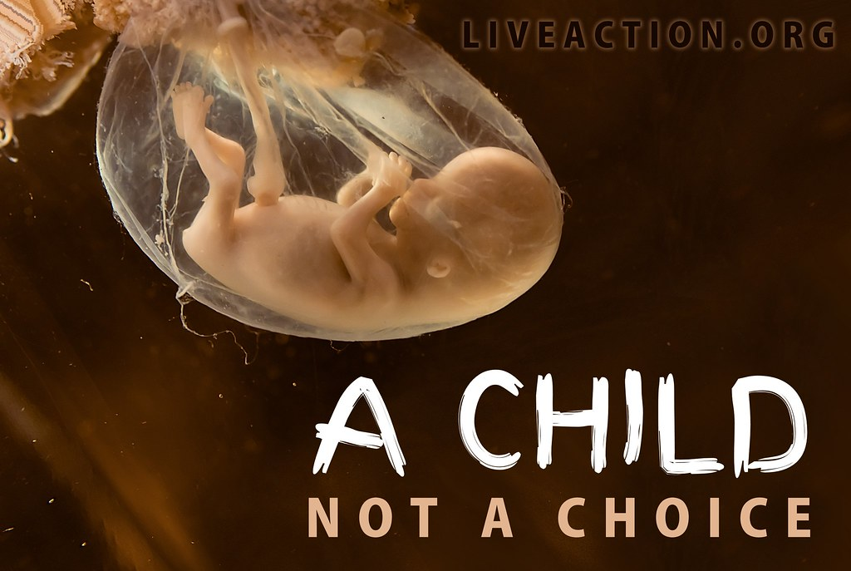
What about …

Slide 17
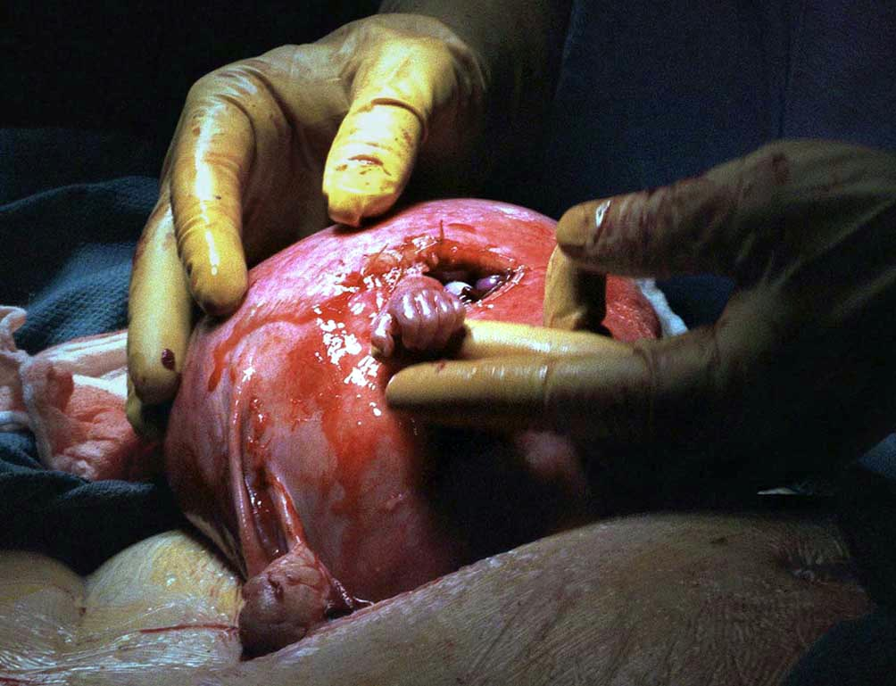
Samuel Armas
21 weeks, undergoing surgery to repair his back.

Slide 18
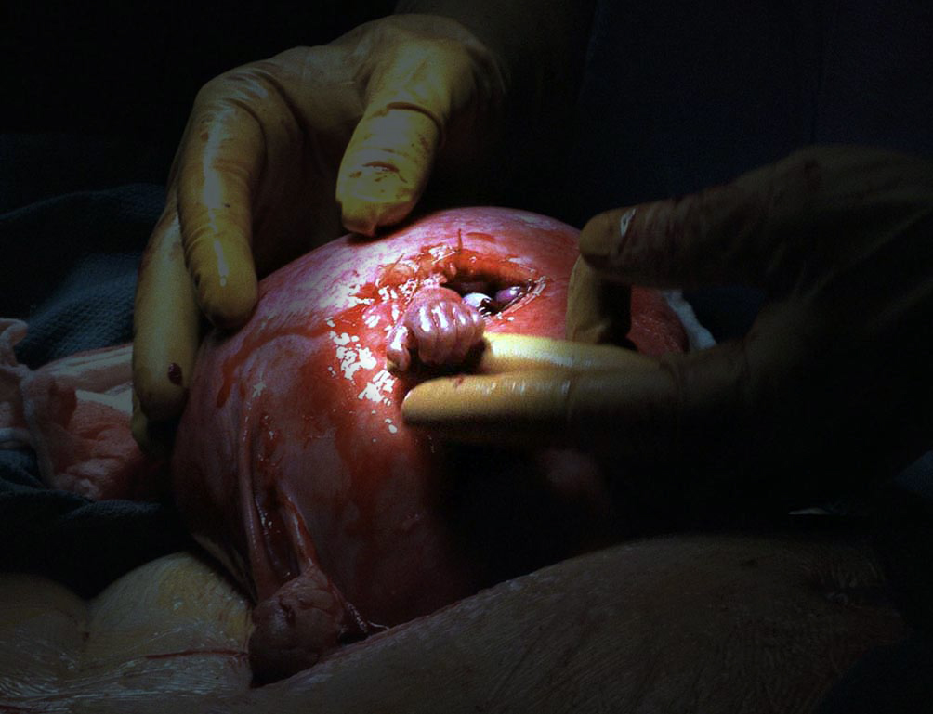
Samuel Armas
The Hand of Hope
Vanderbilt Medical Center - 1999

Slide 20
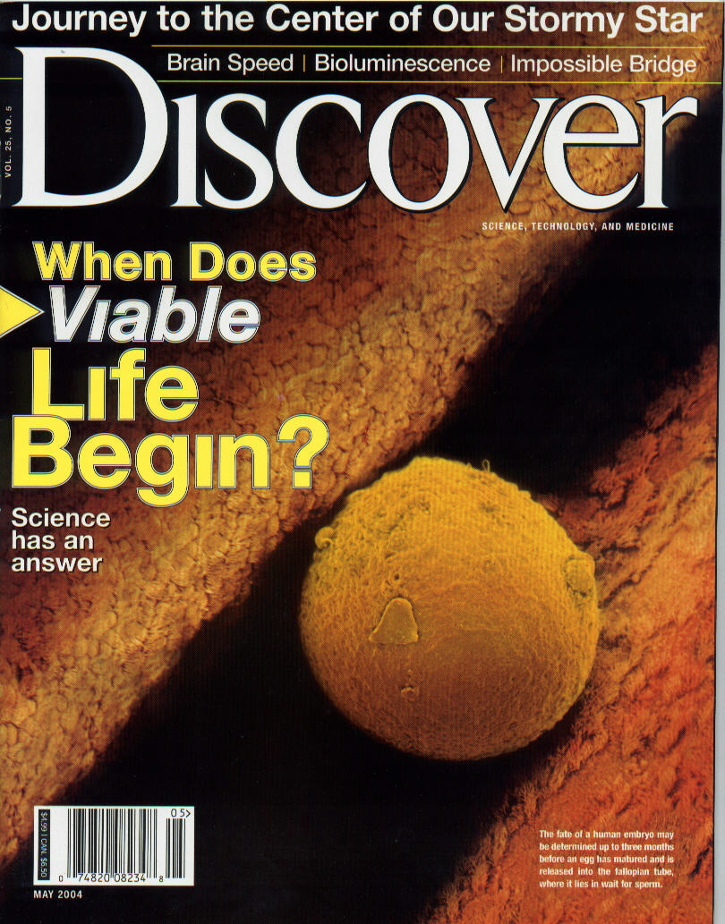

Slide 22
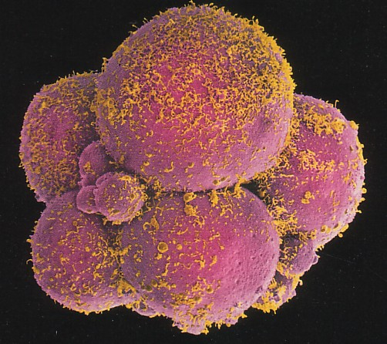

Slide 23
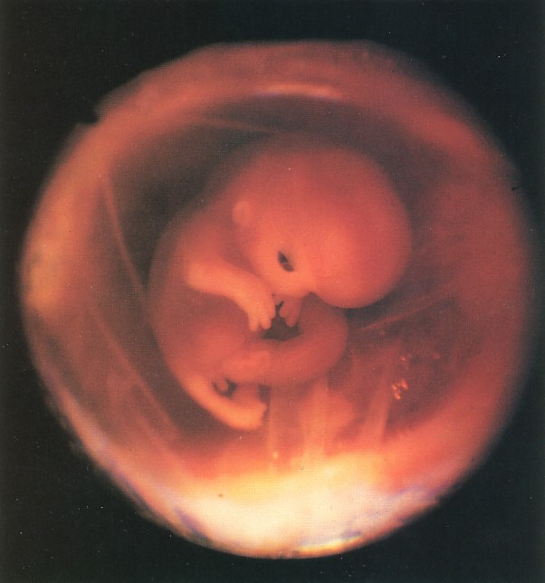
3 weeks – heart is beating
6 weeks – has brain waves

Slide 24
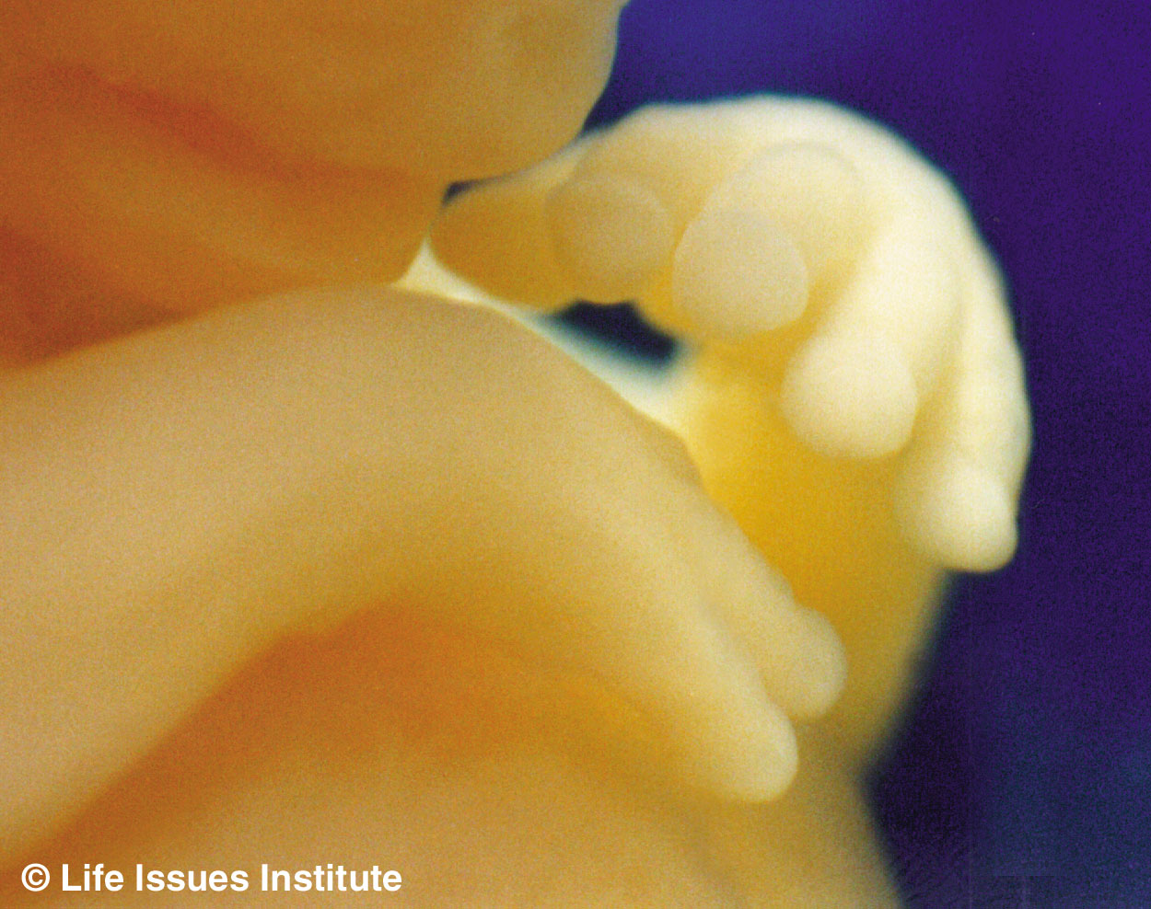
7 weeks

Slide 25
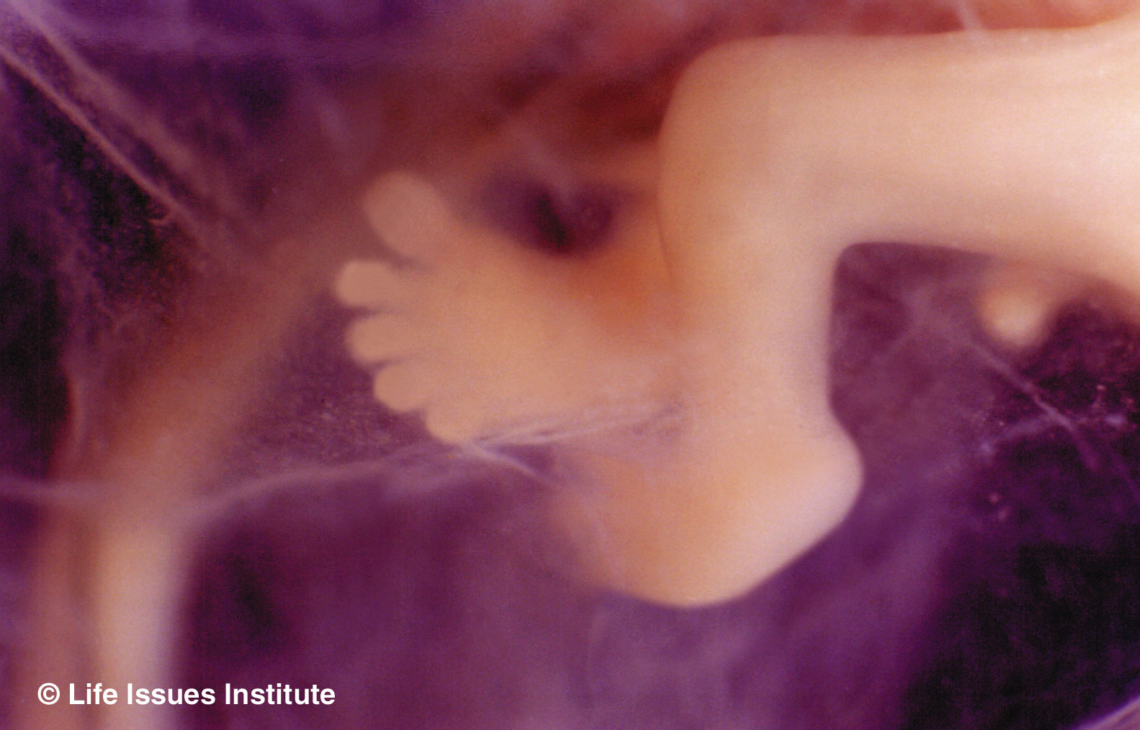
All body systems present
Grips instrument
Sucks thumb
Has hiccups
Girl has ovaries
8 weeks

Slide 26
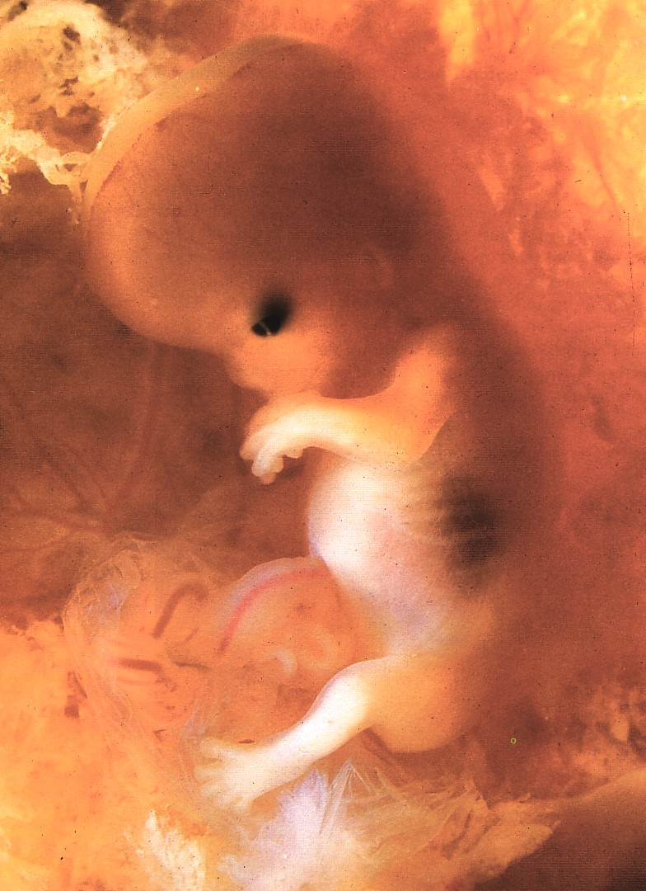
Structure of the body is completely formed.
Has its own unique fingerprints!
10 weeks

Slide 27
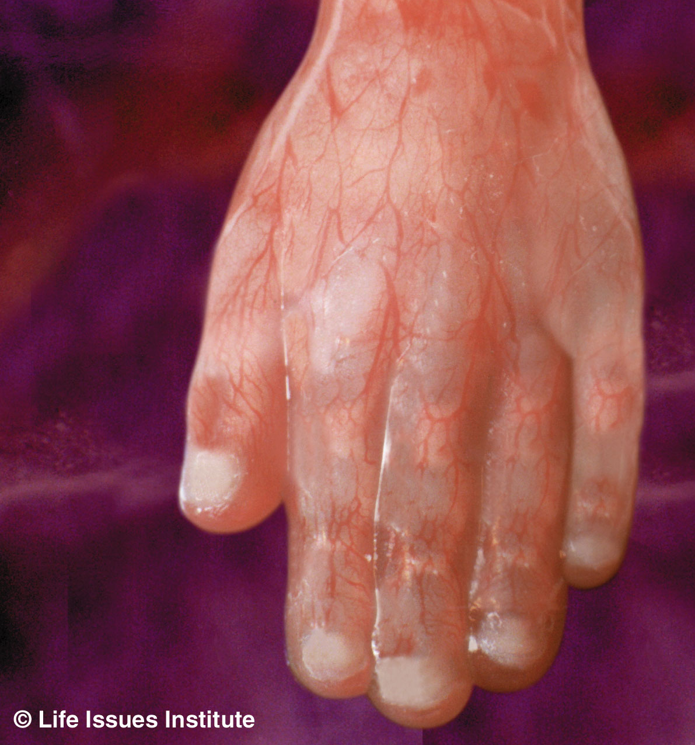
Vigorous activity shows individuality
Curls toes, makes fist
Opens mouth, practices breathing
12 weeks

Slide 28
14 weeks

Slide 29
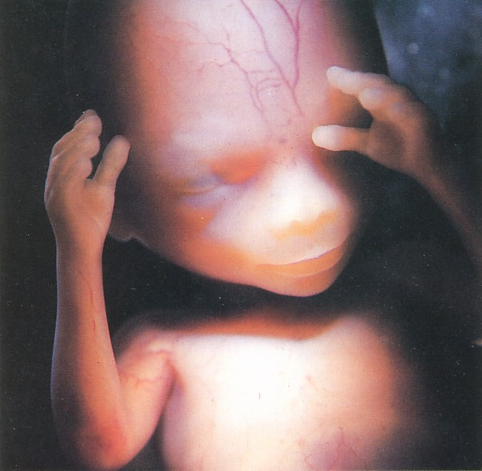
Four inches
Makes facial expressions
15 weeks

Slide 30
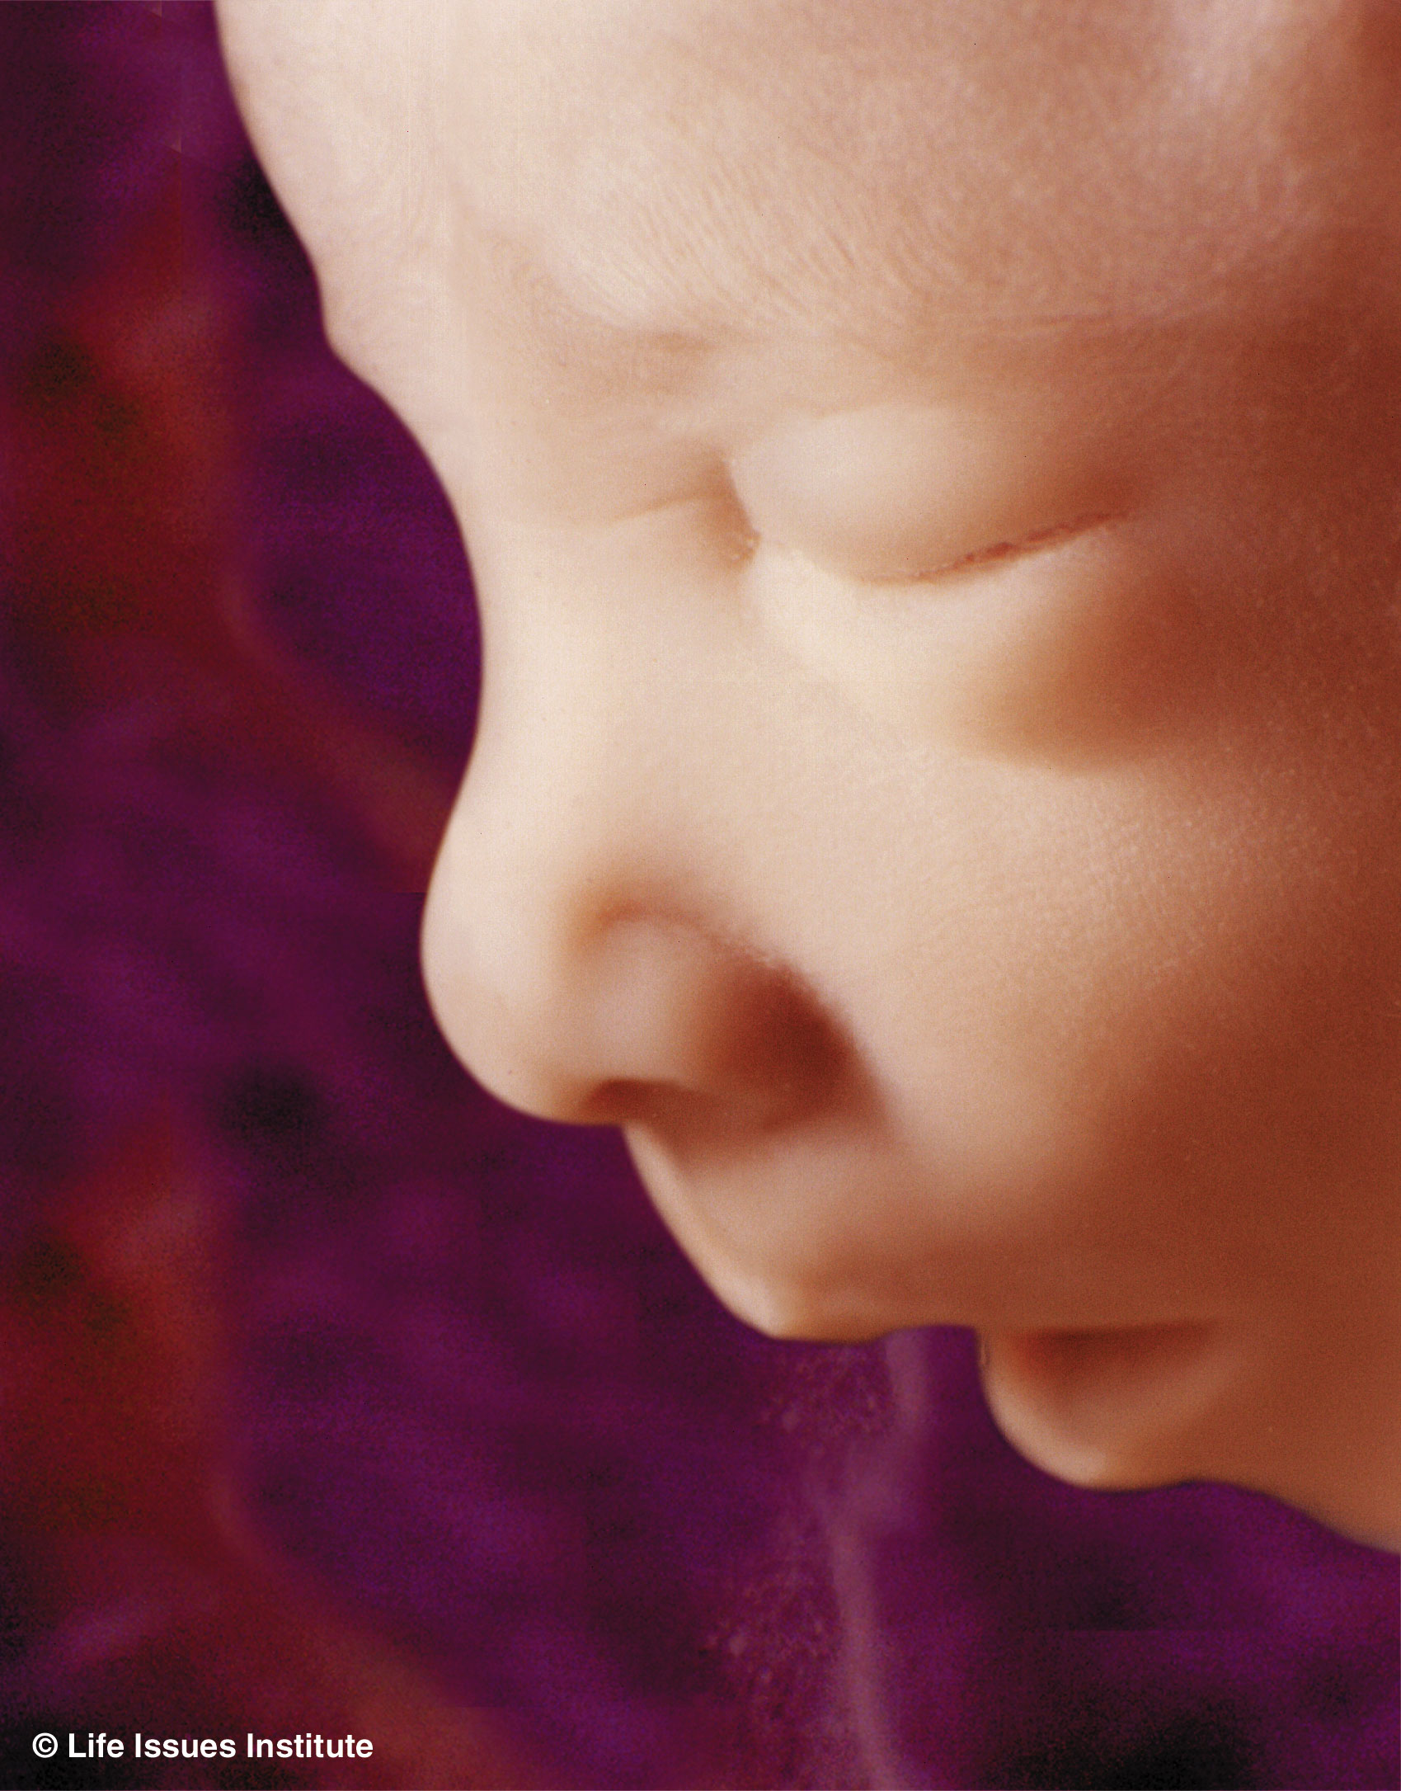
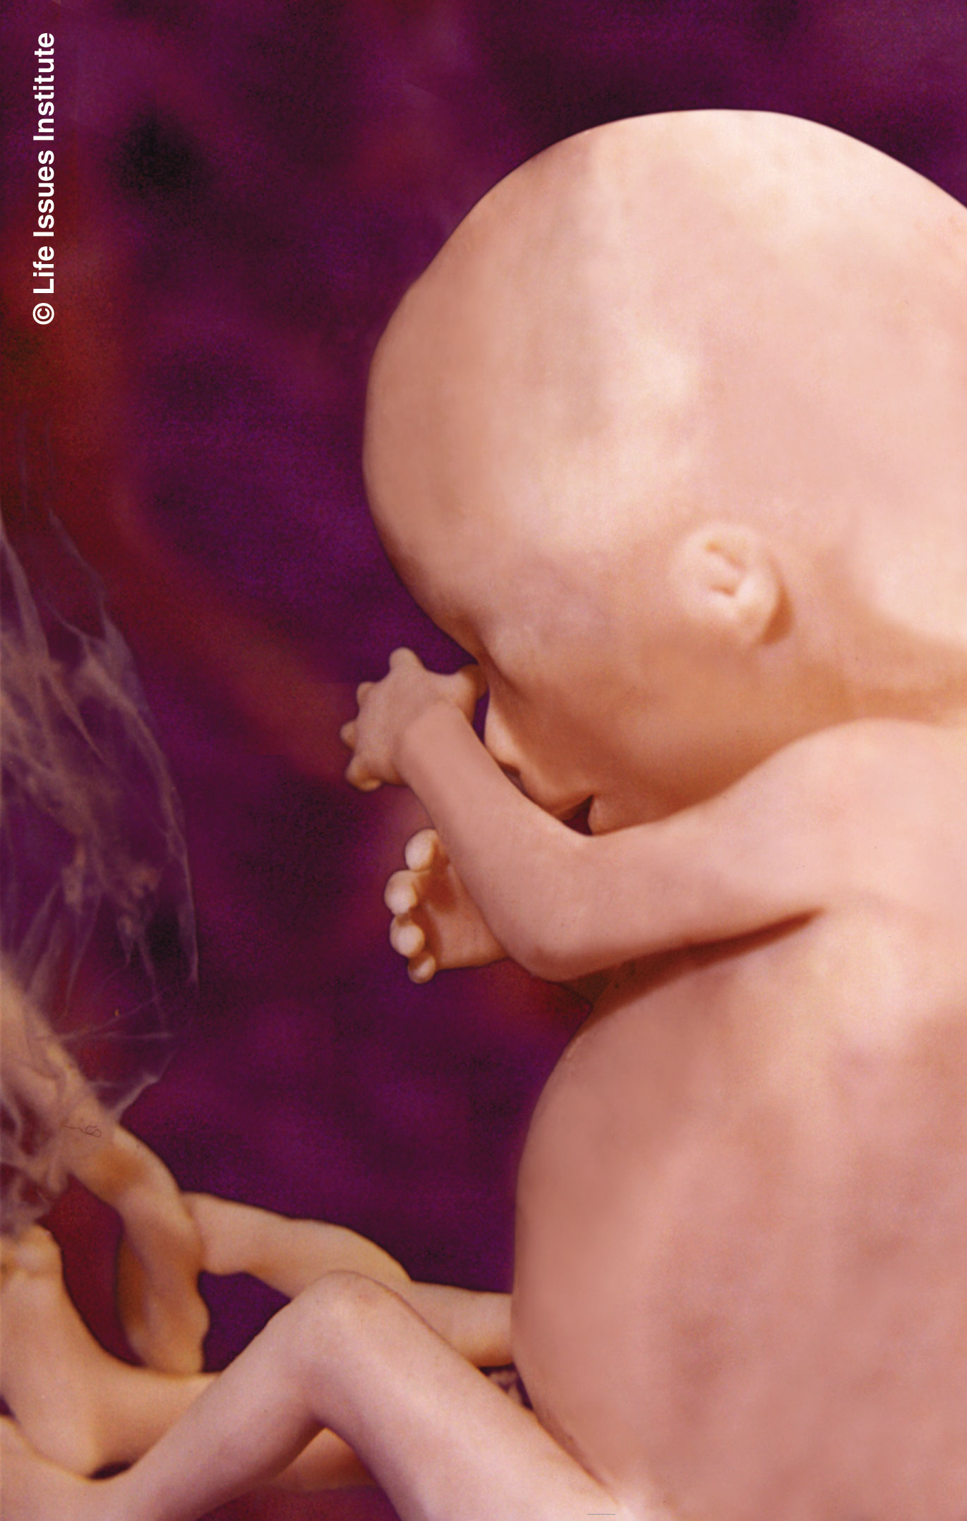
Swims and somersaults
Mother begins to feel movement
“Quickening”
16 weeks

Slide 31
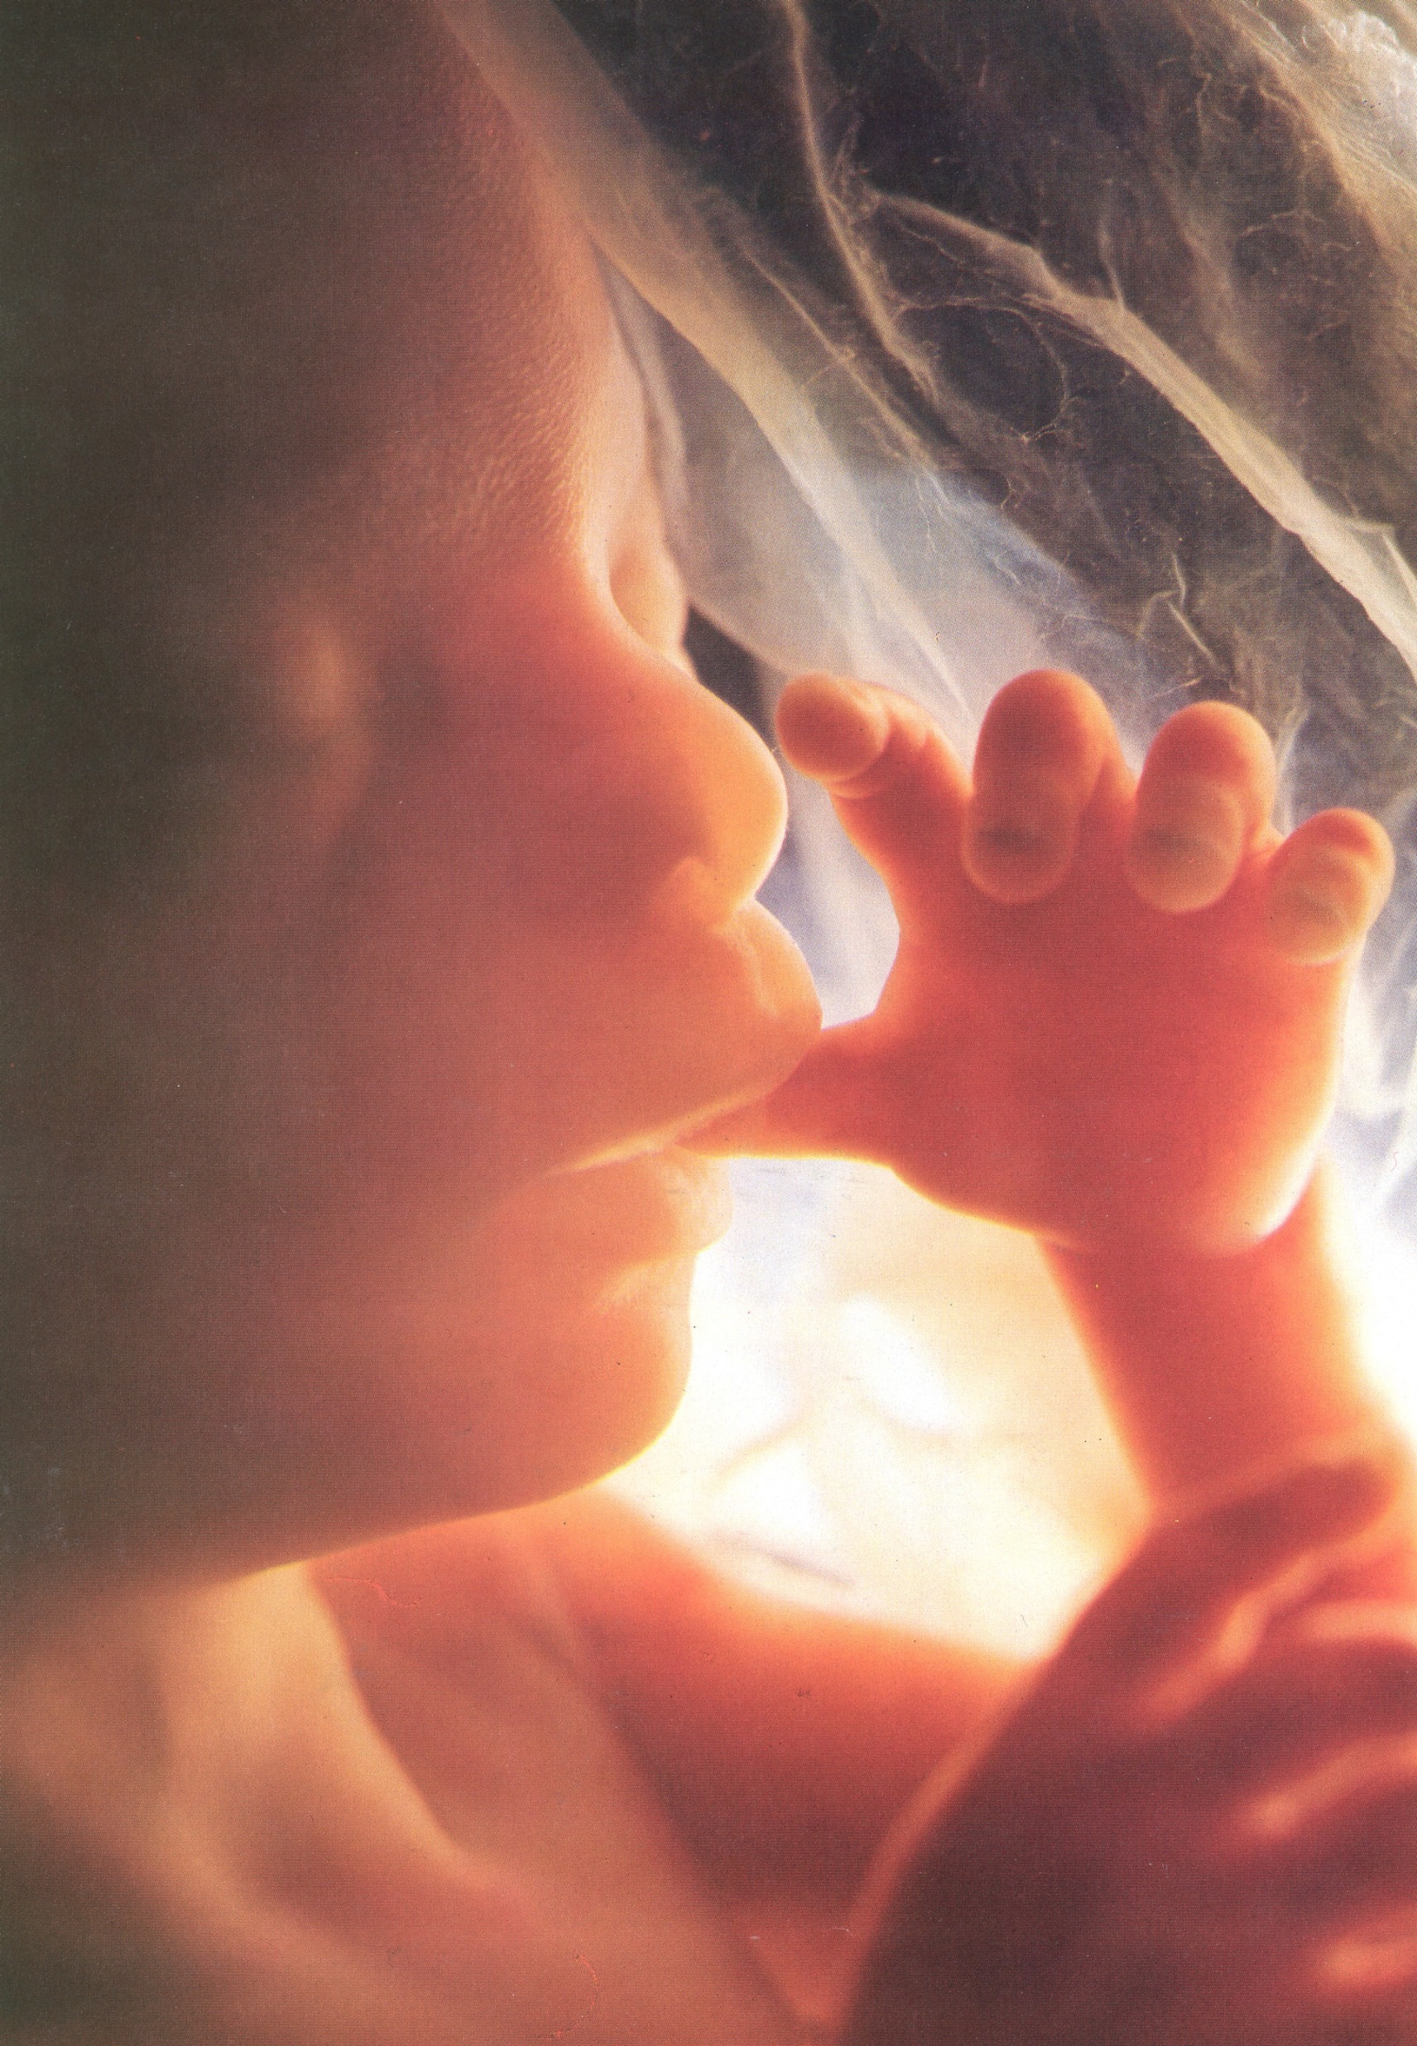
18 weeks

Slide 32
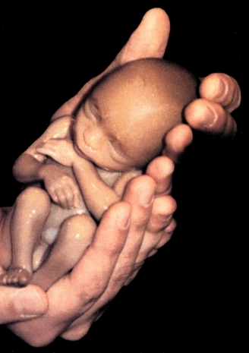
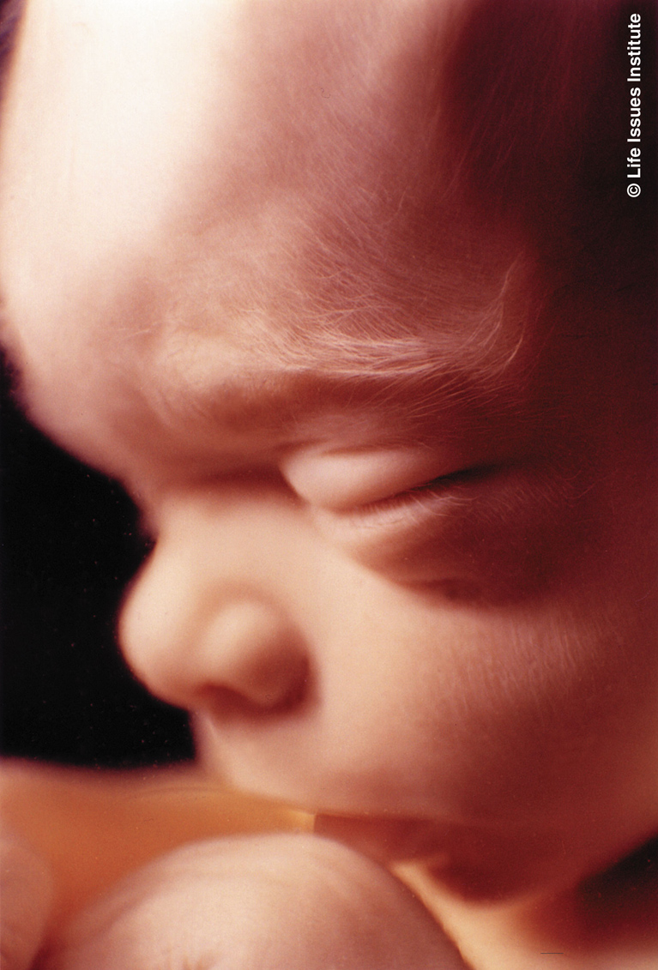
20 weeks

Slide 33
What if it is too late?
We all need and can receive forgiveness (Rom 8:1, 10:11).
2. Your baby can be seen in heaven (2 Sam 12:23).
3. Use your life story as a way to serve others!

Slide 34
An appeal to those who may
be considering an abortion.
1. Choose life!
2.
3. Jennifer Green’s story

Slide 35
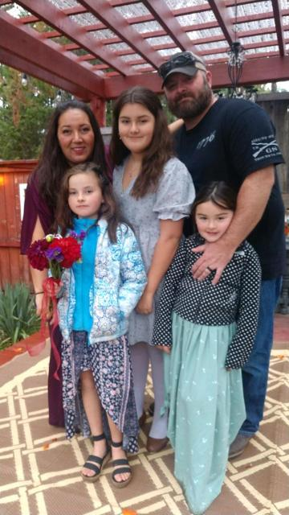
Laura Smith

Slide 36
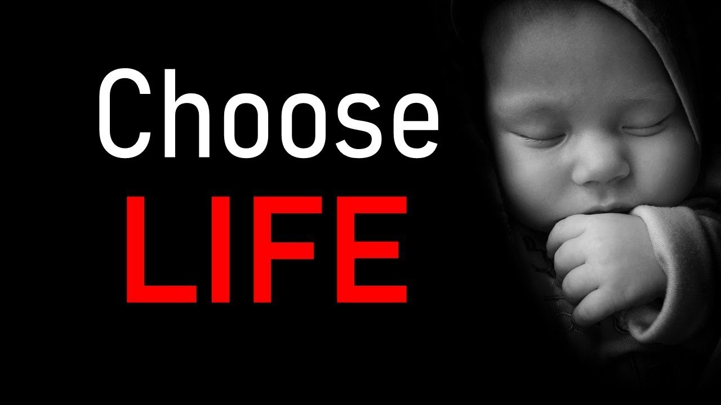
Laura Smith

