Slide 1

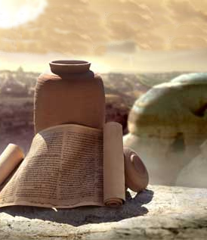
Isaiah 40
7 The grass withers, the flower fades, When the breath of the LORD blows upon it;

Slide 2
Isaiah 40
7 The grass withers, the flower fades, When the breath of the LORD blows upon it; Surely the people are as grass. 8 The grass withers, the flower fades, ...

Slide 3
Isaiah 40
7 The grass withers, the flower fades, When the breath of the LORD blows upon it; Surely the people are as grass. 8 The grass withers, the flower fades, But

Slide 4
Isaiah 40
7 The grass withers, the flower fades, When the breath of the LORD blows upon it; Surely the people are like grass. 8 The grass withers, the flower fades, But the word of our God stands forever.

Slide 5
Matthew 24
35 “Heaven and earth will pass away,...

Slide 6
Matthew 24
35 “Heaven and earth will pass away, but ...

Slide 7
Matthew 24
35 “Heaven and earth will pass away, but My words will not pass away.

Slide 8
I Peter 1
24 For,“ALL FLESH IS LIKE GRASS,
AND ALL ITS GLORY LIKE THE
FLOWER OF GRASS. THE GRASS WITHERS, AND THE FLOWER FALLS OFF,

Slide 9
I Peter 1
24 For,“ALL FLESH IS LIKE GRASS,
AND ALL ITS GLORY LIKE THE
FLOWER OF GRASS. THE GRASS WITHERS, AND THE FLOWER FALLS OFF, 25 BUT ...
...

Slide 10
I Peter 1
24 For,“ALL FLESH IS LIKE GRASS,
AND ALL ITS GLORY LIKE THE
FLOWER OF GRASS. THE GRASS WITHERS, AND THE FLOWER FALLS OFF, 25 BUT THE WORD OF THE LORD ENDURES FOREVER.”
...

Slide 11
I Peter 1
24 For,“ALL FLESH IS LIKE GRASS,
AND ALL ITS GLORY LIKE THE
FLOWER OF GRASS. THE GRASS WITHERS, AND THE FLOWER FALLS OFF, 25 BUT THE WORD OF THE LORD ENDURES FOREVER.”
And this is the word which was preached to you.
Notes:
25

Slide 12
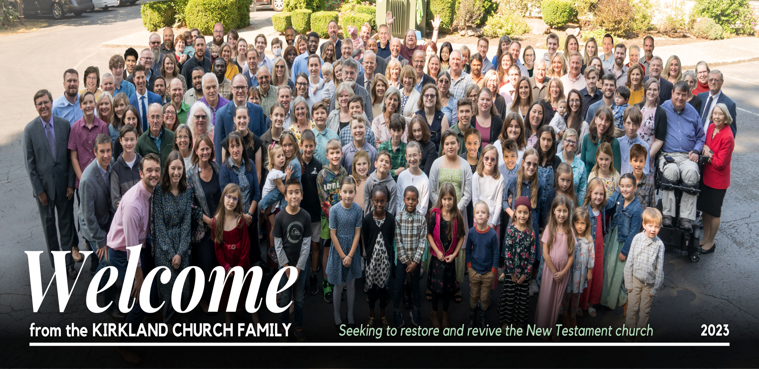

9/18/22

Slide 13

Sunday June 18
10:45 a.m.
Brent Hunter
The Greatest Archaeology
Discovery of all Time!

Slide 14
THESIS:
THE DISCOVERY
THE SITE
THE CONTENTS
THE SIGNIFICANCE

Slide 15
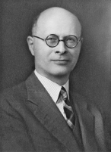
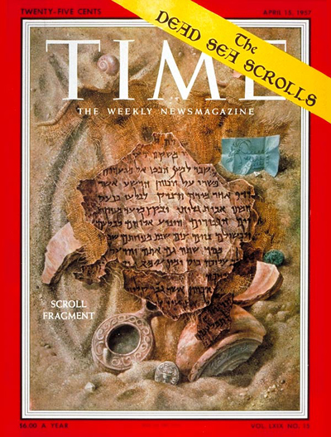
Discovery Of
“the greatest manuscript discovery
of all time”
William Albright, Dean Of American Archeologists

Slide 16
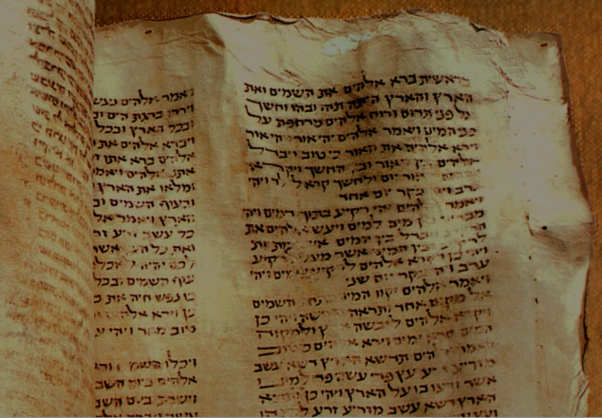
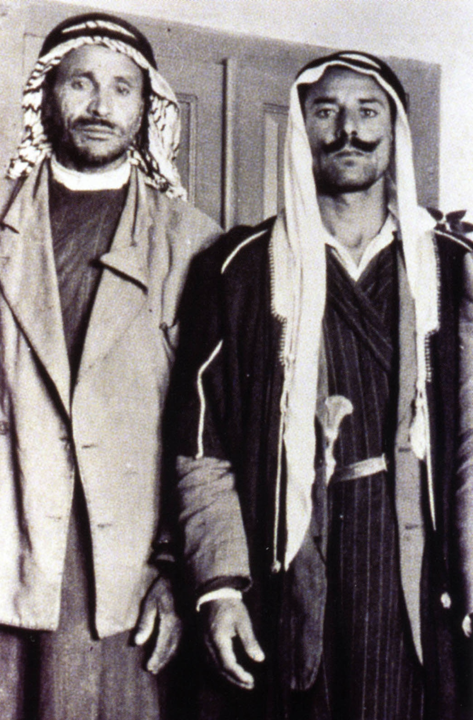
Discovering the Dead Sea Scrolls
Muhammad edh-Dhib
Juma'a Abu-Hashaba
Bedouin Shepherds - 1947
Tending Goats
Notes:
They stumbled upon caves containing the Dead Sea Scrolls.

Slide 17
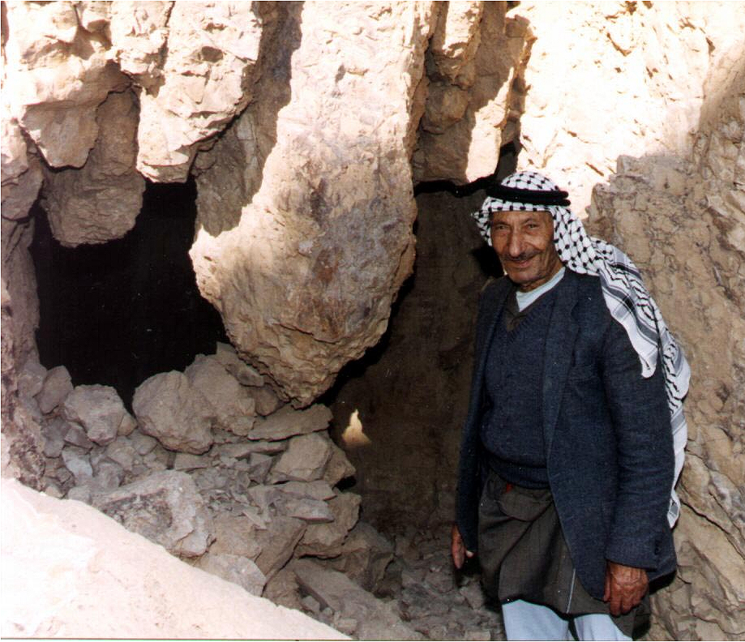
Discovering the Dead Sea Scrolls
Muhammed al-Asi
Cave 1

Slide 18
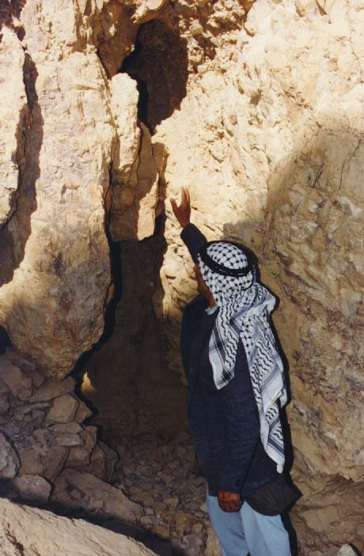
Discovering the Dead Sea Scrolls
Threw a rock to find lost goat
Heard the sound of breaking pottery

Slide 19
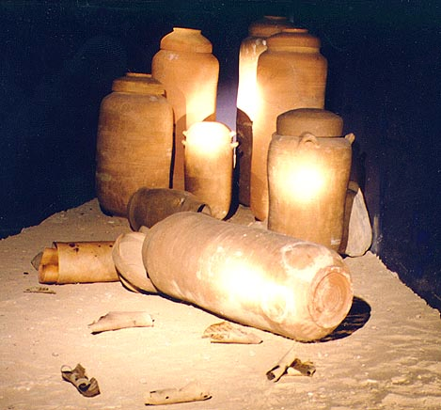
Discovering the Dead Sea Scrolls
Found scroll jars with scrolls

Slide 20
Discovering the Dead Sea Scrolls
Saw 37 scroll jars
Removed 7

Slide 21
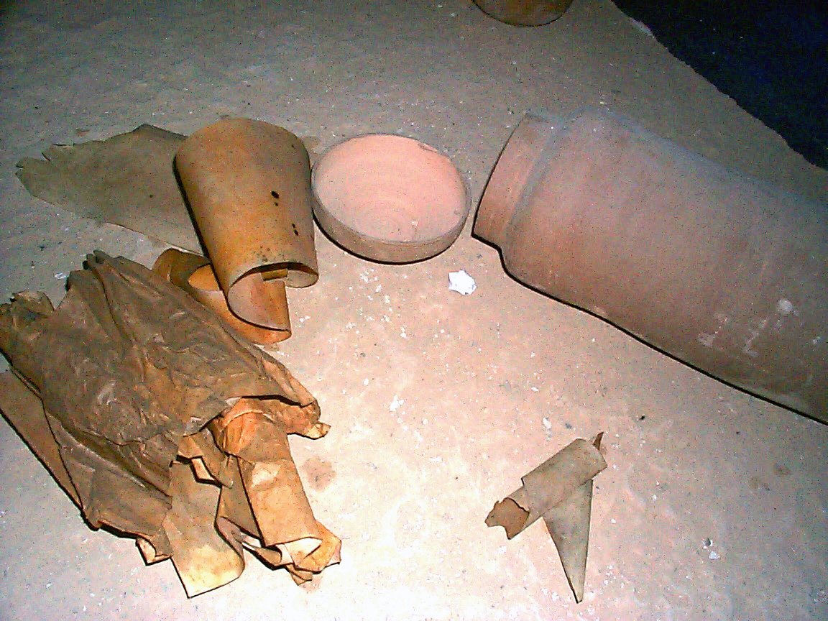
Discovering the Dead Sea Scrolls
Kept scrolls in their tents for 2 years
Decided to sell

Slide 22
Discovering the Dead Sea Scrolls
Kando’s
antiquities shop 1950's
Sold to Khalil Eskander Kando
Bethlehem cobbler and antiquities dealer
of the Syrian Orthodox Church

Slide 23
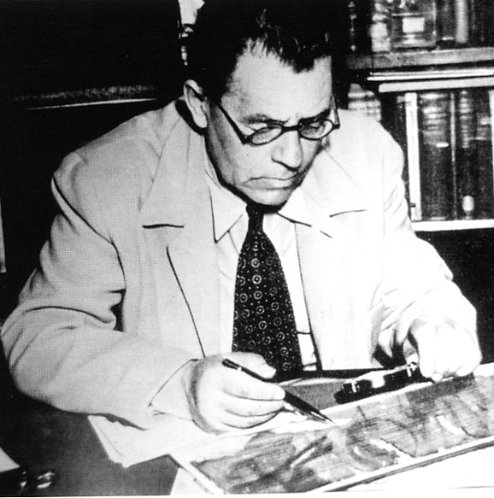
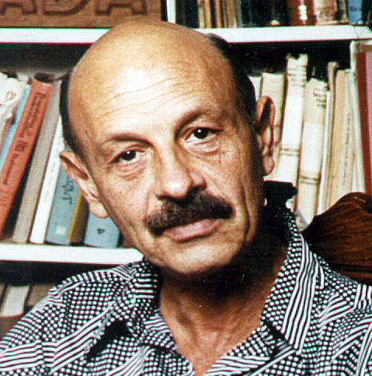
Discovering the Dead Sea Scrolls
Eleazar
Sukenik
Hebrew University
professor
Purchased 3 scrolls
Father of Israeli archaeologist
(November 29, 1947)
Yigael
Yadin
Yigael Yadin
Notes:
Suck’ ah nick

Slide 24
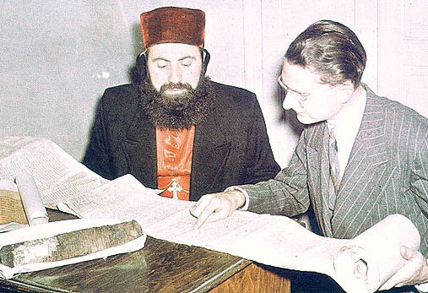
Discovering the Dead Sea Scrolls
Mar Samuel
Archbishop of the Syriac Orthodox Church of Antioch
Purchased
4 scrolls
John Trevor
of Albright Institute
photographed
1948
Notes:
May 1948 UN adopted the resolution recognizing Israel

Slide 25
Discovering the Dead Sea Scrolls
In 1954 Metropolitan Samuel offered his scrolls for sale.
Yigael Yadin saw the ad
Purchased scrolls for Israel For $250,000

Slide 26
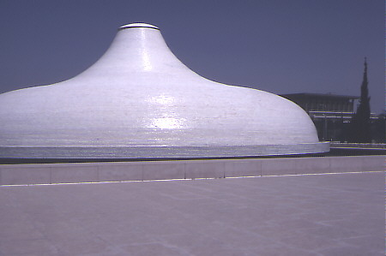
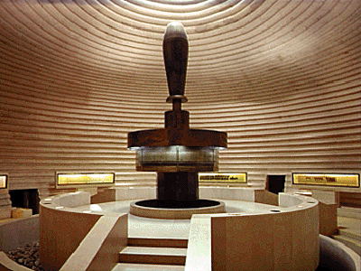
Discovering the Dead Sea Scrolls
Shrine of the Book
Museum of the Dead Sea Scrolls
100’s more found
Exhibited in Jerusalem

Slide 27
Site Of

Slide 28


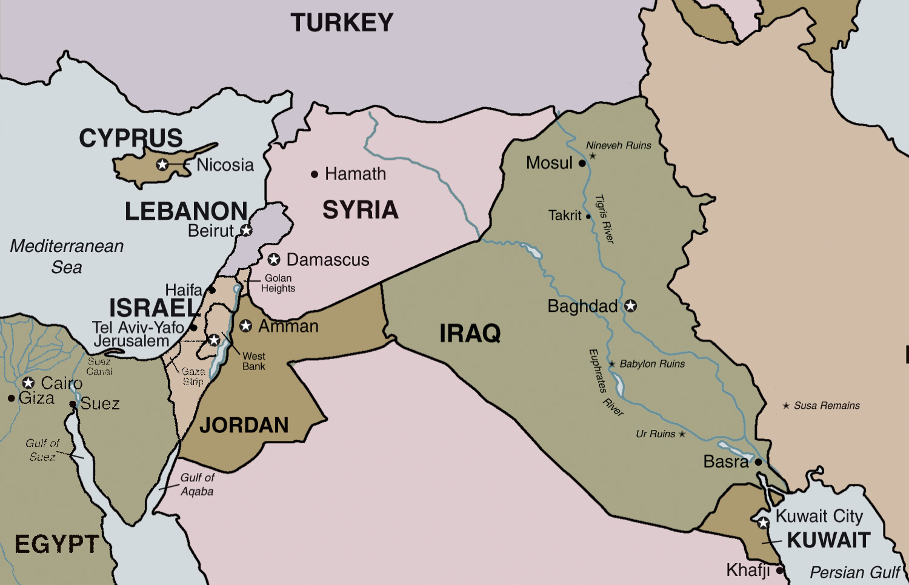
The Site of the Dead Sea Scrolls
Locating the Dead Sea Caves and Community
28
Notes:
Links on this slide will be activated in PowerPoint® Show mode

Slide 29
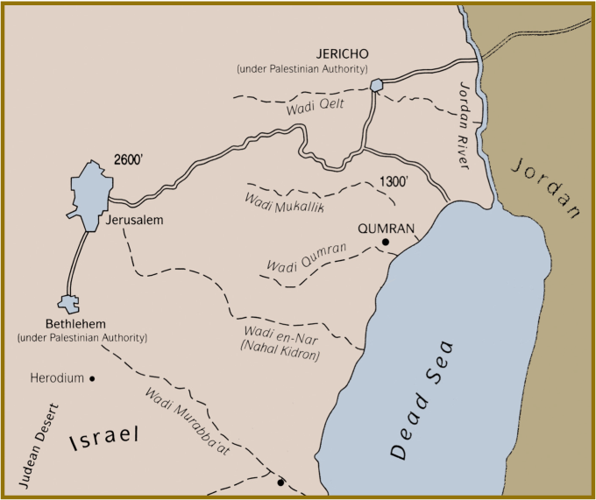
The Site of the Dead Sea Scrolls
Locating the Dead Sea Caves and Community
29
Notes:
Links on this slide will be activated in PowerPoint® Show mode

Slide 30
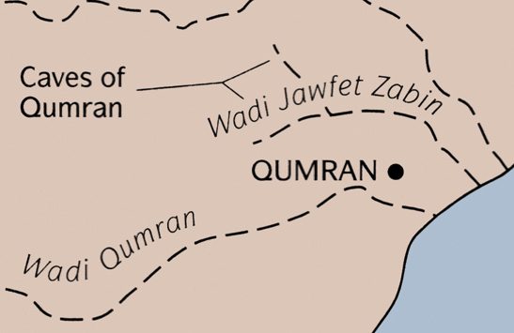
The Site of the Dead Sea Scrolls
Locating the Dead Sea Caves and Community
30
Notes:
Links on this slide will be activated in PowerPoint® Show mode

Slide 31
Locating the Site of the Dead Sea Scrolls
Cave 4
`
Qumran
Scrolls were discovered in Cave 4 in 1952.
Site was excavated from 1951-1956.

Slide 32
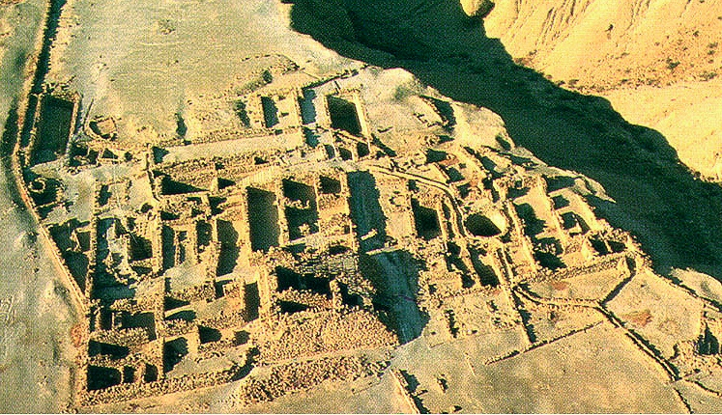
The Site of the Dead Sea Scrolls
Khirbet Qumran
Wadi Qumran
Ritual Bath
Pantry
Pool
Assembly Hall
Stables
Pottery Workshop
Quarters
Cistern
Storerooms
Ritual Bath
Immersion Pool
Scriptorium
Aqueduct
Watchtower
Excavation revealed a complex of buildings
Reconstruction indicates community of 200
Jewish sect (Essenes)produced and preserved the scrolls.

Slide 33
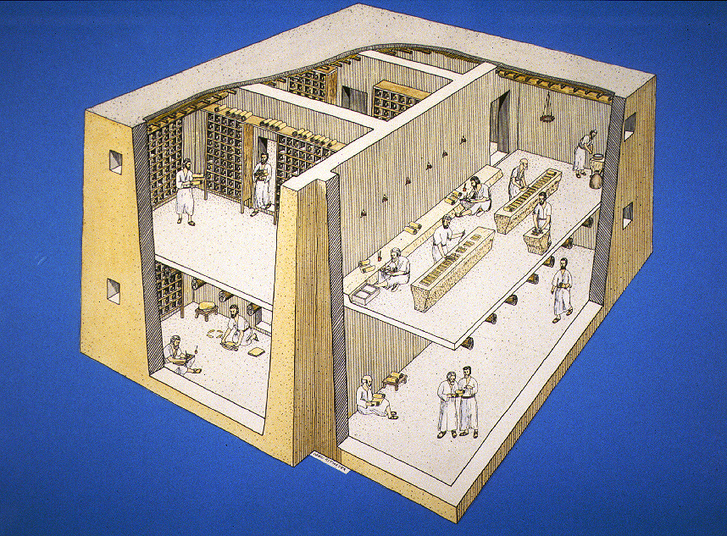
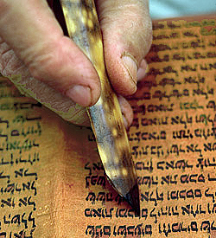
The Authors of the Dead Sea Scrolls
Ink Well
Two-storied Scriptorium where scrolls were copied and stored
Notes:
Links on this slide will be activated in PowerPoint® Show mode

Slide 34
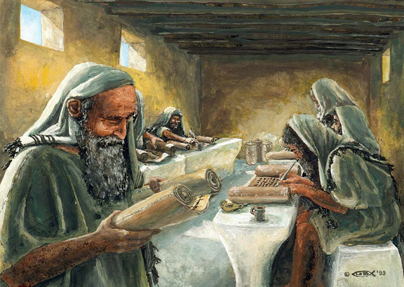
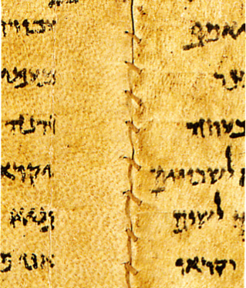
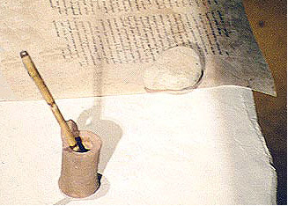
The Authors of the Dead Sea Scrolls
Scribes used benches for writing the scrolls, or for sewing together the leaves of parchment
Notes:
Links on this slide will be activated in PowerPoint® Show mode

Slide 35
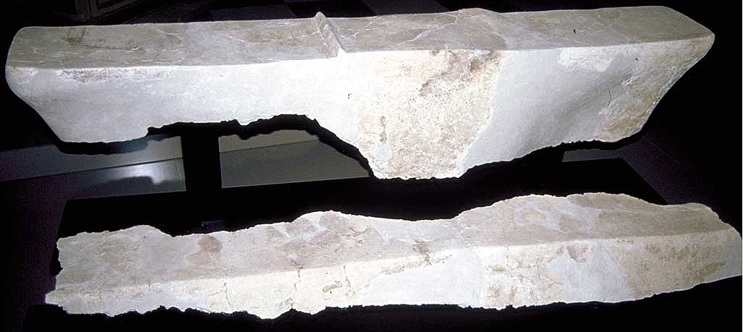
The Authors of the Dead Sea Scrolls
Clay benches found in the collapsed upper story of the Scriptorium
Notes:
Links on this slide will be activated in PowerPoint® Show mode

Slide 36
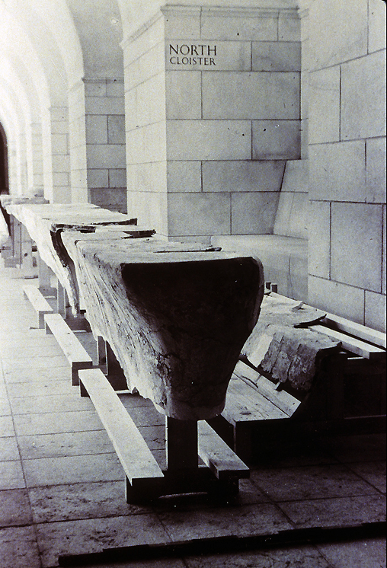
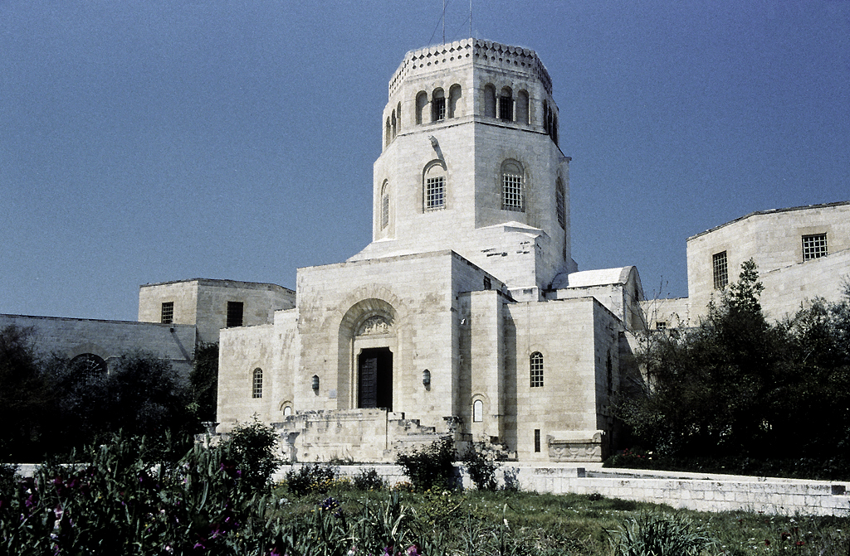
The Authors of the Dead Sea Scrolls
On display at the
Rockefeller Museum
Notes:
Links on this slide will be activated in PowerPoint® Show mode

Slide 37
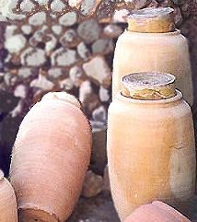
Authors of the Dead Sea Scrolls
AD 66 Jews revolted against Rome
Sect hid Scrolls in jars in caves
Scroll jars
Notes:
Links on this slide will be activated in PowerPoint® Show mode

Slide 38
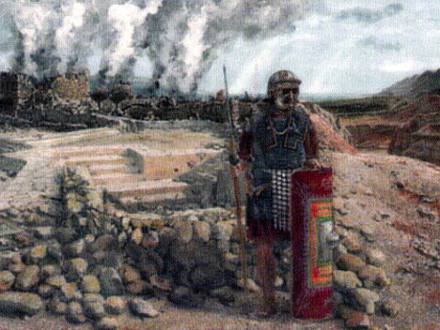
Authors of the Dead Sea Scrolls
AD 68 Roman Tenth Legion destroyed settlement
Notes:
Links on this slide will be activated in PowerPoint® Show mode

Slide 39

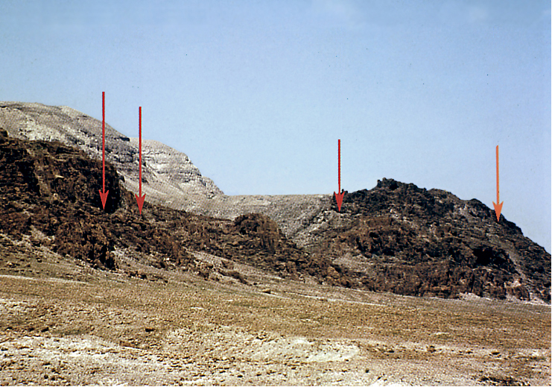
Locating the Site of the Dead Sea Scrolls
Cave 2
Cave 1
Cave 3
Cave 11
To Qumran

Slide 40

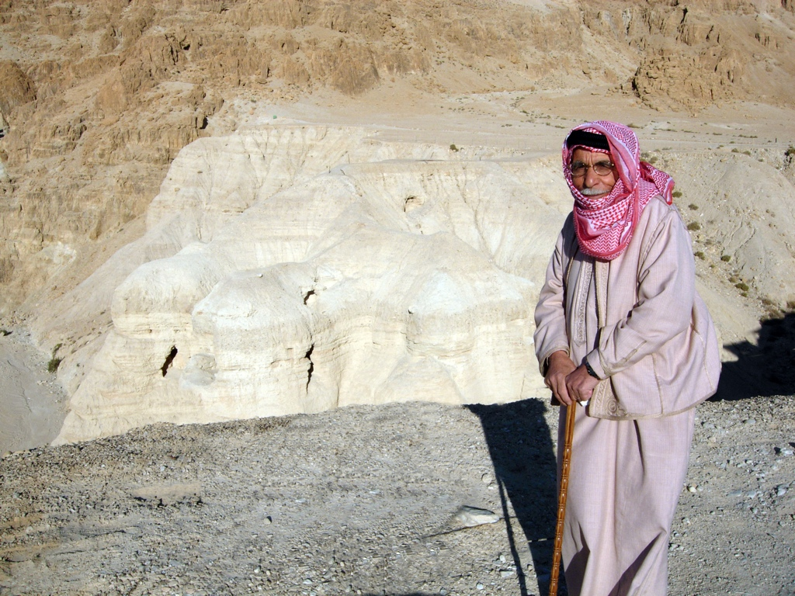
Cave 5
Cave 4
In Cave 4, Bedouin found 15,000 scroll fragments
Archaeologists found another 40,000 beneath cave floor.
Fragments were from 400 manuscripts
(100 were biblical texts)

Slide 41
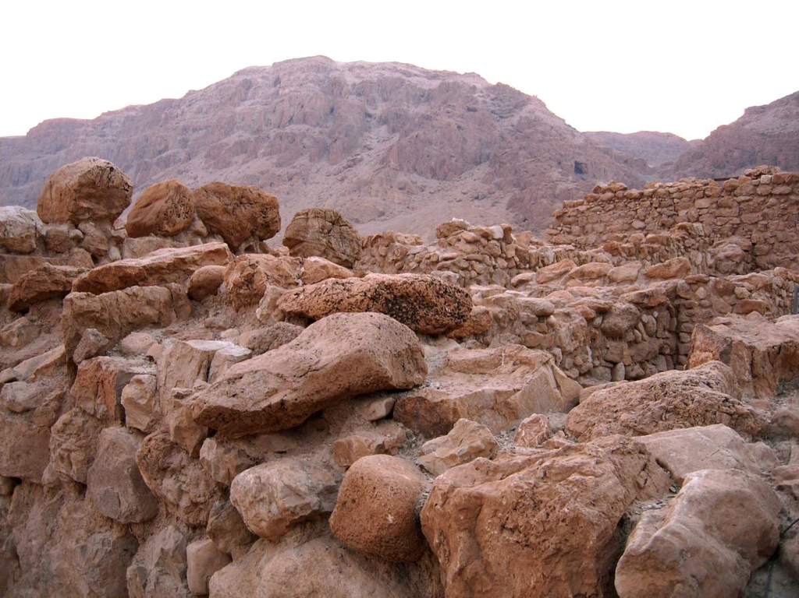
Qumran Plateau

Slide 42
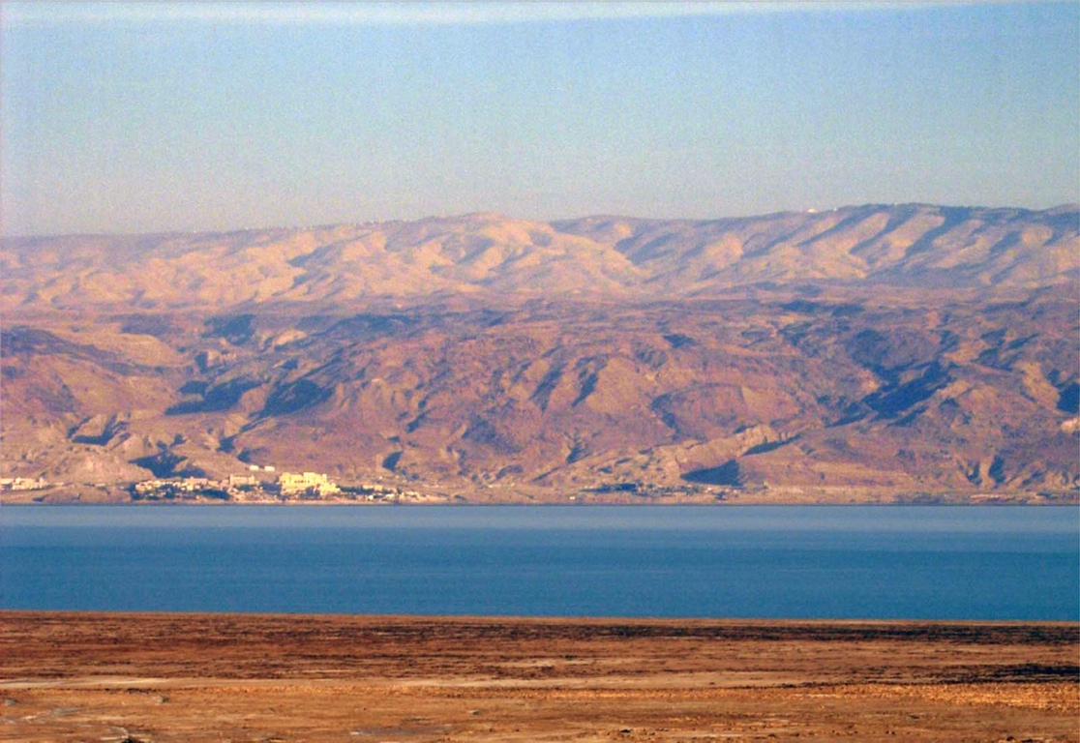
Mt. Nebo
Qumran Plateau

Slide 43
Contents Of

Slide 44
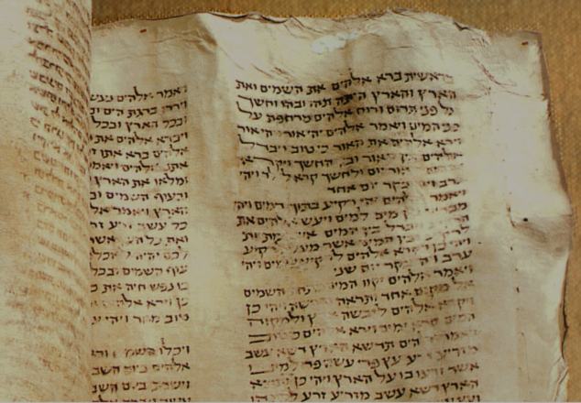

Classifying the Dead Sea Scrolls
Sectarian Texts
200 +
manuscripts
Jewish Literature
(Apocrypha, Pseudepigrapha)
400 +
Biblical Books
manuscripts
200 +
manuscripts

Slide 45
Contents of the Dead Sea Scrolls
The Biblical Manuscripts
Canonical Books | Old Testament Book | Number of Fragments
Torah | Genesis Exodus Leviticus Numbers Deuteronomy | 24 18 18 11 33
Notes:
The range of dates of the Dead Sea Scrolls is from 350 BC to 100 BC

Slide 46
Contents of the Dead Sea Scrolls
The Biblical Manuscripts
Canonical Books | Old Testament Book | Number of Fragments
Prophets | Joshua Judges 1-2 Samuel 1-2 Kings Isaiah Jeremiah Ezekiel 12 Minor Prophets | 2 3 4 3 22 6 6 10
Notes:
The range of dates of the Dead Sea Scrolls is from 350 BC to 100 BC

Slide 47
Contents of the Dead Sea Scrolls
The Biblical Manuscripts
Canonical Books | Old Testament Book | Number of Fragments
Writings | Psalms Proverbs Job Song of Songs Lamentations Ecclesiastes | 39 2 6 4 4 2
Notes:
The range of dates of the Dead Sea Scrolls is from 350 BC to 100 BC

Slide 48
Contents of the Dead Sea Scrolls
The Biblical Manuscripts
Canonical Books | Old Testament Book | Number of Fragments
Writings | Ruth Daniel Ezra-Nehemiah 1-2 Chronicles | 4 8 1 1
Total |  | 223
No Book of Esther fragments, but references to it exist in other scrolls
Notes:
The range of dates of the Dead Sea Scrolls is from 350 BC to 100 BC

Slide 49
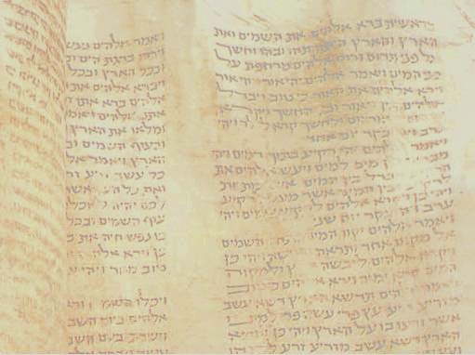
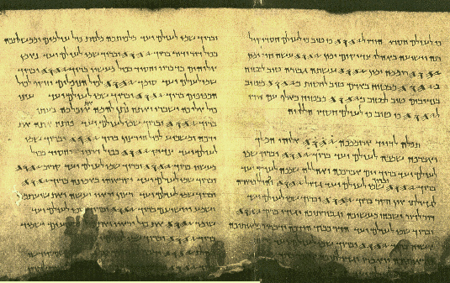
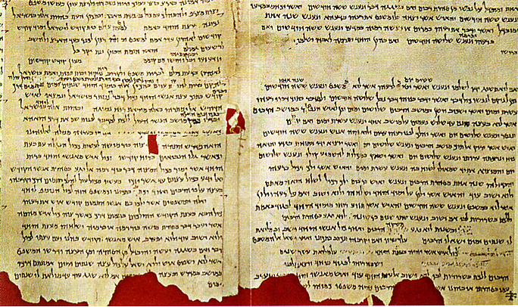
Contents of the Dead Sea Scrolls
The Biblical Manuscripts
Psalms Scroll (1Q10-12)
Samuel Scroll (1Q7)
Whole or fragmentary copies of every book
of the Old Testament
(Except Esther)

Slide 50
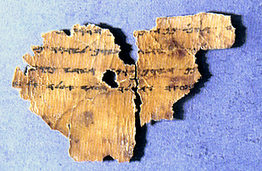
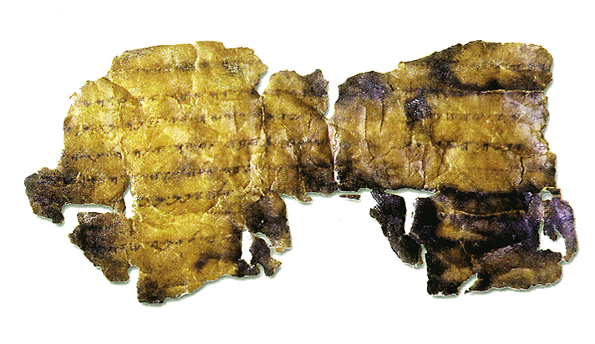
The Contents of the Dead Sea Scrolls
The Biblical Manuscripts
Paleo-Exodus (4Q22) fragment 2
Paleo-Leviticus (11Q1-2)
12 Biblical Scrolls In Paleo-Hebrew
(pre-exilic script)
Oldest - Genesis (4Q12)
Copied 300 B.C.
Notes:
“Cursive” style
Today - Square style

Slide 51
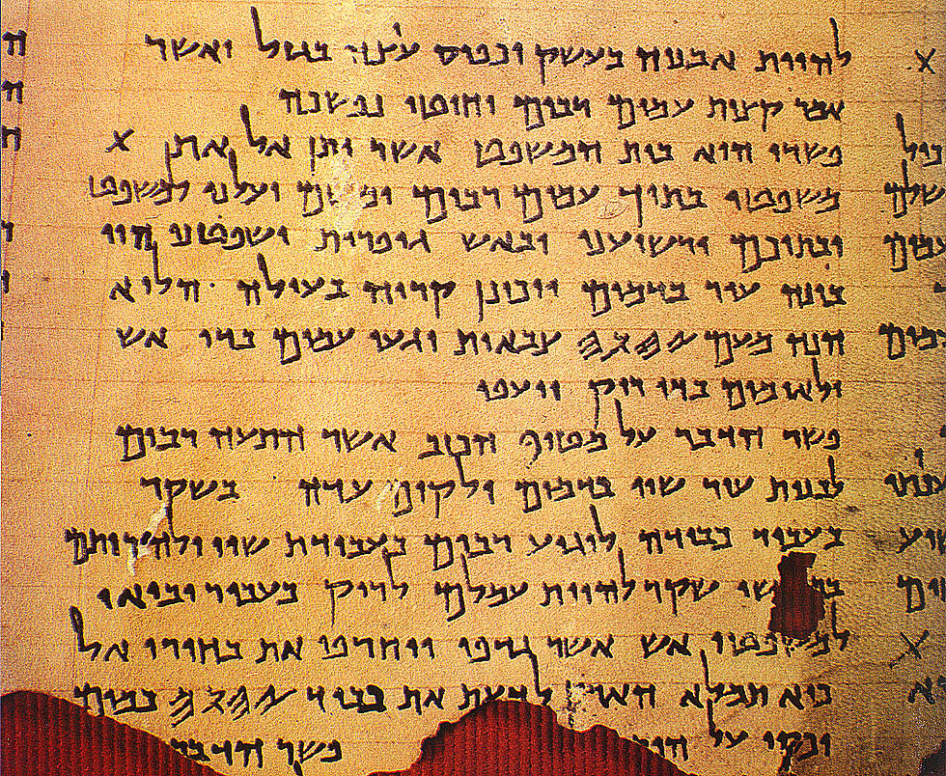

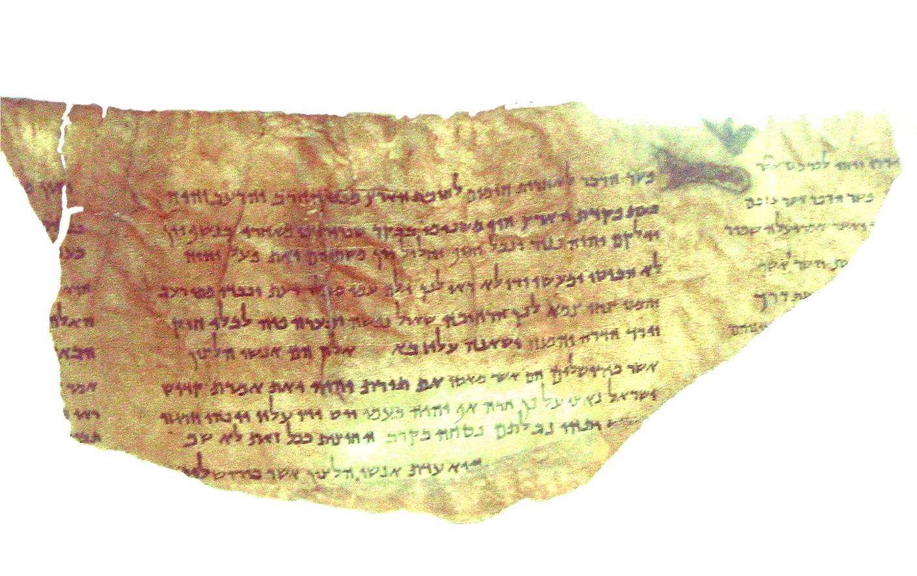
The Contents of the Dead Sea Scrolls
Interpretive Commentaries
Commentary on Isaiah (4Q162)
Commentary on Habakkuk (1QpHab)
View Prophecies Predicting Messiah
As Did New Testament Writers
“Pierced”
“Resurrected”

Slide 52
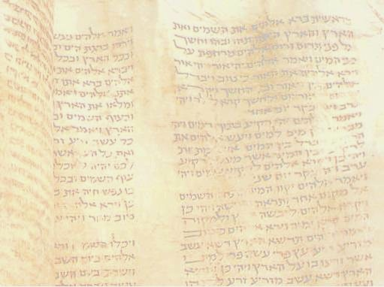
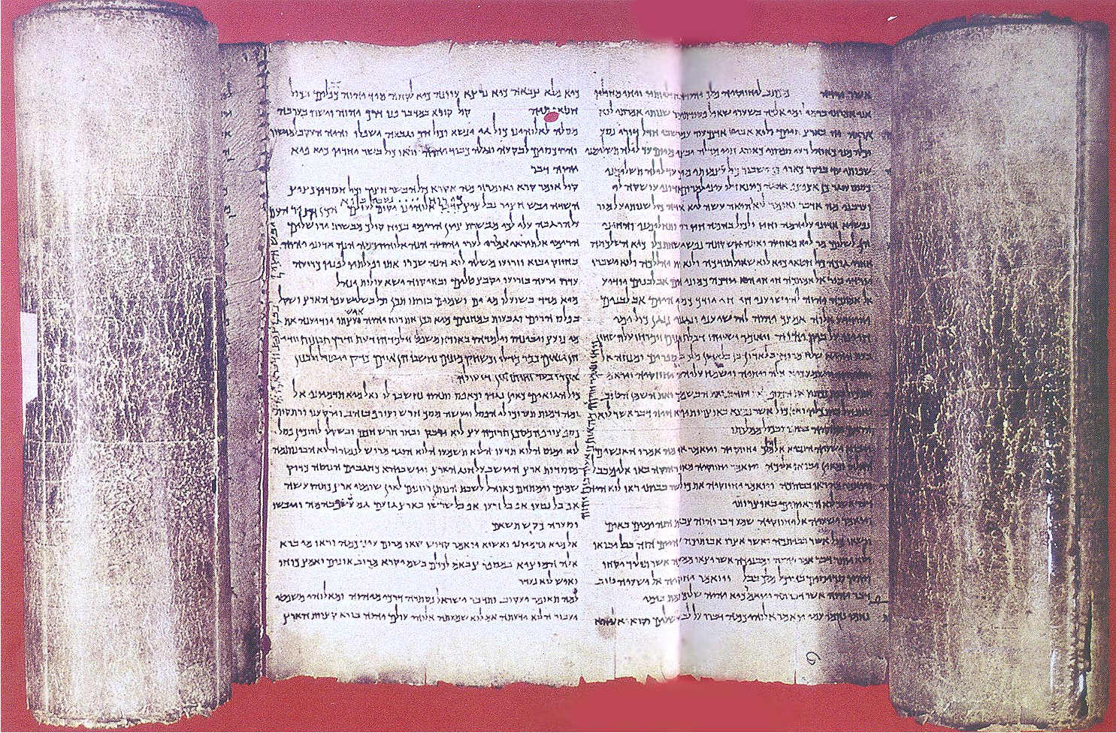
The Contents of the Dead Sea Scrolls
The Biblical Manuscripts
1QIsaª
Great Isaiah Scroll in Paleo-Hebrew from Cave 1
One Complete Intact Scroll
(Symbols mark Messianic passages)

Slide 53
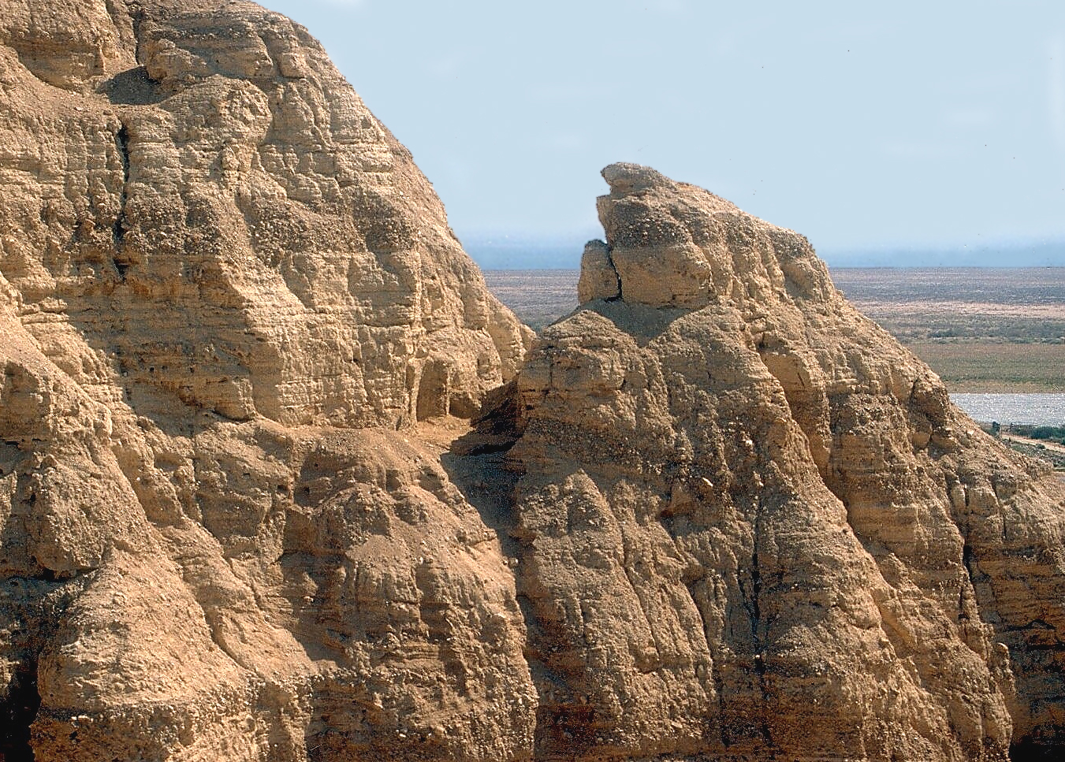
The Contents of the Dead Sea Scrolls
Earliest New Testament Text
Exodus
Jeremiah
7Q5
Mark 6:52-53
Cave 7
Cave 7’s roof and sides have eroded away.
Greek fragments
(7Q3-18)
Notes:
Links on this slide will be activated in PowerPoint® Show mode

Slide 54
The Contents of the Dead Sea Scrolls
Earliest New Testament Text
Cave 7
Cave 7’s roof and sides have eroded away.
(7Q5)
Notes:
Links on this slide will be activated in PowerPoint® Show mode

Slide 55
The Contents of the Dead Sea Scrolls
Mark 6:52-53
Earliest New Testament Text
ouj ga»r sunhvkan e˙pi« toi√ß a‡rtoiß, aÓll∆ h™n aujtw◊n hJ kardi÷a pepwrwme÷nh. Kai« diapera¿santeß e˙pi« th\n ghvn h™lqon ei˙ß Gennhsare«t kai«
ouj ga»r sunhvkan e˙pi« toi√ß a‡rtoiß, aÓll∆ h™n aujtw◊n hJ kardi÷a pepwrwme÷nh. Kai« diapera¿santeß e˙pi« th\n ghvn h™lqon ei˙ß Gennhsare«t kai« proswrmi÷sqhsan.
Notes:
Links on this slide will be activated in PowerPoint® Show mode

Slide 56
The Contents of the Dead Sea Scrolls
Earliest New Testament Text
Mark 6:52-53
ouj ga»r sunhvkan e˙pi« toi√ß a‡rtoiß, aÓll∆ h™n aujtw◊n hJ kardi÷a pepwrwme÷nh. Kai« diapera¿santeß e˙pi« th\n ghvn h™lqon ei˙ß Gennhsare«t kai«
Notes:
Links on this slide will be activated in PowerPoint® Show mode

Slide 57
The Contents of the Dead Sea Scrolls
Earliest New Testament Text
Spanish papyrologist Jose O´Callaghan
7Q6A–Mk.4:28
7Q15–Mark 6:48
7Q5–Mk.6:52, 53
7Q7–Mk.12:17
7Q6B–A.27:38
7Q9–Rom 5:11-12
7Q4–1Tim.3:16, 4:1-3
7Q10–2Pet.1:15
7Q8–Js.1:23, 24
Exodus
Jeremiah
Before 68 AD
Style (papyrology) indicates 50 AD
Notes:
Links on this slide will be activated in PowerPoint® Show mode

Slide 58

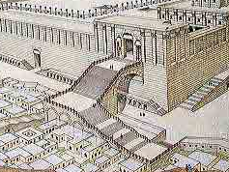
Mark 13
2 And Jesus said to him,
“Do you see these
great buildings?

Slide 59
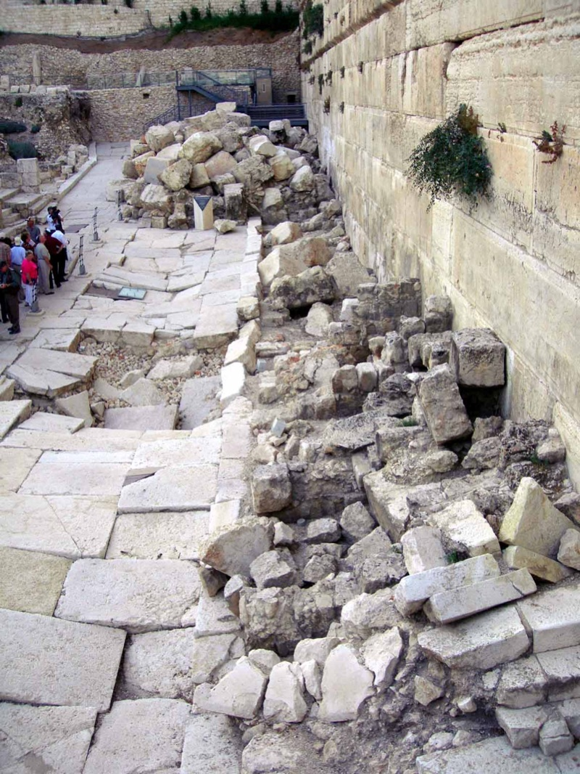
Mark 13
(Written AD 50)
Occured
AD 70
2 And Jesus said to him,
“Do you see these
great buildings?
Not one stone will be left upon another which will not be torn down.”

Slide 60
Significance Of

Slide 61

Significance
They reveal a sect whose approach to Scripture and view of prophecy were similar to the early church.
Destroys idea that beliefs of New Testament were developed over hundreds of years.

Slide 62
Significance
Like John the Baptist, believed they were in desert as forerunners for the Messiah and arrival was imminent.

Slide 63
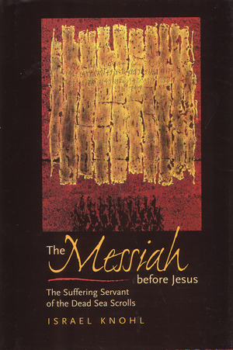
Significance
Like Jesus and Apostles, believed they were living in last days, that Scriptures predicted the coming Messiah:
Suffering, Executed, Resurrected
Judge at end of time, on throne of God

Slide 64
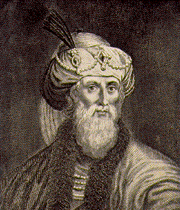

Significance of the Dead Sea Scrolls
Accuracy of
Textual Transmission
We have given practical proof of our reverence for our own Scriptures.
—Flavius Josephus (Contra Apion, Book I, sec., 8, p. 158)
Notes:
Links on this slide will be activated in PowerPoint® Show mode

Slide 65
Significance of the Dead Sea Scrolls
Accuracy of
Textual Transmission
For although such long ages have now passed, no one has ventured either to add, or to remove, or to alter a syllable;
—Flavius Josephus (Contra Apion, Book I, sec., 8, p. 158)
Notes:
Links on this slide will be activated in PowerPoint® Show mode

Slide 66
Significance of the Dead Sea Scrolls
Accuracy of
Textual Transmission
We have given practical proof of our reverence for our own Scriptures. For although such long ages have now passed, no one has ventured either to add, or to remove, or to alter a syllable; and it is an instinct with every Jew, from the day of his birth, to regard them as the decrees of God, to abide by them, and, if need be, cheerfully to die for them.
—Flavius Josephus (Contra Apion, Book I, sec., 8, p. 158)
Notes:
Links on this slide will be activated in PowerPoint® Show mode

Slide 67
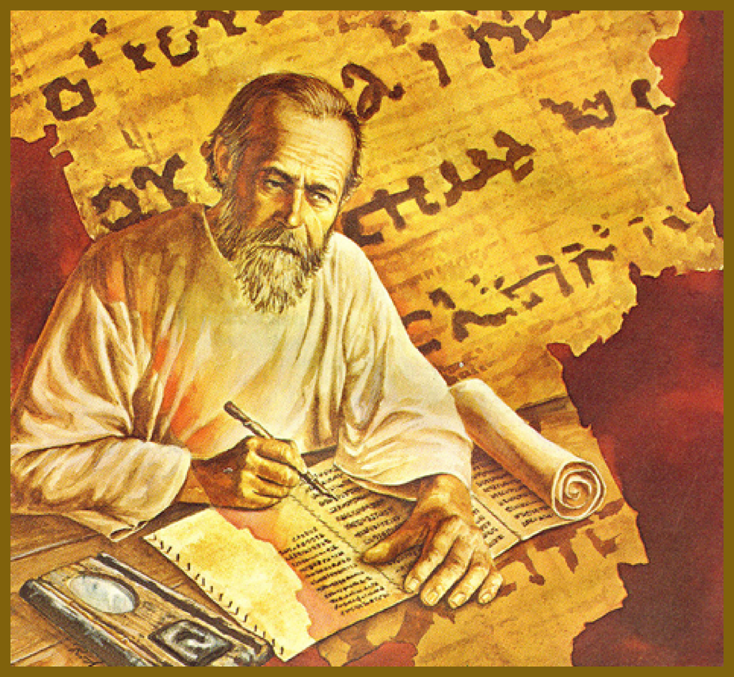
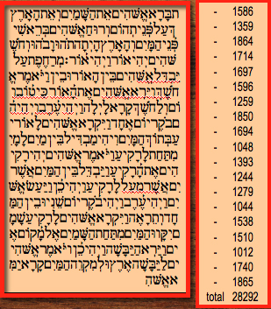
Significance of the Dead Sea Scrolls
Accuracy of Textual Transmission
Copying methodology reveals extreme care and great reverence.
Every letter was counted!
Notes:
Links on this slide will be activated in PowerPoint® Show mode

Slide 68


Every Book Of Old Testament Represented
Over 1,000 years older
than previous manuscripts!

Slide 69

The Significance of the Dead Sea Scrolls
Aleppo Codex
Masoretic Text
AD 1
AD 500
AD 900
Notes:
Links on this slide will be activated in PowerPoint® Show mode

Slide 70

The Significance of the Dead Sea Scrolls
Over 1000 Years
Earlier
Isaiah Scroll
Aleppo Codex
Dead Sea Scrolls
Masoretic Text
125 BC
AD 1
AD 500
AD 900
Notes:
Links on this slide will be activated in PowerPoint® Show mode

Slide 71
The Significance of the Dead Sea Scrolls
Over 1000 Years
Earlier
Isaiah Scroll
Aleppo Codex
How Do They Compare?
Identical, Word-For-Word
In More Than 95% Of The Text
Less Than 5% Variation
(tense and spelling errors)
Notes:
Links on this slide will be activated in PowerPoint® Show mode

Slide 72
The Significance of the Dead Sea Scrolls
Over 1000 Years
Earlier
Isaiah Scroll
Aleppo Codex
How Do They Compare?
No Substantive Difference!
Notes:
Links on this slide will be activated in PowerPoint® Show mode

Slide 73

The Significance of the Dead Sea Scrolls
About
25
Years
Latest OT Autograph
Written About
BC 325
Oldest Dead Sea Scroll
Written About
BC 300
Less Than A Generation Removed
(The Generation Closest To Original)
Notes:
Links on this slide will be activated in PowerPoint® Show mode

Slide 74
The Significance of the Dead Sea Scrolls
Earliest New Testament Text
Cave 7
Proof N.T. Written
During Lifetime Of Eyewitnesses
Before Events Foreseen In Prophecy
Notes:
Links on this slide will be activated in PowerPoint® Show mode

Slide 75

Notes:
Links on this slide will be activated in PowerPoint® Show mode

Slide 76

5,600
Manuscripts
Averaging 405 pages each
(2.6 million pages)
+10,000
Latin MSS
+5,000
Coptic, Syriac, Georgian, Eithiopic, Armenian MSS
Notes:
Links on this slide will be activated in PowerPoint® Show mode

Slide 77
Quoted Manuscripts
Early Church Fathers
Wrote Commentaries
Over One Million
Quotations Of NT
“...if all other sources of our knowledge of text of the New Testament were destroyed, would be sufficient alone for the reconstruction of practically the entire New Testament.”
Bruce Metzger & Bart Ehrman
Notes:
Links on this slide will be activated in PowerPoint® Show mode
ERR men

Slide 78
Very Early Manuscripts
1st Century - 2 confirmed fragments
        8 probable fragments
2nd Century - 12 MSS
3rd Century - 64 MSS
Almost 100 Witness
Within 200 Years Of Autographs
No Substantive Variants!
Notes:
Links on this slide will be activated in PowerPoint® Show mode

Slide 79

Sir Frederic Kenyon
Director (21 years)
British Museum Of Natural History
It cannot be too strongly asserted that in substance the text of the Bible is certain: especially is this the case with the New Testament. ...
Notes:
Links on this slide will be activated in PowerPoint® Show mode

Slide 80
Sir Frederic Kenyon
Director (21 years)
British Museum Of Natural History
The number of manuscripts of the New Testament, of early translations from it, and of quotations from it in the oldest writers of the Church, is so large that it is practically certain that the true reading of every doubtful passage is preserved in some one or other of these ancient authorities.
Notes:
Links on this slide will be activated in PowerPoint® Show mode

Slide 81
Sir Frederic Kenyon
Director (21 years)
British Museum Of Natural History
This can be said of no other ancient book in the world.
Notes:
Links on this slide will be activated in PowerPoint® Show mode

Slide 82
Isaiah 40
7 The grass withers, the flower fades, When the breath of the LORD blows upon it; Surely the people are grass. 8 The grass withers, the flower fades,
But
the word of our God stands forever.

Slide 83

John 12
48 “He who rejects
Me and does not
receive My sayings, has one who judges him; the word I spoke is what will judge him ...

