Slide 1
The Significance of Confession

Slide 2
Definition
Homologeo
Omoios = Likewise
Lego = Speak
Agree, Repeat, “Amen”
Admit, Confess
Give praise
Confession always implies truth revealed, or a confirmation that something is true.
Ephesians 4:25, 31-32

Slide 3
Confession
Command & Expectation
Joshua 7:19
Then Joshua said to Achan, “My son, I implore you, give glory to the LORD, the God of Israel, and give praise to Him; and tell me now what you have done. Do not hide it from me.”
James 5:16
Therefore, confess your sins to one another, and pray for one another so that you may be healed. The effective prayer of a righteous man can accomplish much.
Galatians 6:2
Bear one another’s burdens, and thereby fulfill the law of Christ.
It’s actually me talking!!!

Slide 4
Confessing Sin To Others
Sin against someone - Matthew 5:23-24
In need of support – Galatians 6:1-2
Need healing – Psalm 32:1-4
Need wisdom – Proverbs 28:13
Need to be transparent – Leviticus 5:1-5
You have been wronged – Matthew 18:15

Slide 5
Confession
Jesus Is Lord
Jesus as Lord – Romans 10:9-10
Belief in the Gospel – Acts 24:14-15
When I stumble – Acts 23:1-5

Slide 6
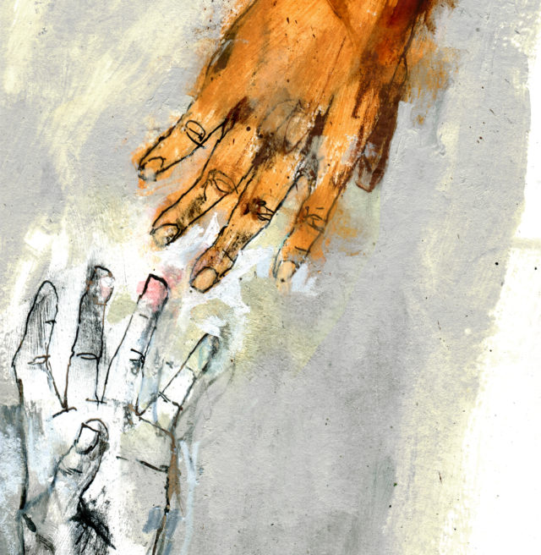
Confession
To God
Psalm 51:3–4
Be For I know my transgressions, And my sin is ever before me. Against You, You only, I have sinned And done what is evil in Your sight, So that You are justified when You speak And blameless when You judge.

Slide 7
I don’t confess because…
Pride
Trust
Culture
1 John 1:7
but if we walk in the Light as He Himself is in the Light, we have fellowship with one another, and the blood of Jesus His Son cleanses us from all sin.

