Slide 1
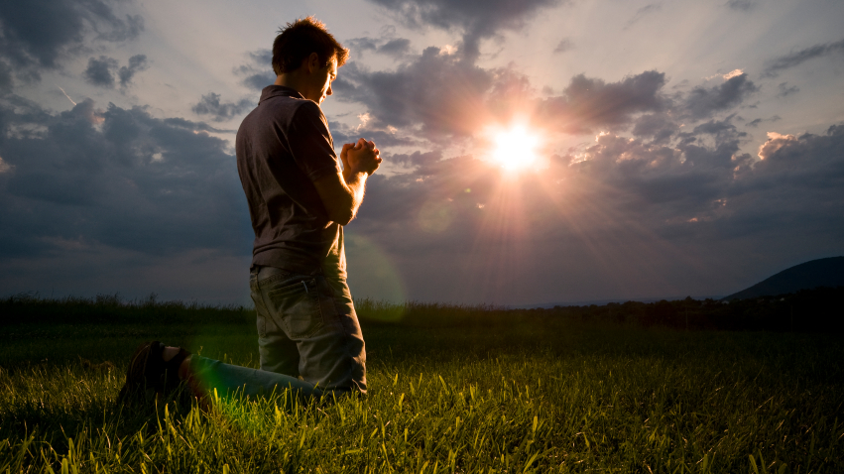
The Significance of Prayer
At all times you ought to pray and not lose heart
Do I want peace in my life?

Slide 2
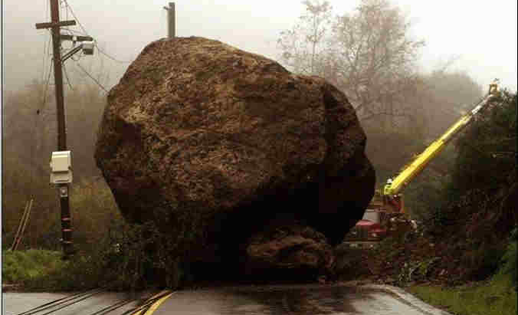
Barriers To Prayer
Tradition • Pride • Un-Belief

Slide 3
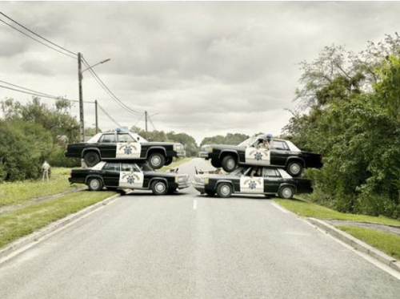
Barriers To Prayer
TRADITIONS
Meals
Bedtime
Opening Prayer
Closing Prayer
List Prayers
Matthew 6:5, 7 • Hebrews 4:13-16
Notes:
These are the times we are supposed to pray and we may use this as the basis for our answer to others OF COURSE I PRAY. But these prayers tend to be by rote and are similar every time we give it.

Slide 4
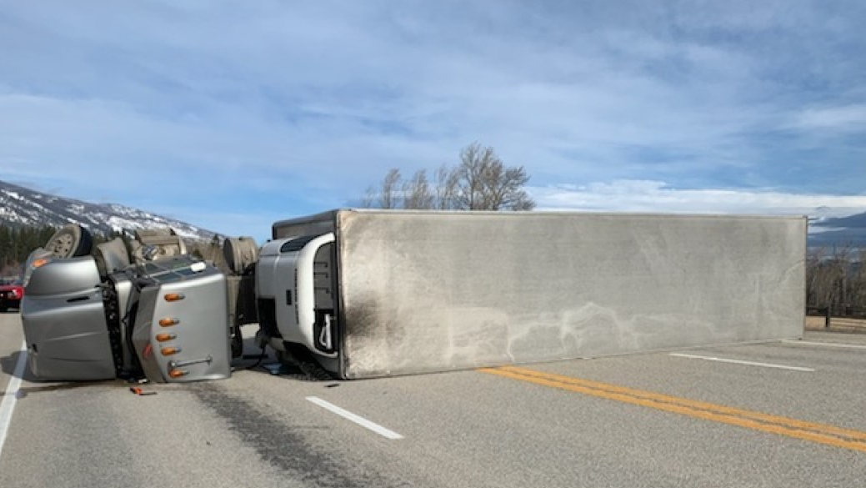
Barriers To Prayer
PRIDE
Jeremiah 10:23 • Malachi 1:9-14
Notes:
The solutions man creates to maintain his pride or have God on his own terms are stupid.
Im in control, I know what I am doing. I don’t have a problem.

Slide 5
Barriers To Prayer
UNBELIEF
Mark 10:17-22 No Comfort John 11:21, 32 No Help Mark 4:25-42 No Answer Job 2:9 Curse God and die Mark 9:22-23 No Healing
The fool says in his heart “there is no God” - Psalm 14:1

Slide 6
Do I want peace in my life?
EXCHANGE
Tradition – Obedience: pray at all times and not lose heart
Pride – Relationship: your Father knows what you need before you ask
Unbelief – Trust: With God all things are possible
Peace that Jesus had – Mark 10:17-22 with God all things are possible John 11:4 this will not end in death but for the glory of God Mark 4:40 Sleeping during the storm- why do you have no faith Job 1:21 The Lord gives and the Lord take away blessed be the Lord Mark 9:22-23 All things are possible for him who believes
Notes:
Mark 10:17-22 For all things are possible with God
John 11:4 This will not end in death but to the glory of God
Mark 4:40 Sleeping during a storm – why is it you have no faith
Job 1:21 The Lord giveth and the Lord taketh away, blessed be the name of the Lord
Mark 9:22-23 All things are possible to Him that believes

Slide 7
Do I want peace in my life?
Psalm 3
Notes:
Mark 10:17-22 For all things are possible with God
John 11:4 This will not end in death but to the glory of God
Mark 4:40 Sleeping during a storm – why is it you have no faith
Job 1:21 The Lord giveth and the Lord taketh away, blessed be the name of the Lord
Mark 9:22-23 All things are possible to Him that believes

