Slide 1
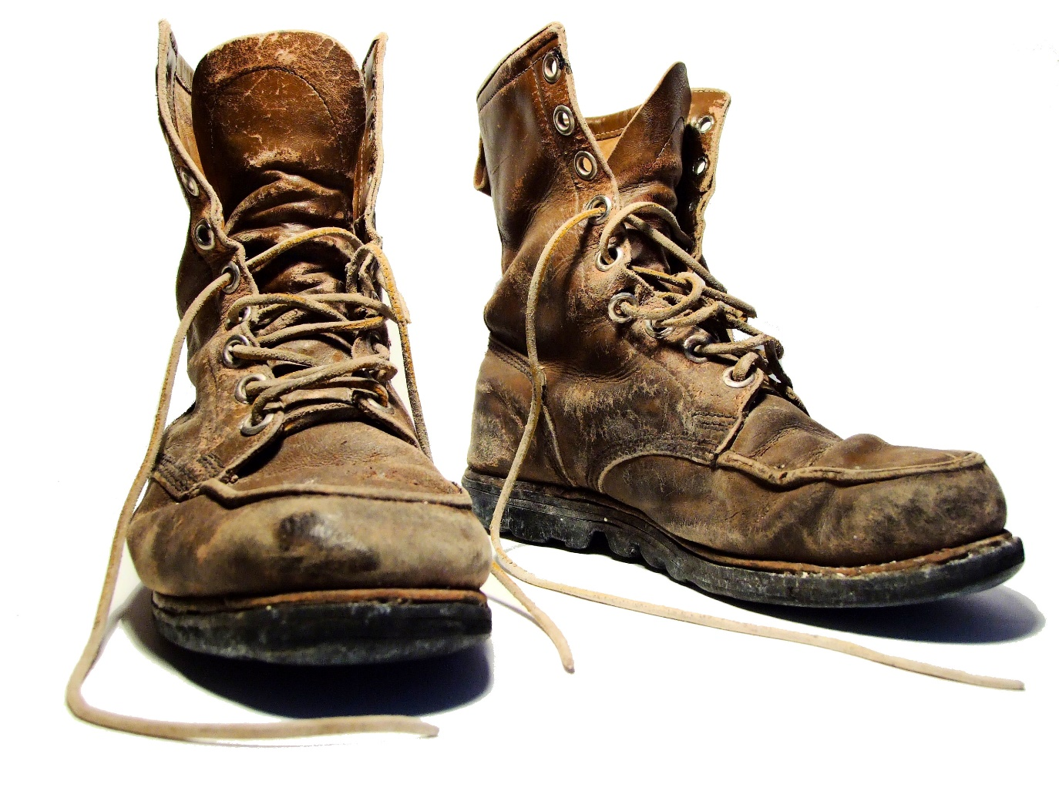
Take Off Your Steel Toe Boots
REBOOT OR DEBOOT
Jerimiah 1:9-10

Slide 2
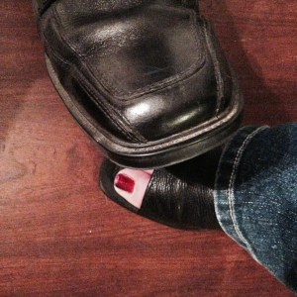
Jeremiah 1:9-10 (18:7-12)
“Behold, I have put My words in your mouth… To pluck up and to break down, To destroy and to overthrow, To build and to plant.”

Slide 3
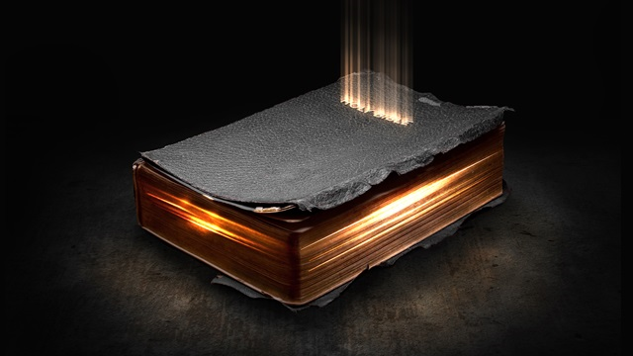
Hebrews 4:12
For the word of God is living and active and sharper than any two-edged sword, and piercing as far as the division of soul and spirit, of both joints and marrow, and able to judge the thoughts and intentions of the heart.

Slide 4
God’s word is living and active
God’s word exposes the intention of your heart
You are exposed by the way you respond to it

Slide 5
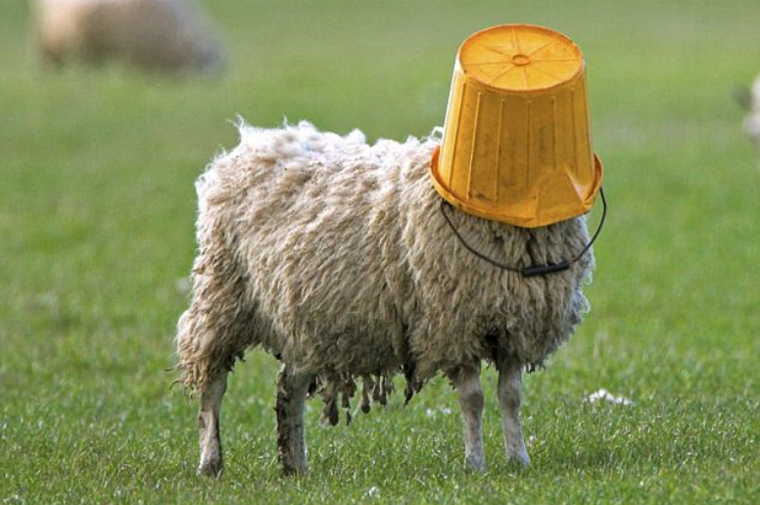
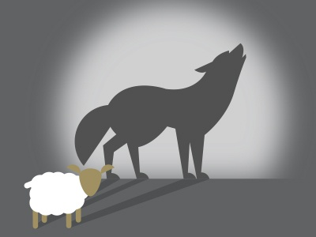
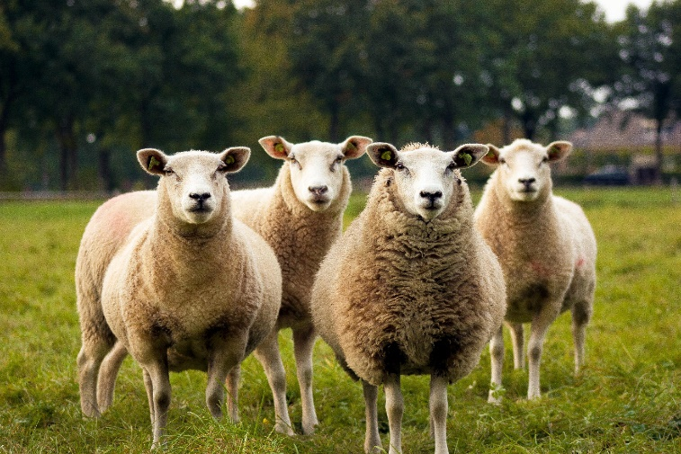
Jeremiah 23:9-29
Notes:
Dumb, Devious, Dubious

Slide 6
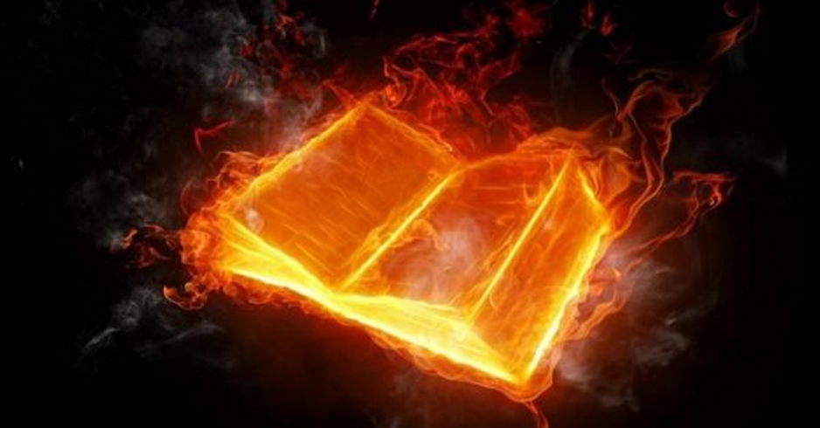
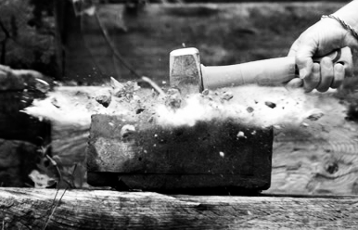
Jeremiah 23:29
“Is not My word like fire?” declares the Lord, “and like a hammer which shatters a rock?

Slide 7
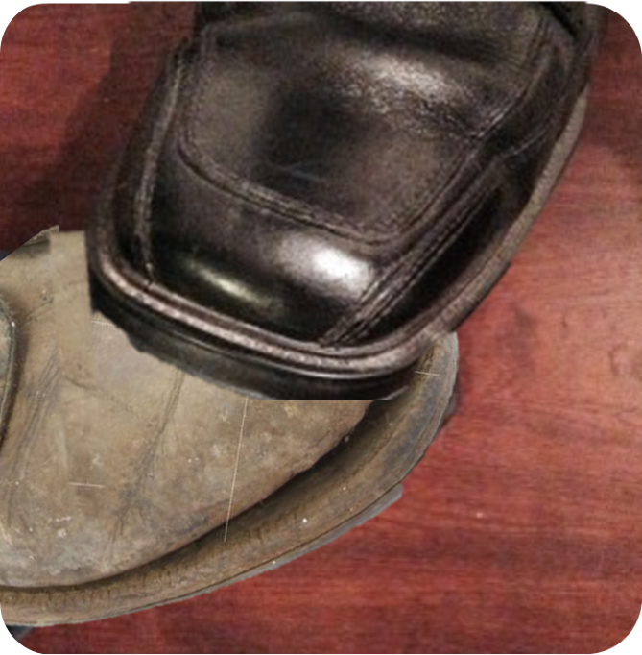
The word of God causes my heart to take action

Slide 8
The word of God causes my heart to take action
WHAT WILL YOU DO?

