Slide 1
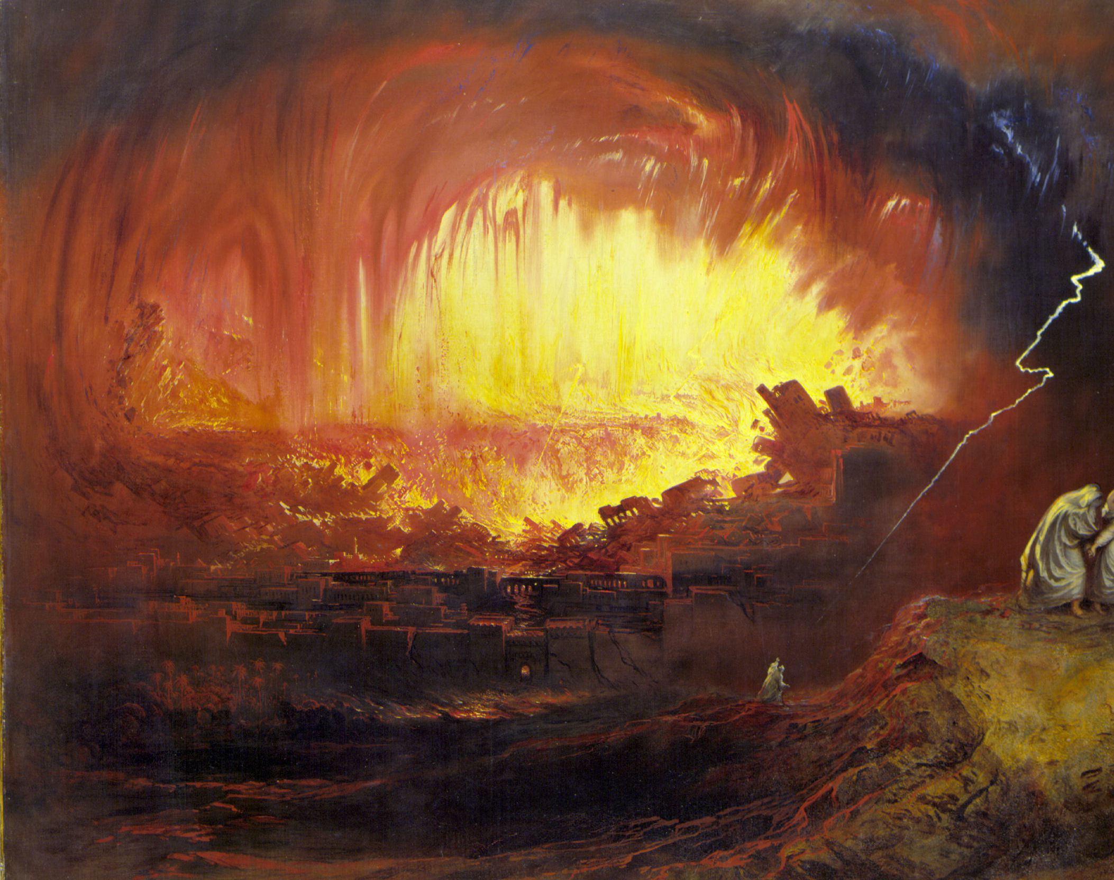
Living in the Shadow of Sodom and Gomorrah

