Slide 1
John 5
Part 2, vs. 19-47

Slide 2
John 20:(30-)31
Many other signs therefore Jesus also performed in the presence of the disciples, which are not written in this book; but these have been written that you may believe that Jesus is the Christ, the Son of God; and that believing you may have life in His name.

Slide 3
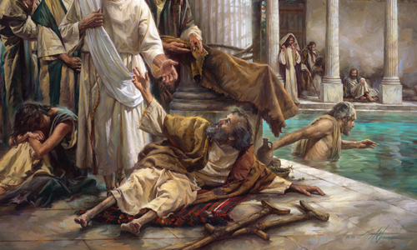
Review John 5:1-16
Jesus in Jerusalem
During a Feast of the Jews
At the Pool of Bethesda
Man afflicted almost 40 years
Jesus healed the man

Slide 4
Review John 5:1-16
Jesus instructed man to pick up his pallet
Jews questioned man, “why carrying?”
Jesus and man meet up again in temple
Man tells the Jews who had healed him
Jews angry that Jesus healed man on Sabbath

Slide 5
John 5:17-18
“God (My Father) is working…
…So shall I (His Son)”
Jews sought to kill him (even more)
Not only because breaking Sabbath
Also because Jesus called God His Father and made Himself equal with God

Slide 6
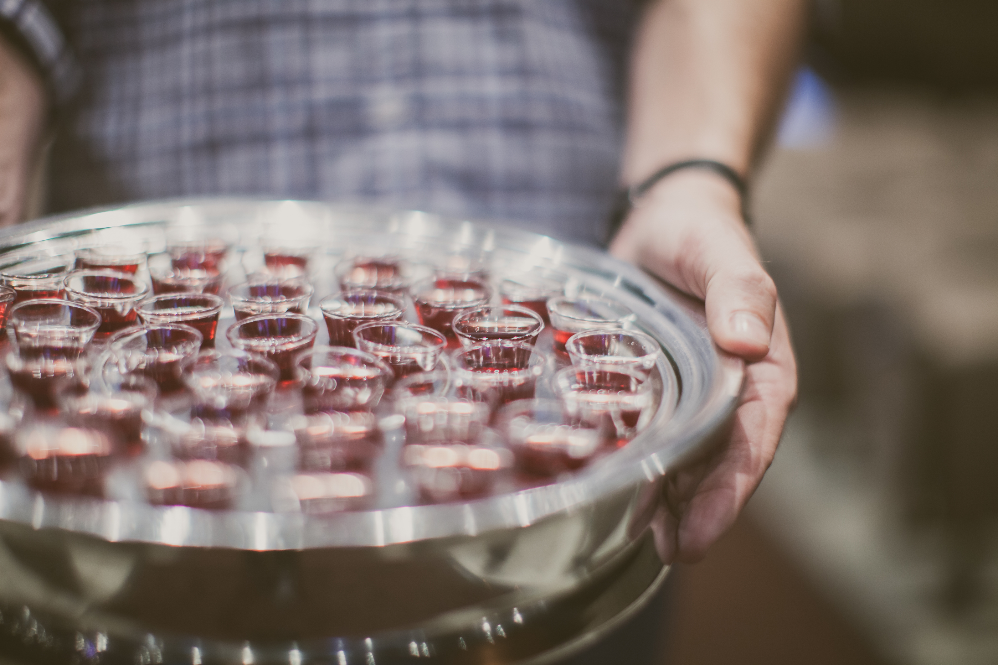
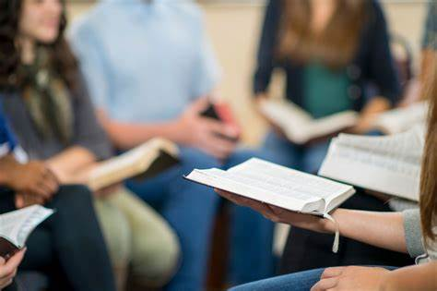
On Sunday, we…
Elders/Deacons Serve
Steve preaches
Other members
Prepare and serve Lord’s Supper
Teach
Greet, coordinate, clean
While others work at employment

Slide 7
John 5:19-21
Jesus only doing what He sees God do
“in like manner”
God shows Jesus all things
Greater works still to come
God gives life, Son gives also
“to whom He wishes”

Slide 8
Luke 8:9-10
Disciples questioned what parable (of the Soils) meant
Disciples, who sought God, could be spoken to ”plainly”
Understood if spiritually minded
While others simply “heard a story”

Slide 9
John 5:22-30
Jesus has been afforded the power of all judgement
If you honor God, you honor Jesus
Jesus was sent by God
Believing in Jesus grants eternal life

Slide 10
John 5:22-30
God and Jesus both offer life
God gave all authority to Jesus
Jesus is guided by God
Jesus is God
Jesus only does God’s will

Slide 11
John 5:31-38
Witnesses
One cannot be his own witness
John the Baptist is a witness
Jesus’ own works/signs/miracles are a witness
God said He would send His own Son
But did the Jews truly believe God’s word?

Slide 12
John 5:39-47
Witnesses (cont’d)
If you read the scriptures, then you should know Jesus
If you know God, then you should know Jesus
If you know Moses, then you should know Jesus
If you believe, then you should know Jesus

Slide 13
