Slide 1
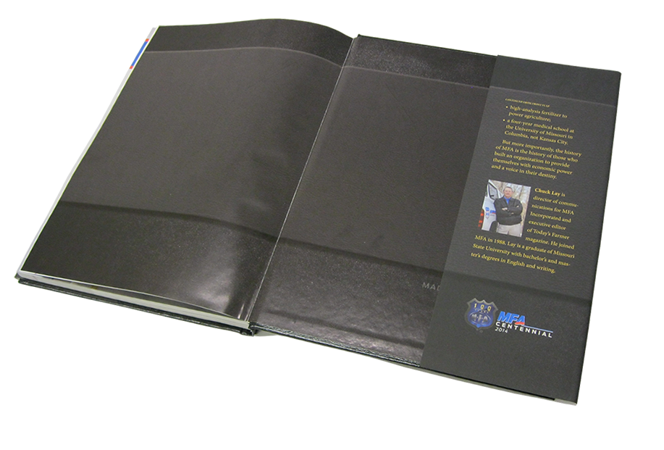
John 20:31
…but these (signs) have been written that you may believe that Jesus is the Christ, the Son of God; and that believing you may have life in His name.

Slide 2
John 5
Part 1, vs. 1-18

Slide 3
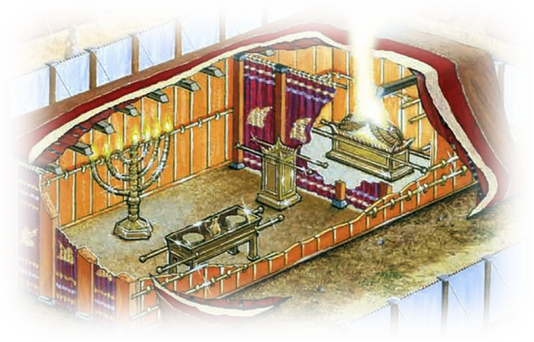
Jewish Feasts
Feast of Passover (Unleavened Bread)
Feast of Atonement (Yom Kippur)
Feast of Weeks (Pentecost)
Feast of Booths/Tabernacles
Feast of Dedication (Hanukkah)
Feast of Trumpets
Feast of First Fruits

Slide 4
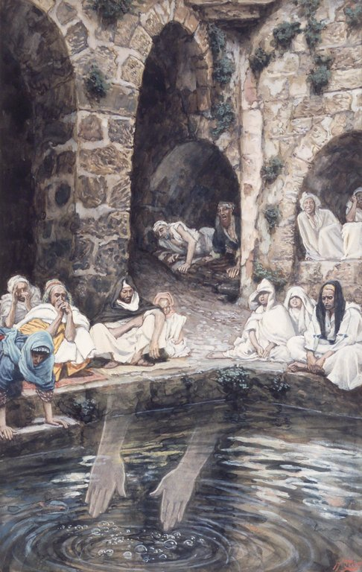
Pool of Bethesda
Five porticoes (covered porches)
Surrounded by sick, blind, lame
Waters stirred seasonally
Healing properties

Slide 5
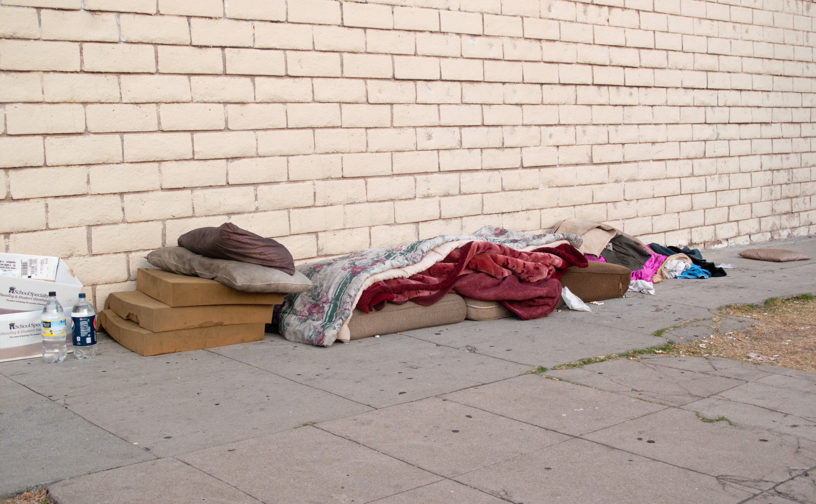

Slide 6
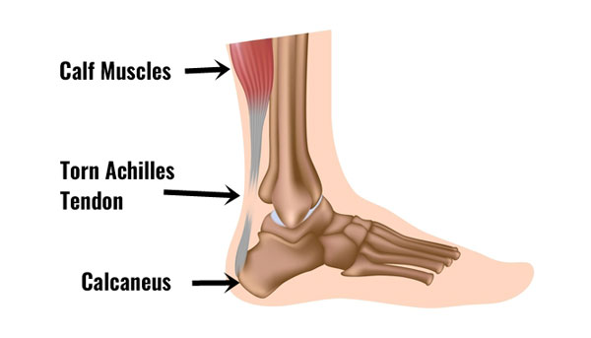

Slide 7
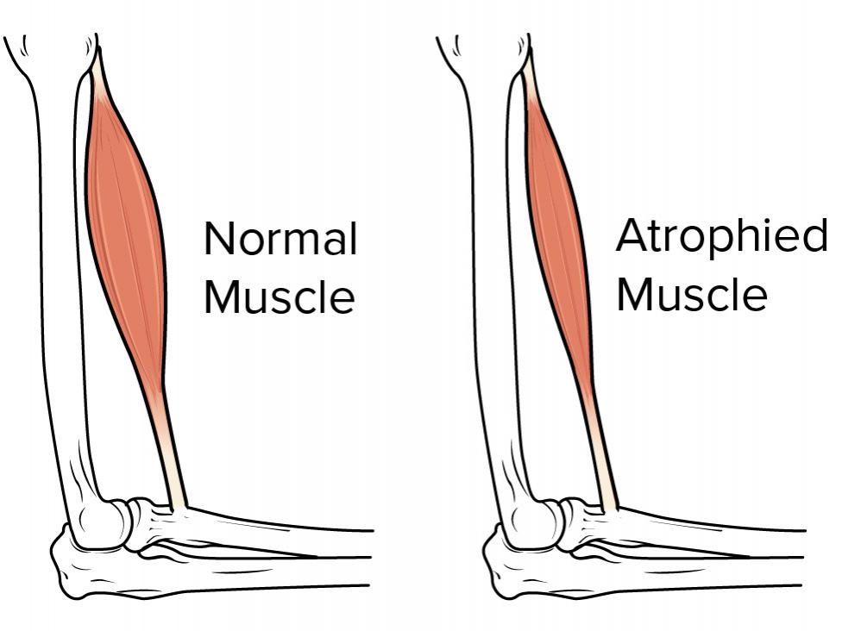

Slide 8
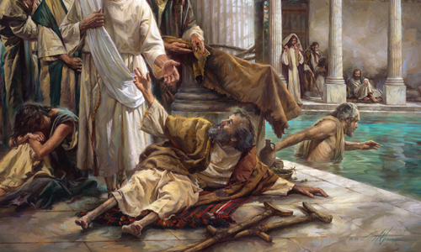

Slide 9
Romans 6:23
Cost of sin = death
God’s gift is free…
= Eternal life
Jesus is Lord

Slide 10
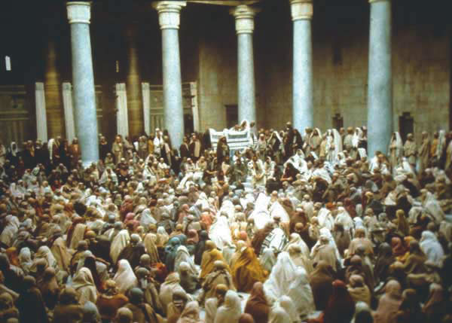

Slide 11
John 5
Part 2, vs. 19-47

