Slide 1
John 4: 3 - 54
John Study
20 : 31 - but these are written so that you may believe that Jesus is the Christ, the Son of God, and that by believing you may have life in His name.
The Power of His Word and the constant need to spread it.
Notes:
As we go through these passages you will see that Jesus takes advantage of every opportunity and deems it a necessary part of his life to “Do the will of Him who sent him.” You should also see the working power of his Word “The Truth” and what it can do in our lives.
*Read Vs 3-6

Slide 2
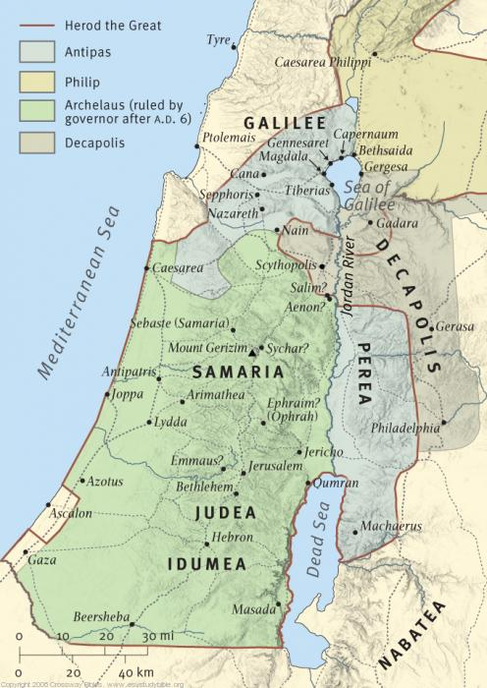
Notes:
Envy and Malice of the Pharisees due to Baptisms of Jesus caused him to leave Judea.
The name of Sychar has changed several times. Earliest known name is Gen was called Shechem and today it is know as Nablus.
Even though the names have changed we know exactly where it is because of Jacob’s well

Slide 3
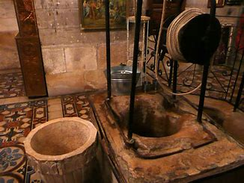
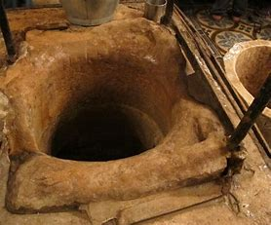
Jacob’s Well
Most Authentic Site Jesus visited in the Bible
Associated to Jacob through several different traditions
Measured 40 meters (131 feet) in 1935, believed deeper
Cut through solid limestone rock
Notes:
Jewish, Samaritan, Christian and Muslim traditions all associate the well with Jacob
A church was built over the well
The well is still used for drinking today
*Set stage of Jesus’ journey, being tired, thirsty, hungry in the heat of the day (sixth hour). Read Vs 7-9

Slide 4
Worldly Traditions that could have prevented this occasion
Gender
Race
Religion
Sinner / Outcast
Notes:
Men did not usually talk to their own wives or daughters in public during this time and in this section of the world.
Vs 9, even the lady was surprised that Jesus spoke to her being a woman from Samaria.
Vs 20, Samaritans accepted Moses but did not accept the other prophets. Similar to the different interpretations of Christian religions today.
Vs 6;18, sixth hour was about noon suggests that she was an outcast getting water in the heat of the day when no one else would have normally been there, had a problem with adultery, fornication.

Slide 5
Spiritual Knowledge
What is the Gift of God?
What is living Water?
Why does the lady relate living water to normal water?
Why does she ask Jesus if he is greater than Jacob?
Notes:
Larry spoke last week about being born again spiritually. This was a new concept at the time it was spoken and now we see Jesus expanding on that with some spiritual knowledge and a spiritual need required to follow Jesus and worship the Father.
* Read Vs 10-15
Gift of God could mean one of two things, either the gift is Christ or it could be referring to her opportunity of seeking salvation.
Vs 41 – Living water is the Word of God
Living water was a common phrase of this day. It meant water that was running such as wells or springs and not stagnant. Basically it was drinkable, clean water.
Blinded by the physical world and what she has gained from it and what she thinks she can gain from it. More excited about not having to draw water daily than having eternal life.

Slide 6
The Power of God’s Word
What are some hurdles she needs to overcome to believe?
What connections did she make as Jesus gave her truth?
What does Jesus reveal about God and about true worshipers?
What is the result of Jesus telling her He is the Messiah?
Notes:
*Read Vs 16-29
Only believed in Moses and not the other prophets, Was a sinner and not closely following the scriptures teachings, Very/extremely Physically minded.
She knew he was of God by knowing her life, but hesitated to believe he was the Messiah probably because he was Jewish. Deut. 18: 15 / Changes topic with not so important question.
True worshipers are those who use their hearts in their worship, not those who just mimic vane repetitions. They are searching for God and trying to please him with their lives. Worshiping in Spirit is doing so using Heart, Soul and Mind. Their entire being is dedicated to their service to him.
Instant Belief that He was the Messiah. Immediately started evangelizing and cause the town people to believe. 1st proclamation of who He was and purpose of recording.

