Slide 1
John 2:13-25
Timeline of Jesus Ministry
Accuracy of Scripture
Righteous Anger
Misuse of God’s House is Unacceptable
Prophesy Fulfilled
Jesus acknowledged as a Prophet
Jesus is the Christ, the Son of God

Slide 2
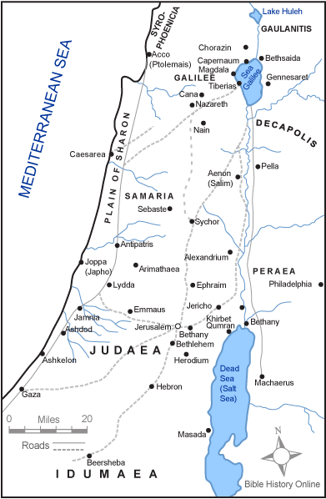

Slide 3
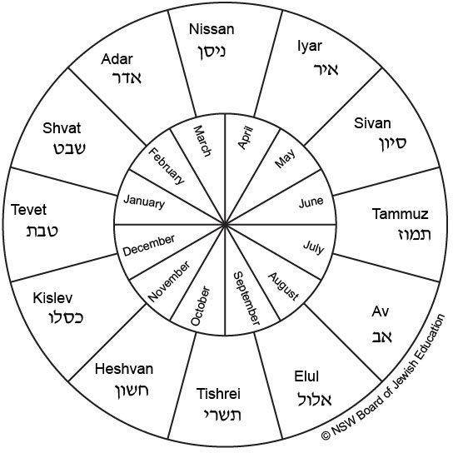

Slide 4
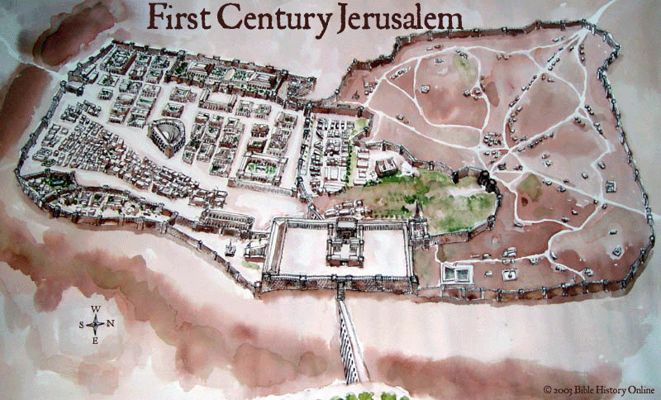

Slide 5
Measuring the Ministry
John 2:13 1st Passover 6 months
John 5:1 A feast (Passover) 1.5 yr
John 6:4 Passover 1.5 or 2.5 yr
John 11:55 Passover 2.5 or 3.5 yr

Slide 6
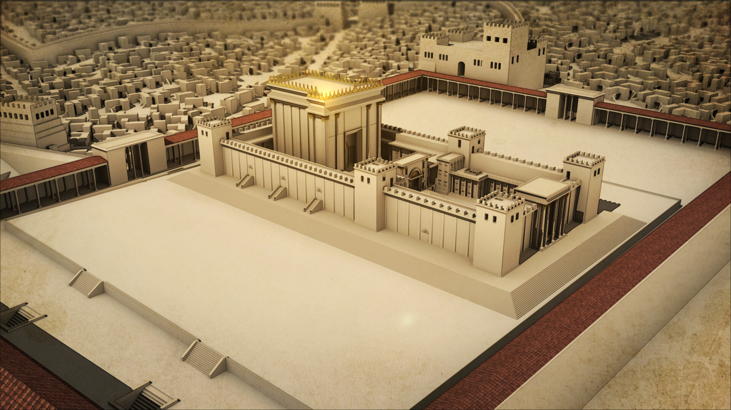

Slide 7
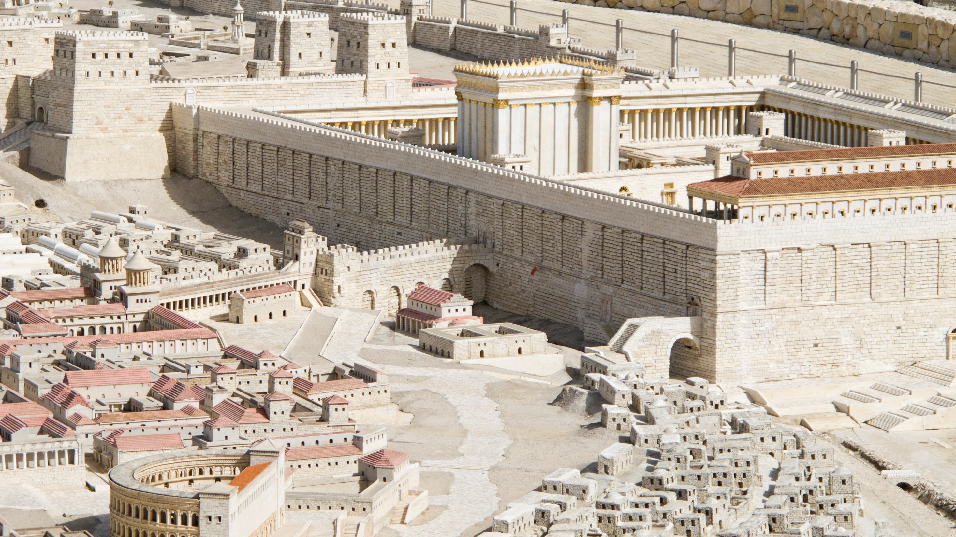

Slide 8
Encounter with Nicodemus
Born again:
Water/Spirit
Son of Man
Heart of Gospel
Judgment

Slide 9
Born of Water
Acts 2:38 for forgiveness
Acts 22:16 wash away your sin
Acts 8:36 believe with all your heart (water)
1 Pet 3:21 baptism saves you
Gal. 3:27, 2 Cor.5:17 into Christ, new creature
Mark 16:16 believe and baptized saved

Slide 10
Mark 16:16
"He who has believed and has been baptized shall be saved; but he who has disbelieved shall be condemned.
"He who has believed and has not been baptized shall be saved; but he who has disbelieved shall be condemned.

Slide 11
Born of Spirit/Receive the Gospel
1 Cor. 15:1-4
Rom.1:16 power of God unto salvation
Hear: Rom. 10:17 Faith is from hearing the gospel
Believe/Faith: Mark 16:15-16, Heb. 11:6
Repent: Acts 17:30
Confess: Matt.10:32-33
Baptized:
Remain Faithful:1 John 2:3-6

Slide 12
John 2:22-4:2
Jesus' disciples begin baptizing
John the Baptist continues to prepare the way
John credits his success to God Vs.27
John reiterates he is not the Christ Vs.28
John has taken great joy in doing his job Vs.29
John teaches eternal life is found in Jesus Vs.36
Belief/Faith is coupled with obedience Vs.37

