Slide 1
God knows Your Birth Order
Exodus 11:4-6; 12:23

Slide 2
God Formed You In The Womb
Jeremiah 1:5
“Before I formed you in the womb I knew you, And before you were born I consecrated you; I have appointed you a prophet to the nations.”

Slide 3
God Know The Number Of Your Days
Psalm 139:16
Your eyes have seen my unformed substance; And in Your book were all written The days that were ordained for me, When as yet there was not one of them.

Slide 4
God Knows Your Abilities
Exodus 4:11
The LORD said to him, “Who has made man’s mouth? Or who makes him mute or deaf, or seeing or blind? Is it not I, the LORD?

Slide 5
The Hairs On Your Head Are Numbered
Luke 12:7
“Indeed, the very hairs of your head are all numbered. Do not fear; you are more valuable than many sparrows.

Slide 6
God Has Future Plans For You
Jeremiah 29:11
‘For I know the plans that I have for you,’ declares the LORD, ‘plans for welfare and not for calamity to give you a future and a hope.

Slide 7
God Has Examined Your Heart
Jeremiah 17:10
“I, the LORD, search the heart, I test the mind, Even to give to each man according to his ways, According to the results of his deeds.

Slide 8
God Knows The Secrets Of The Heart
Psalm 44:21
Would not God find this out? For He knows the secrets of the heart.

Slide 9
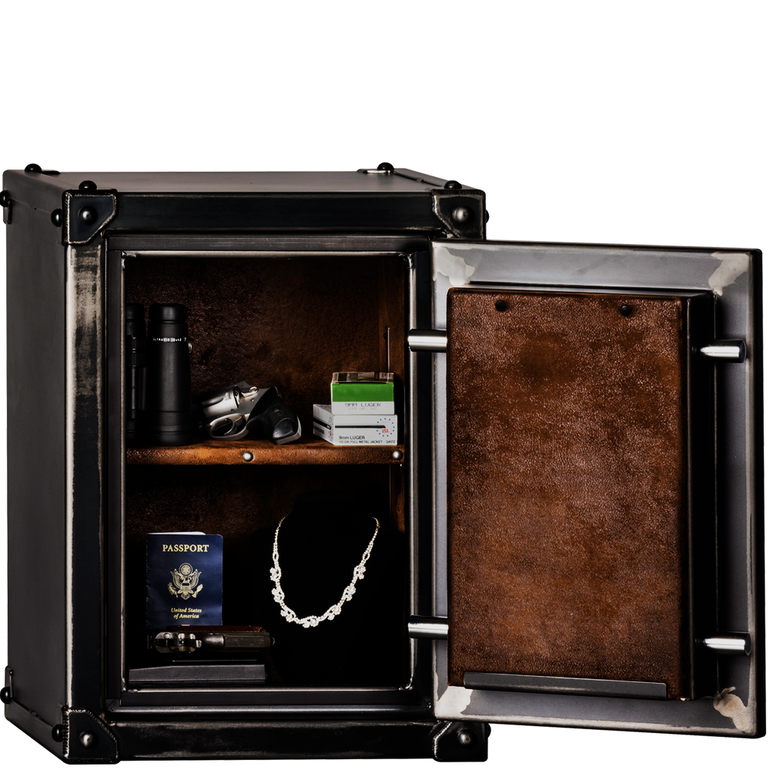
God Knows Our Secret Sins
Psalm 90:8
You have placed our iniquities before You, Our secret sins in the light of Your presence.

Slide 10
God Knows All Your Tears
Psalm 56:8
You have taken account of my wanderings; Put my tears in Your bottle. Are they not in Your book?

Slide 11
God Knows What You Need Before You Ask
Matthew 6:8
“So do not be like them; for your Father knows what you need before you ask Him.

Slide 12
God Knows Your Limits
1 Corinthians 10:13
No temptation has overtaken you but such as is common to man; and God is faithful, who will not allow you to be tempted beyond what you are able, but with the temptation will provide the way of escape also, so that you will be able to endure it.

Slide 13
God Has Placed You In His Church
1 Corinthians 12:18
But now God has placed the members, each one of them, in the body, just as He desired.

Slide 14
Why Does God Know You So Well?
Because He Loves You
Notes:
BIRTH ORDER
FORM
PURPOSE
DAYS
ABILITIES
HAIRS
FUTURE
HEART
SECRETS
SINS
TEARS
NEEDS
LIMITS
PLACE

Slide 15
Hard Choices

Slide 16
Feeling Lost & Alone
Without Value

Slide 17
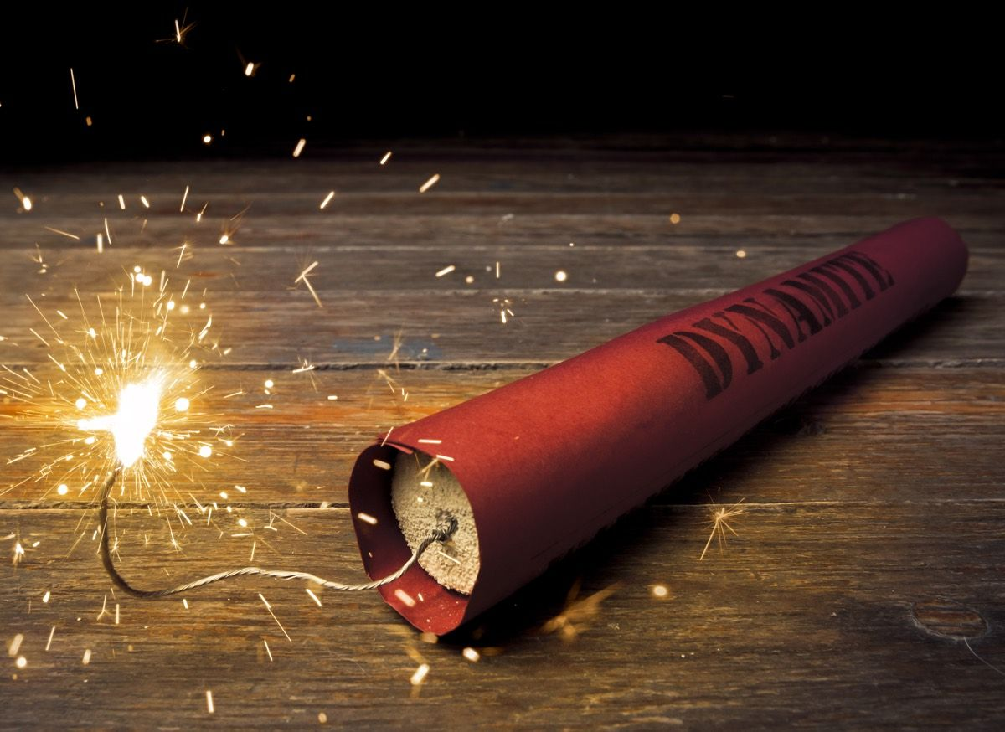
End Of Your Fuse

Slide 18
Overwhelmed
Stressed
Weighed Down
Struggling

Slide 19
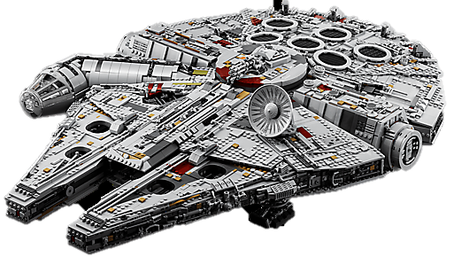
Biblical Ideal

Slide 20
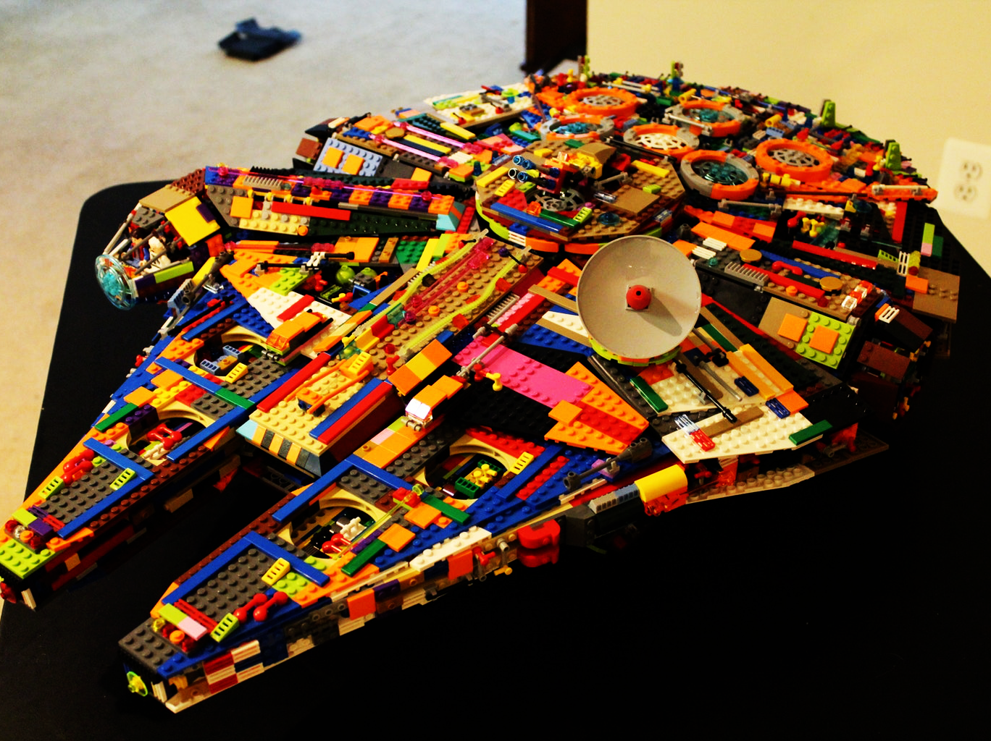
Everyone’s Life Is Compatible With The Scripture

Slide 21
For God So Loved The World That He Gave His Only Begotten Son
John 3:16

