Slide 1
The Significance of
Repenting

Slide 2
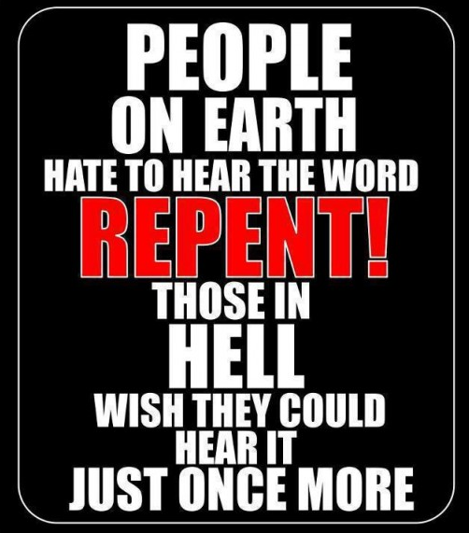
John 8:24
“Therefore I said to you that you will die in your sins; for unless you believe that I am He, you will die in your sins.”
Luke 13:3
“I tell you, no, but unless you repent, you will all likewise perish.
Ezekiel 33:11
“Say to them, ‘As I live!’ declares the Lord God, ‘I take no pleasure in the death of the wicked, but rather that the wicked turn from his way and live. Turn back, turn back from your evil ways! Why then will you die, O house of Israel?’

Slide 3
What Is Different In Your Life?
Faith x 2
Hope
Love x2
Grace
Prayer x2
Confession

Slide 4
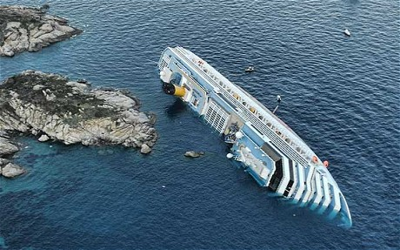
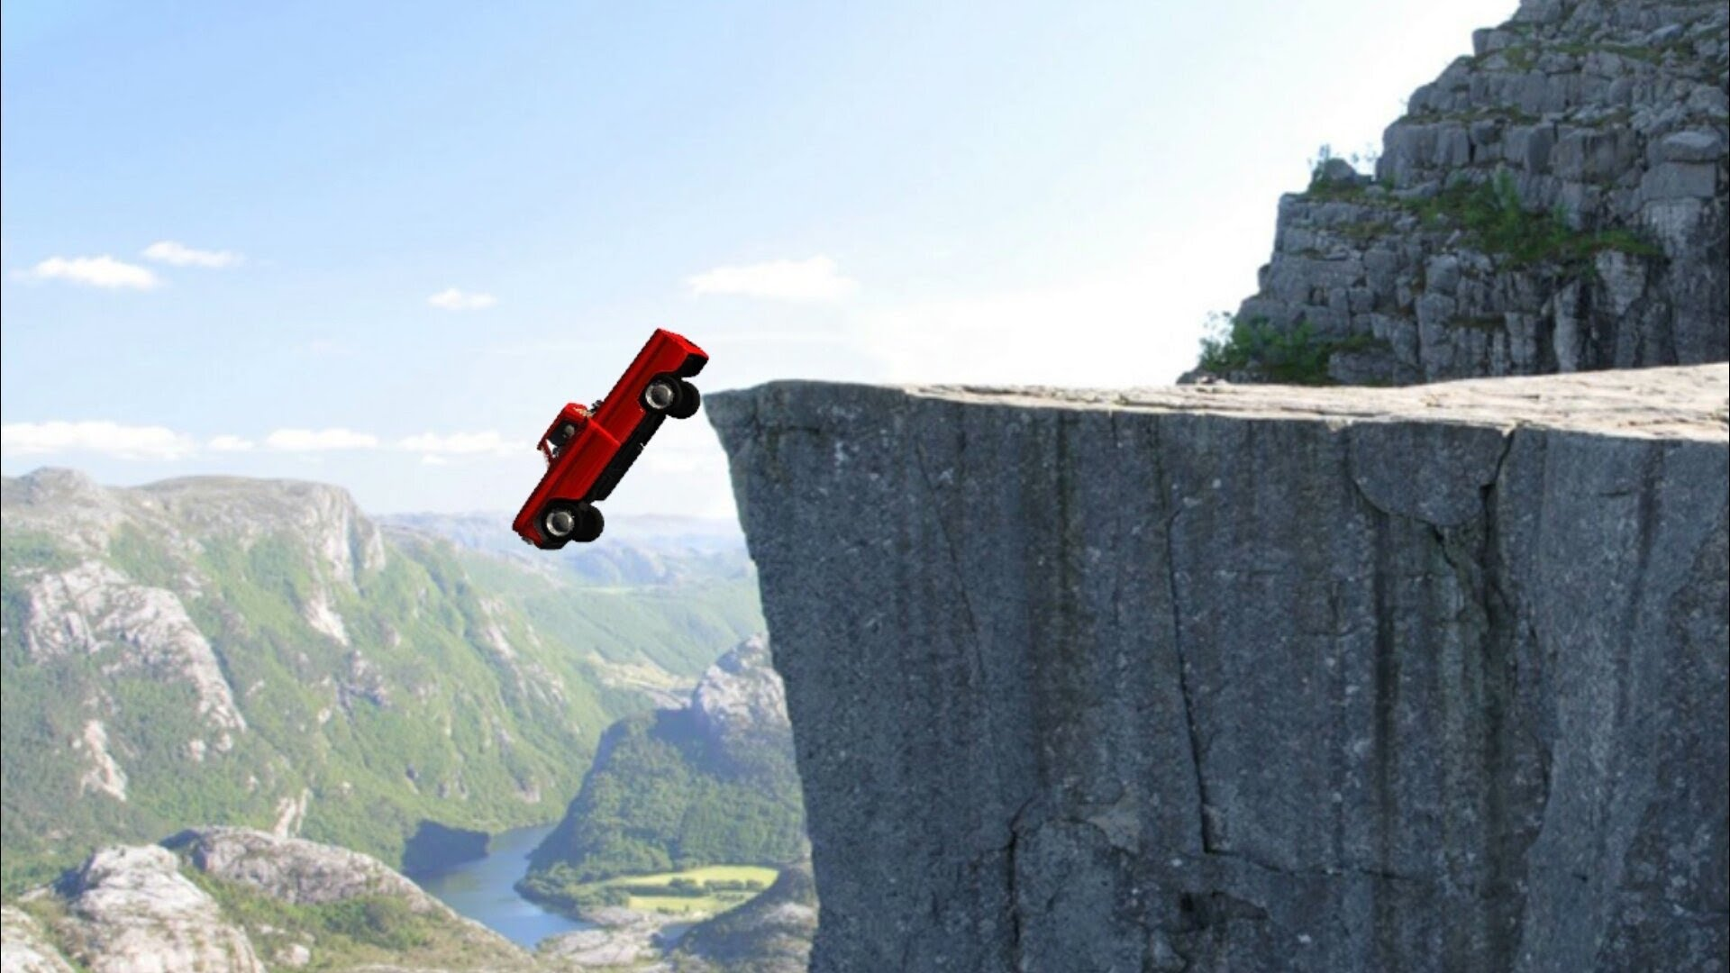
Repent
Course Correction Christians who need to improve or have become luke-warm.
Revelation 3:14-19
Rebellion
Following the path that leads to destruction and judgement.
Isaiah 30:1, 8-11

Slide 5
Isaiah 30:8-14
They Do Not Listen

Slide 6
Isaiah 30:15-22
Repent & Turn

Slide 7
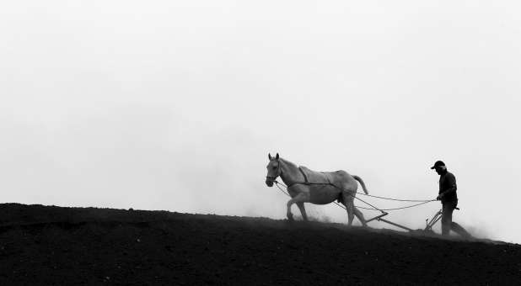
Jeremiah 4:3
For thus says the Lord to the men of Judah and to Jerusalem, “Break up your fallow ground, And do not sow among thorns.

Slide 8
Joel 2:13
And rend your heart and not your garments.” Now return to the Lord your God, For He is gracious and compassionate, Slow to anger, abounding in lovingkindness And relenting of evil.

