Slide 1
Genesis 2
creation of man

Slide 2
Days Of Creation
FORMLESS / ORDER-LESS
EMPTY
3-5
14-19
6-8
20-23
9-13
24-31
2:1-3 God Rested

Slide 3
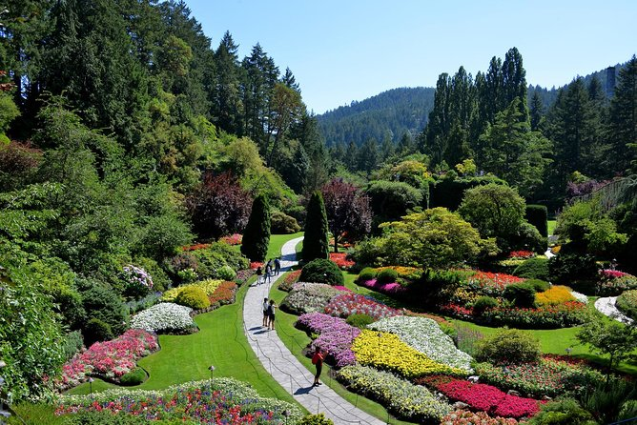
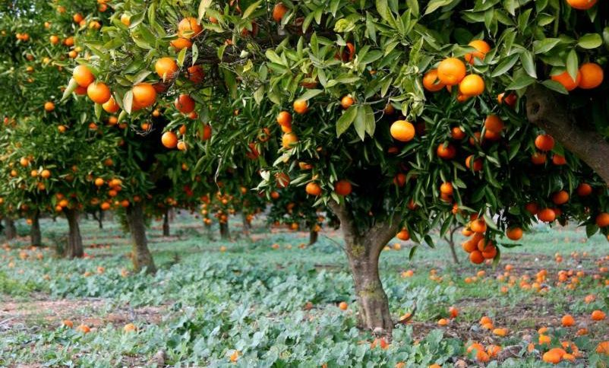
Genesis 2:9
Out of the ground the Lord God caused to grow every tree that is pleasing to the sight and good for food; the tree of life also in the midst of the garden, and the tree of the knowledge of good and evil.
Notes:
Pleasing to the sight, good for food
Pleasing to God… or Good to make one wise

Slide 4
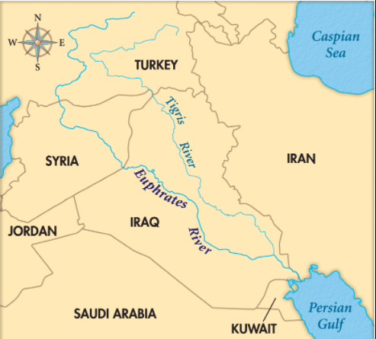
Garden Of Eden
Genesis 2:8-14
Pishon
Gihon
Tigris
Euphrates

Slide 5
Genesis 2:16–17
The Lord God commanded the man, saying, “From any tree of the garden you may eat freely; but from the tree of the knowledge of good and evil you shall not eat, for in the day that you eat from it you will surely die.”
Notes:
Pleasing to the sight, good for food
Pleasing to God… or Good to make one wise

Slide 6
Creation Of Woman
Genesis 2:18-25

