Slide 1
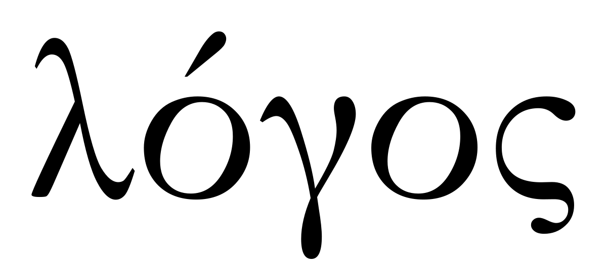
The Gospel Of John
“that you might believe”

Slide 2
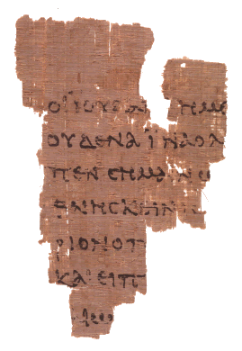
The Gospel Of John
The Author – Manuscripts of the fourth gospel are uniformly attributed to John
The Sevens of John Signs, I AM’s, Confessions, Discourses feasts, equalities, parables
John’s Teaching Style Infused with prophetic reference Brilliant Mnemonics Airtight biblical testimony Connects Jesus to God’s own authority by demonstrating fulfilled prophecy
Papyrus fragment dated 160AD Contains portions of John 18

Slide 3
The Purpose Of The Book Of John
John 20:30–31 Therefore many other signs Jesus also performed in the presence of the disciples, which are not written in this book; but these have been written so that you may believe that Jesus is the Christ, the Son of God; and that believing you may have life in His name.

Slide 4
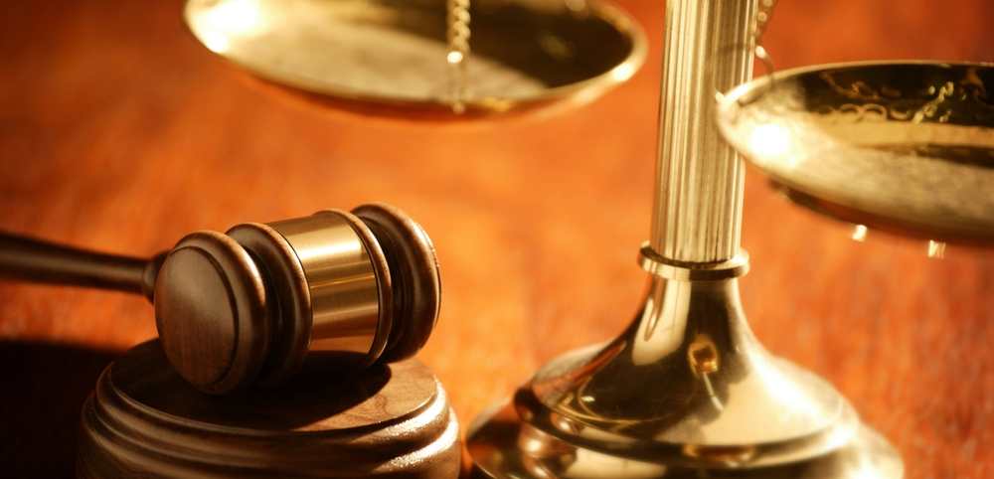
A Legal Case For Jesus
John 20:30–31 Therefore many other signs Jesus also performed in the presence of the disciples, which are not written in this book; but these have been written so that you may believe that Jesus is the Christ, the Son of God; and that believing you may have life in His name.

Slide 5
A Legal Case For Jesus
Deuteronomy 18:20-22
If the thing does not come about or come true this is not the word that the Lord has spoken.

Slide 6
The Gospel Of John
“that you might believe”

Slide 7
John 20:30–31 these have been written so that you may believe that Jesus is the Christ, the Son of God; and that believing you may have life in His name.

Slide 8
A Legal Case For Jesus
The case for belief is made in a way that it would be reasonable to die for your belief.

Slide 9
A Legal Case For Jesus
This is not what you do when you are trying to prove something obvious or easily accepted. John’s claims about Jesus are extraordinary and require sufficient evidence
God’s standard for testimony is two or three witnesses
God’s standard for a prophet is that the words spoken in the name of the Lord must come to pass

Slide 10
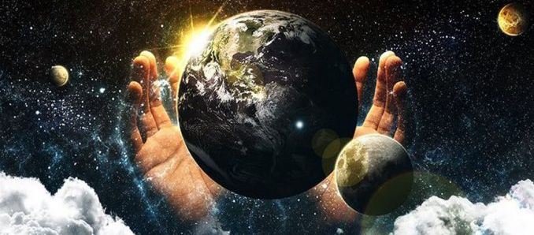
That You Might Believe…
Jesus is the creator of all things
Genesis 1:1-3 • Deuteronomy 5:22-29
Notes:
Exodus 20:11
“For in six days the Lord made the heavens and the earth, the sea and all that is in them, and rested on the seventh day; therefore the Lord blessed the sabbath day and made it holy.

Slide 11
That You Might Believe…
The Word became flesh
Deuteronomy 18:15-22 One will rise up
John 1:2 HE…
John 1:6-8 John testified about the light
John 1:9 The light was in the world
John 1:10-11 Rejected by His people
John 1:12-13 God chose a new people
John 1:14 The word became flesh

Slide 12
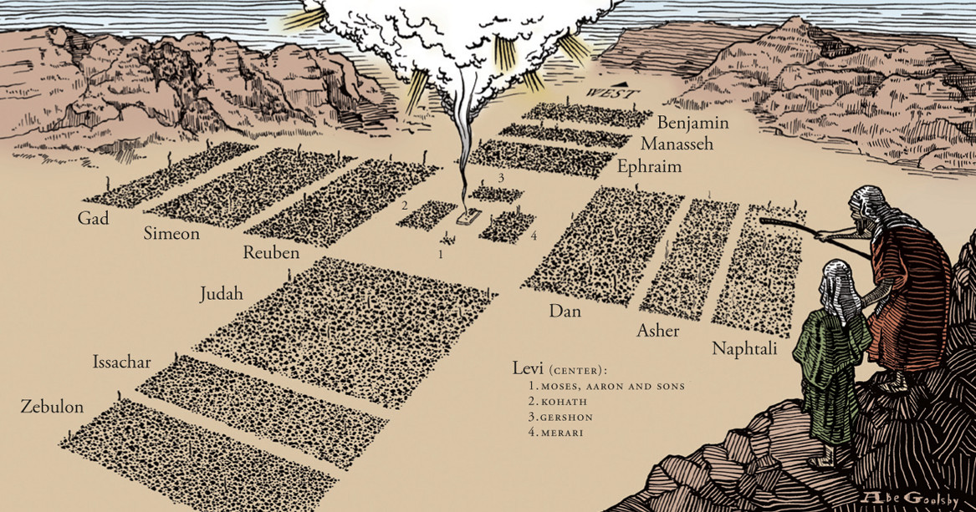
That You Might Believe…
God’s Answer To Moses Intercession
Exodus 33:12-23
13-14 Let me know your ways
16 Let your presence be among your people
18 Show me Your Glory (Ex. 34:5-8)

Slide 13
Notes:
John 1:45 we have found him of whom Moses and the Prophets write.

Slide 14
so that you may believe that Jesus is the Christ, the Son of God; and that believing you may have life in His name.

Slide 16
Deuteronomy 5:22-29 The Voice Of God
Deuteronomy 18:15-17 The Prophet Of God
Genesis 1:3-4 The Words Of God
John 1:2 The Man Of God

