Slide 1
THE RACE OF FAITH
αγώνας
Agónas
fight, match, race, contest, competition

Slide 2
Event Distance 26.2 Miles
Training Distance Per Week
Week 1 – 19 miles Week 9 – 39 miles
Week 2 – 21 miles Week 10 – 30 miles
Week 3 – 24 miles Week 11 – 41 miles
Week 4 – 27 miles Week 12 – 43 miles
Week 5 – 32 miles Week 13 – 45 miles
Week 6 – 24 miles Week 14 – 34 miles
Week 7 – 34 miles Week 15 – 25 miles
Week 8 – 36 miles Week 16 – 12 miles
486
TOTAL
MILES

Slide 3
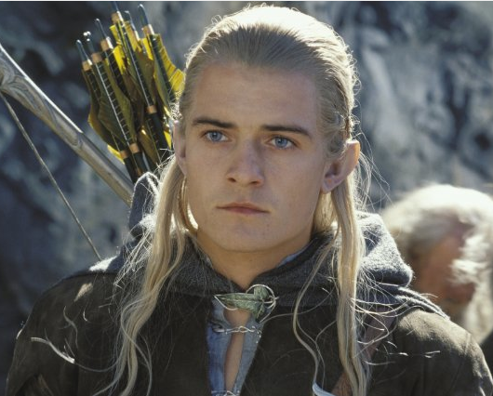
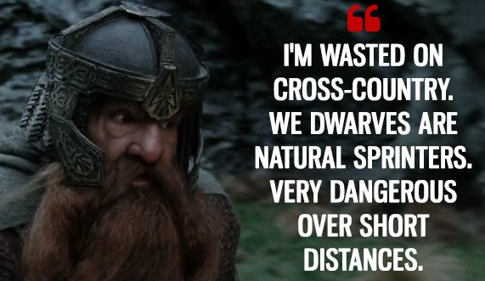

Slide 4
Hebrews 12:1-2 Therefore we also, since we are surrounded by so great a cloud of witnesses, let us lay aside every weight, and the sin which so easily ensnares us, and let us run with endurance the race that is set before us, looking unto Jesus, the author and finisher of our faith, who for the joy that was set before Him endured the cross, despising the shame, and has sat down at the right hand of the throne of God.

Slide 5
OUR RACE
God chose us
Your race is unique
No time-outs
Requires great endurance

Slide 6
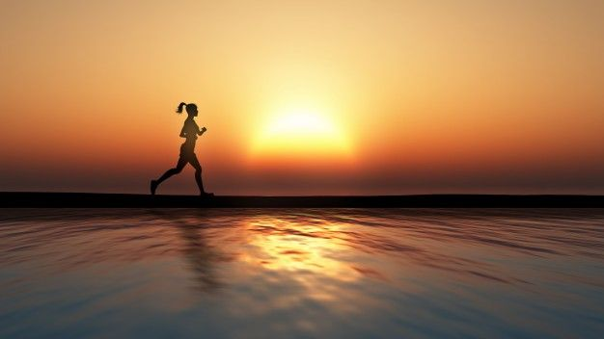
Hebrews 12:1 Therefore we also, since we are surrounded by so great a cloud of witnesses,

Slide 8
Hebrews 12:1 let us lay aside every weight, and the sin which so easily ensnares us, and let us run with endurance the race that is set before us.

Slide 9
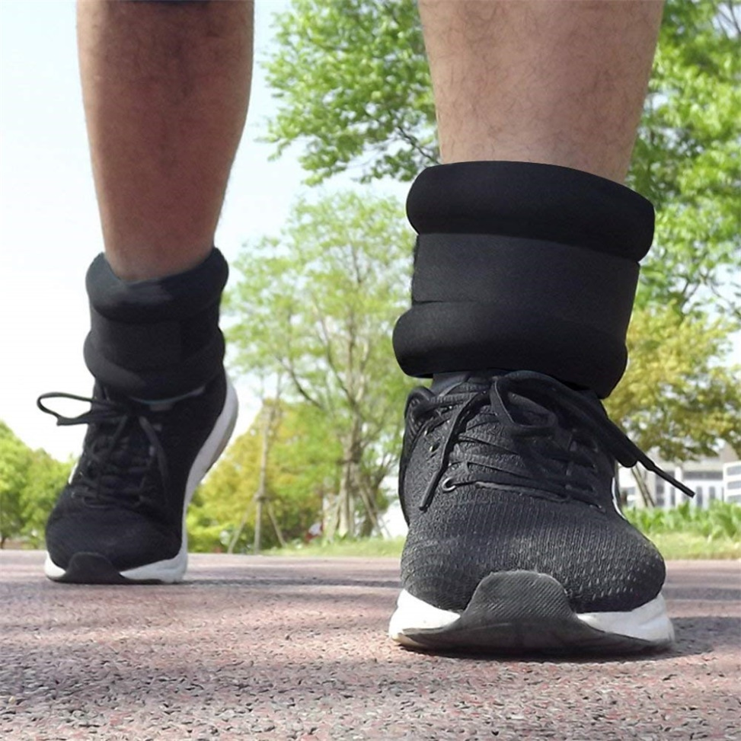
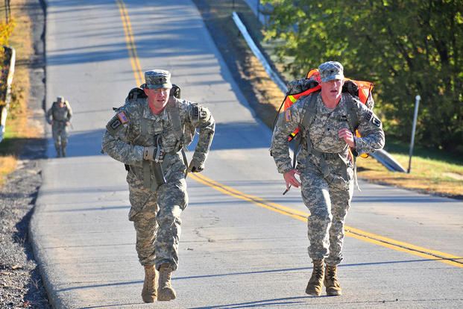

Slide 10
1 John 2:15-17 Do not love the world or the things in the world. If anyone loves the world, the love of the Father is not in him. For all that is in the world—the lust of the flesh, the lust of the eyes, and the pride of life—is not of the Father but is of the world. And the world is passing away, and the lust of it; but he who does the will of God abides forever

Slide 11
Hebrews 12:1 let us lay aside every weight, and the sin which so easily ensnares us, and let us run with endurance the race that is set before us.

Slide 12
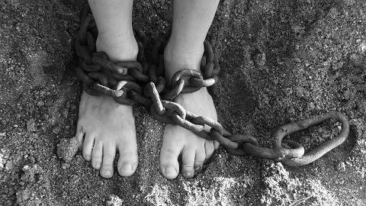

Slide 13
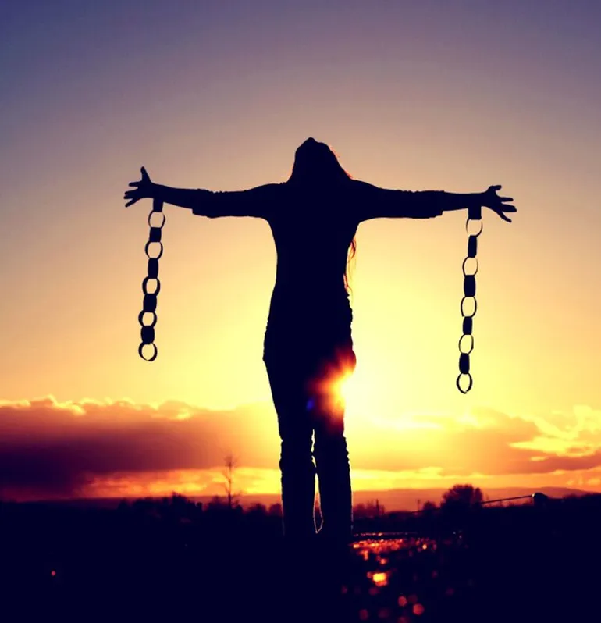
Romans 6:1-2 What shall we say then? Shall we continue in sin that grace may abound? Certainly not! How shall we who died to sin live any longer in it?

Slide 14
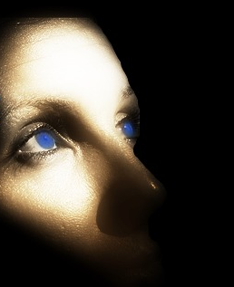
Hebrews 12:2 looking unto Jesus, the author and finisher of our faith, who for the joy that was set before Him endured the cross, despising the shame, and has sat down at the right hand of the throne of God.

Slide 15
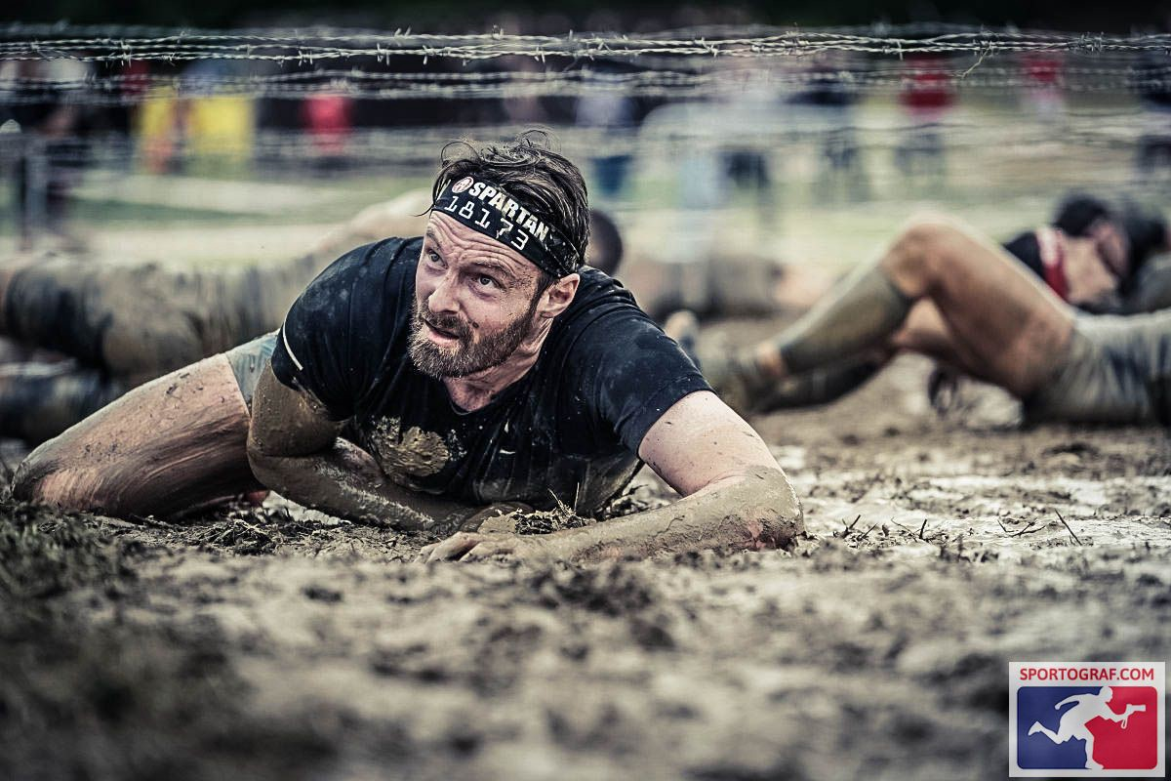
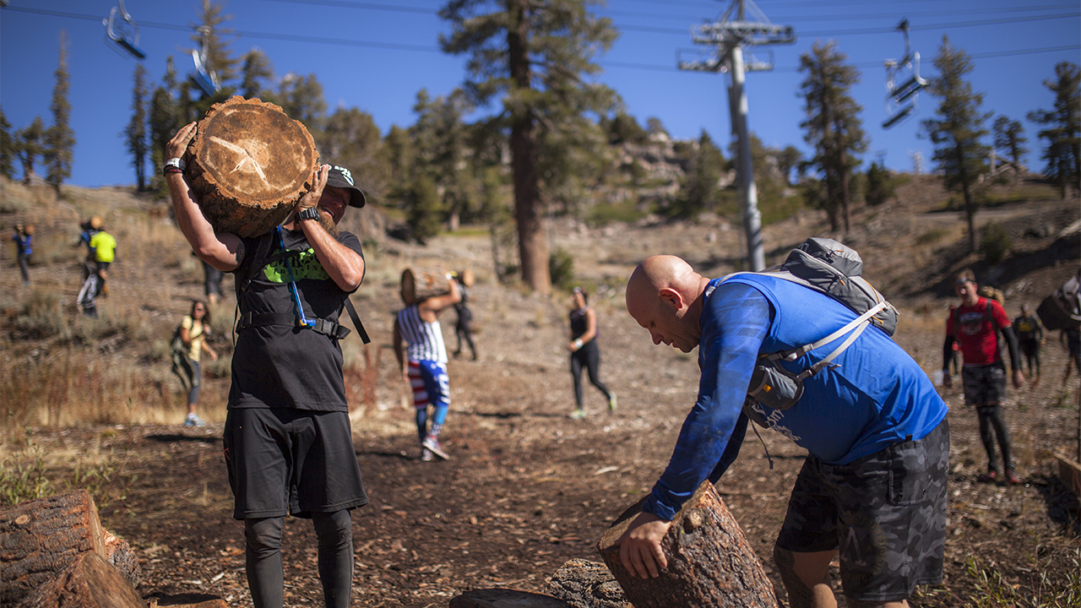

Slide 16
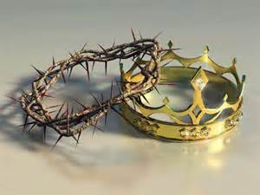
1 Corinthians 9:24 Do you not know that those who run in a race all run, but one receives the prize? Run in such a way that you may obtain it.

Slide 18
2 Corinthians 11:24-28 From the Jews five times I received forty stripes minus one. Three times I was beaten with rods; once I was stoned; three times I was shipwrecked; a night and a day I have been in the deep; in journeys often, in perils of waters, in perils of robbers, in perils of my own countrymen, in perils of the Gentiles, in perils in the city, in perils in the wilderness, in perils in the sea, in perils among false brethren; in weariness and toil, in sleeplessness often, in hunger and thirst, in fastings often, in cold and nakedness

Slide 19
