Slide 1
“THAT YOU MAY BELIEVE”
GOSPEL
THE
JOHN
OF

Slide 2
31 but these are written so that you may believe that Jesus is the Christ, the Son of God, and that by believing you may have life in his name.
JOHN 20.31

Slide 3
30 Now Jesus did many other signs in the presence of the disciples, which are not written in this book;
JOHN 20.30

Slide 4
What is the difference between:
Faith
Belief

Slide 5
Week 1
John is not the light
Sent to bear witness to the light
Week 2
All might believe through John
Wedding at Cana
JOHN 1.6-8

Slide 6
Focus
Matt, Mark, Luke (Synoptic) | John
Dress
Food
Activity
Conversation “Crowd” | Conversation “the Jews”

Slide 7
Are you Elijah?
Who are you?
The Prophet?
JOHN 1.19-25

Slide 9
Evidence to Believe John The Baptist
Prophecy [Malachi 4.5, Isaiah 40.3]
Humble Lifestyle [Mark 1.6]
Teaching Stubborn [Mark 6:14-29]
Truth Over Death [Matt 11.7]

Slide 10
Application To Us
Pay Attention To The Details
Believe => Faith
Life Reflects Our Belief In God
Be Bold

Slide 11
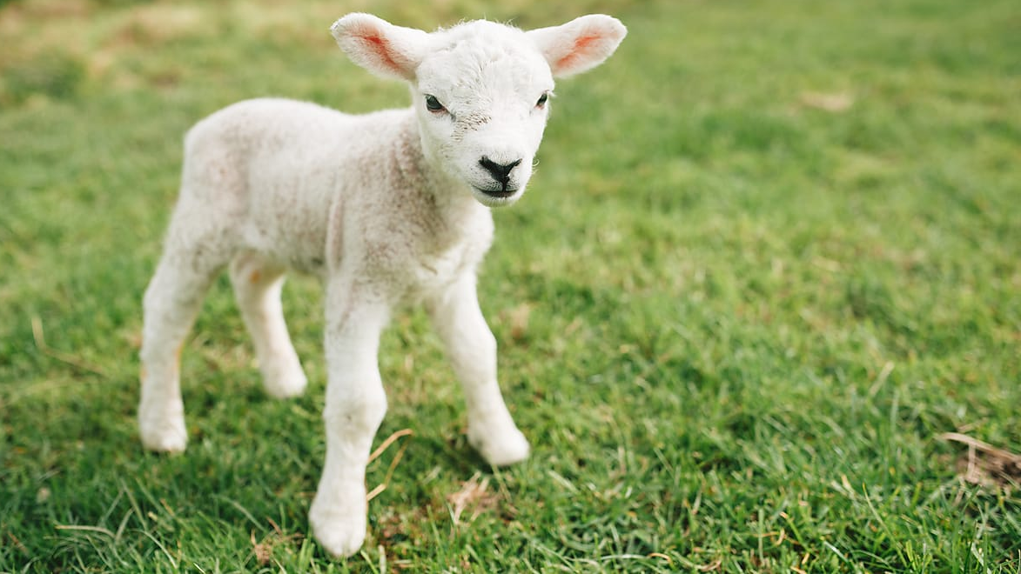

Slide 12
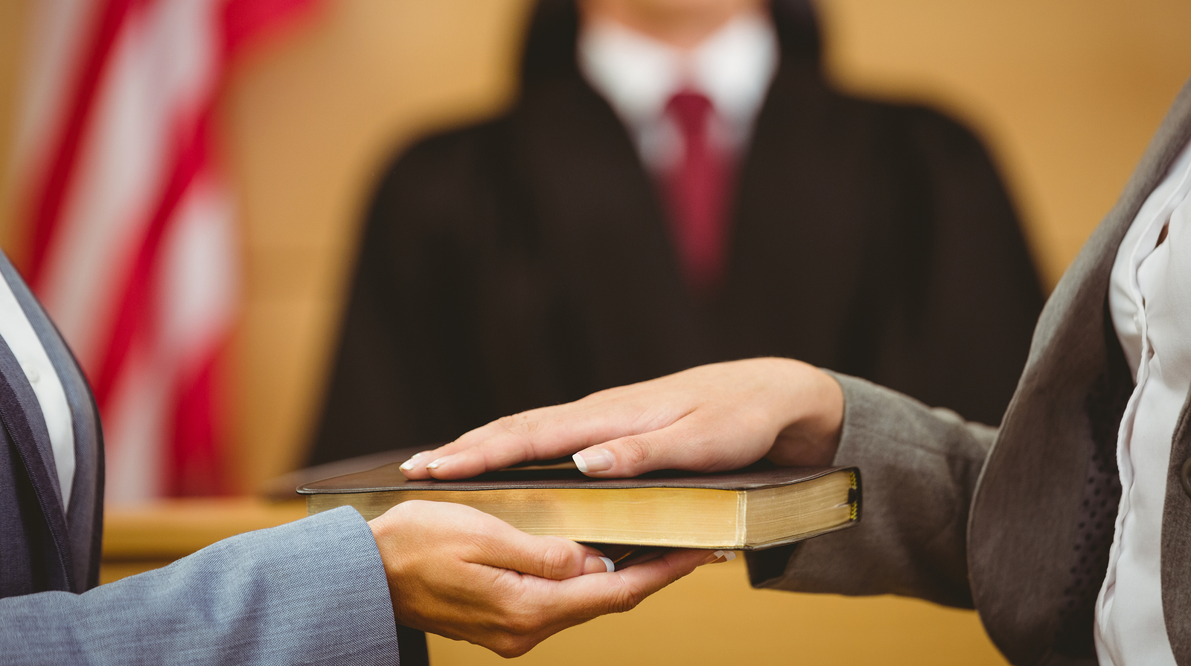

Slide 13
Impact To Us
John’s Testimony Incredible Value
Millions Lambs Not Enough
Take Advantage Of Offer
Share This Offer With Everyone

