Slide 1
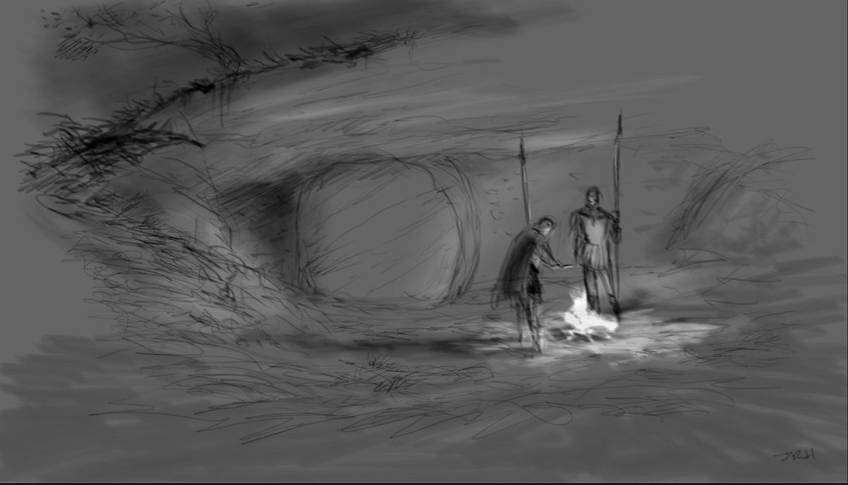
Before He Arose

Slide 2
Did God turn His back on Jesus?
Notes:
Did God forsake Jesus
Does God have a back to turn?
Is there a bible example of God turning His back on anyone?
There is not one time in the scripture that says God turned His back on anything!
Deut 31:17-18 I will forsake them and turn my face from them
Joshua 24:20 – God will do harm after He has done good
Make His Face Shine on you. Num. 6:22-27; Psalm 80:3

Slide 3
Before He Arose…
Where was Jesus when His body was in the grave?
Jesus was being tormented in hell
Jesus must receive the punishment for sin to pay for sin
Jesus went to hell to preach to those who did not have a chance to hear the gospel in their life

Slide 4
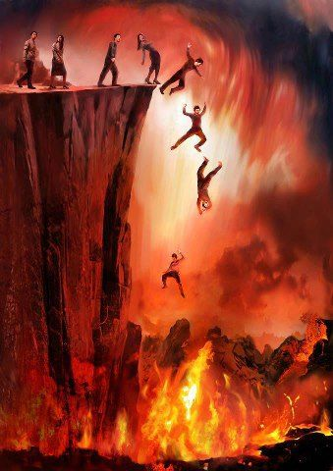
Hell – Rev. 19:20; 21:8
Ghenna – Mark 9:38
Hades GRK; Sheol HBRW
Luke 16:22-23
Torment & Abrahams Bosom
After You Die

Slide 5
Acts 2:30-31
Luke 23:43
Before He Arose

Slide 6
Did Jesus Preach In Hades
1 Peter 3:19, 4:6; Phil. 2:10; Eph. 4:9; Rom 10:6-7

Slide 7
Spiritual War & War In Heaven

