Slide 1
The Significance of

Slide 2
FAITH IS VICTORY
1 John 5:4 Faith overcomes the world
Romans 3:28 Justified by faith
Galatians 3:26 Sons of God by faith
Ephesians 2:8 Saved by faith
John 6:47 If you believe you have eternal life
Romans 5:1 Peace with God through faith
Romans 8:1 No condemnation in Christ
1Peter 1:7 More Precious than gold
Galatians 3:22 Promise given to believers
Ephesians 1:18-19 God’s inheritance

Slide 3
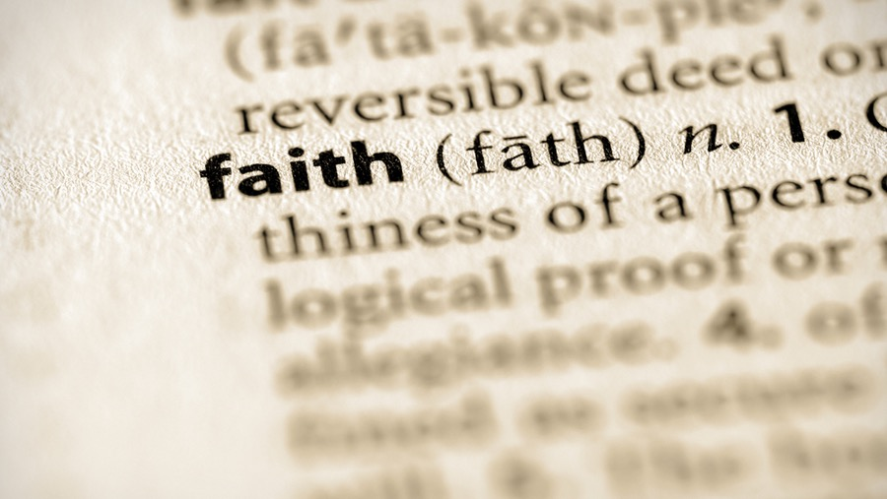
Believe • Trust God • Fear God • Humble before God

Slide 4
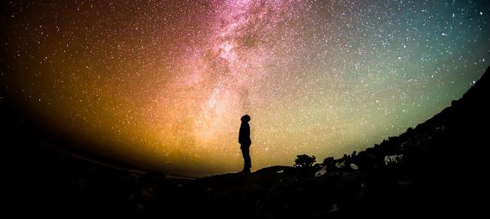
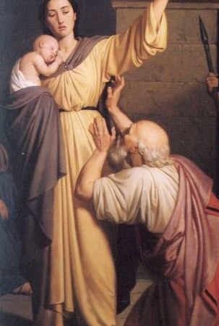
Faith Believes God
Faith Follows Jesus

Slide 5
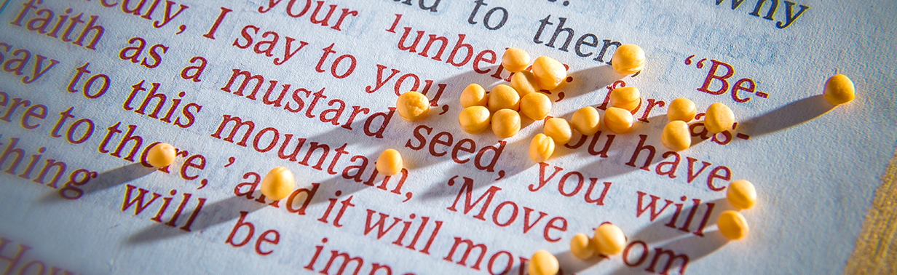
Faith Is Not Idle
James 2:17, 24 Faith by itself is dead
2 Peter 1:5 In your faith supply
Matthew 17:20-21 Faith grows

Slide 6
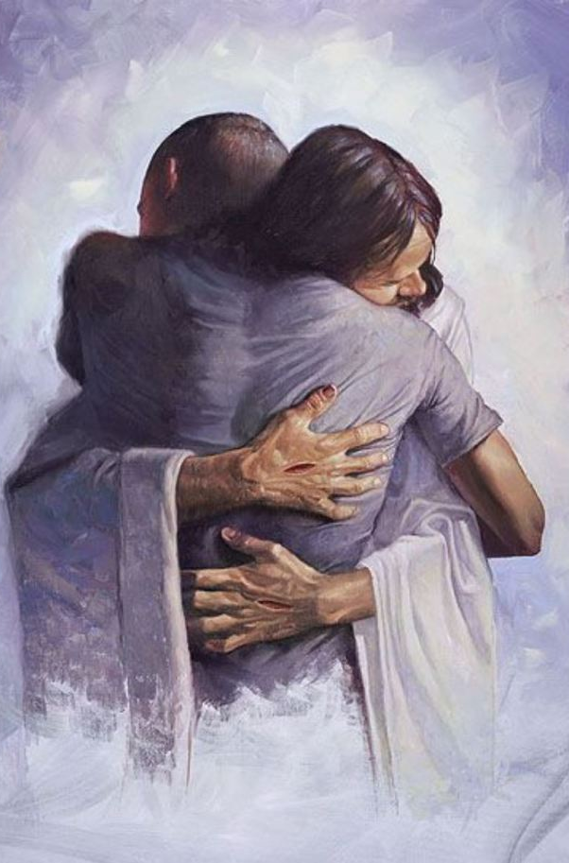
Faith Loves God Without Limits
John 12:3 Mary then took a pound of very costly perfume of pure nard, and anointed the feet of Jesus and wiped His feet with her hair; and the house was filled with the fragrance of the perfume.
300 Denarii for the perfume
Poured it all on Jesus feet
Wiped Jesus feet with her hair
Matthew 26:13

Slide 7
Faith Decreases You
Greater
Than
John 3:30 He must increase but I must decrease
Galatians 2:20 Yet not I but Christ lives in me

Slide 8
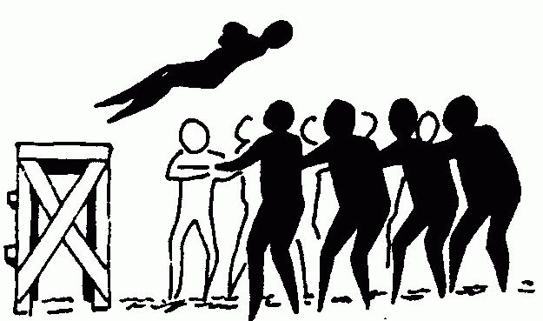
Faith Trusts God

Slide 9
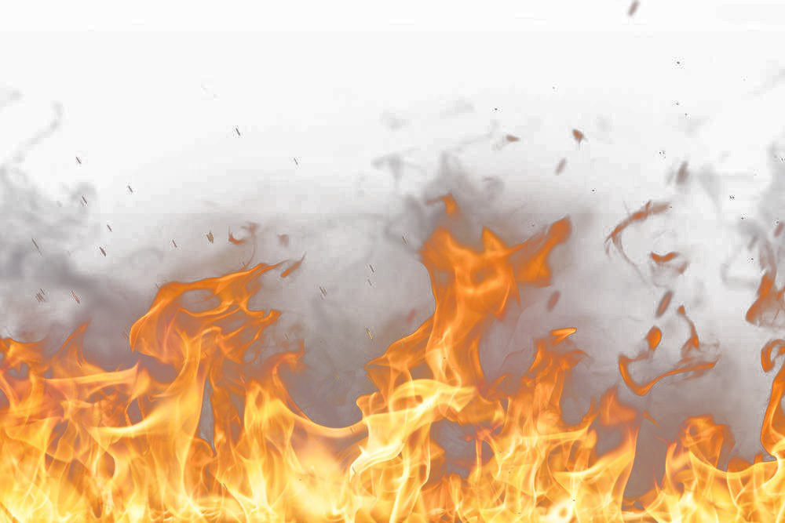
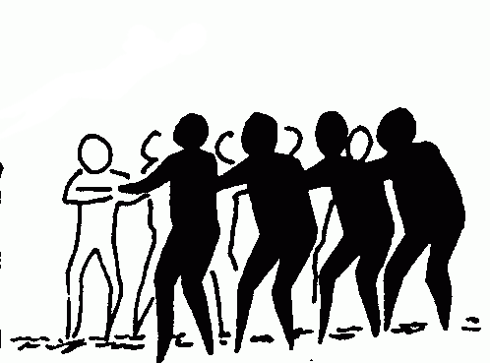
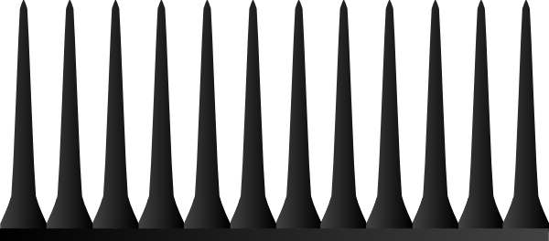
Faith Trusts God
Psalm 56:3-4 What can man do to me?
Mark 14:33-36 Not what I will but what you will
There would be no sense in saying you trusted a person if you would not take His advice - CS Lewis
How do we decide? ✭✭✭✭✭

Slide 10
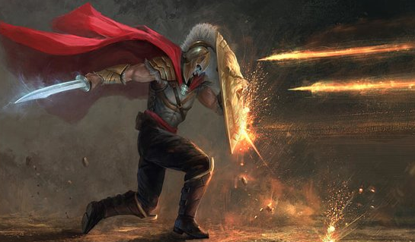
Faith Protects You
Greater
Than
Ephesians 6:16
in addition to all, taking up the shield of faith with which you will be able to extinguish all the flaming arrows of the evil one.
Notes:
Just because we are not threatened by persecution does not mean Satan has taken a vacation in his efforts to destroy the church.
The only thing necessary for the triumph of evil is for good men to do nothing.”― Edmund Burke (in a letter addressed to Thomas Mercer).

Slide 11
The Significance of
Faith is the basis for our salvation, and the first step in following Christ into eternity.

