Slide 1
The Significance of

Slide 2
FAITH IS VICTORY
1 John 5:4 Faith overcomes the world
Romans 3:28 Justified by faith
Galatians 3:26 Sons of God by faith
Ephesians 2:8 Saved by faith
John 6:47 If you believe you have eternal life
Romans 5:1 Peace with God through faith
Romans 8:1 No condemnation in Christ
1Peter 1:7 More Precious than gold
Galatians 3:22 Promise given to believers
Ephesians 1:18-19 God’s inheritance

Slide 3
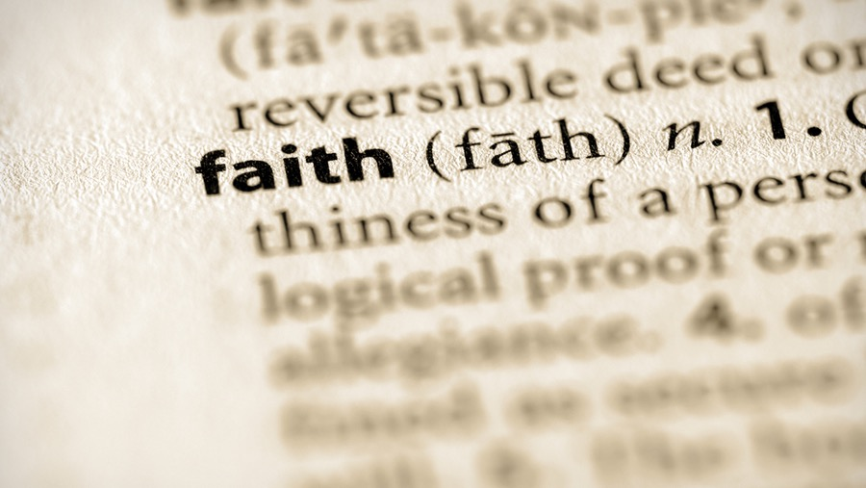
Believe – whoever believes in Him shall not perish Jn. 3:16
Trust God – in God I put my trust… what can man do Ps. 56:4
Fear God – Now I know you fear God Gen. 22:12
Humble before God – Humble, Contrite, Tremble Isaiah 66:2
Hebrews 11:1-3 • Philippians 3:8-11 • James 2:17, 24
Exodus 9:20-21

Slide 4
Faith Believes God
Hebrew 11:6 God is a rewarder
Romans 4:18-22 God can keep His promises
Good things & Bad Things
John 8:23-24 There is something worse than death

Slide 5
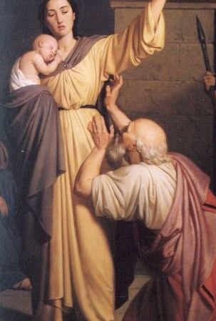
Faith Follows Jesus
Luke 14:26-35 Follow Jesus
Count the cost and don’t count the cost
2 Timothy 4:7 I have kept the faith
Philippians 3:8-11 All things but loss

Slide 6
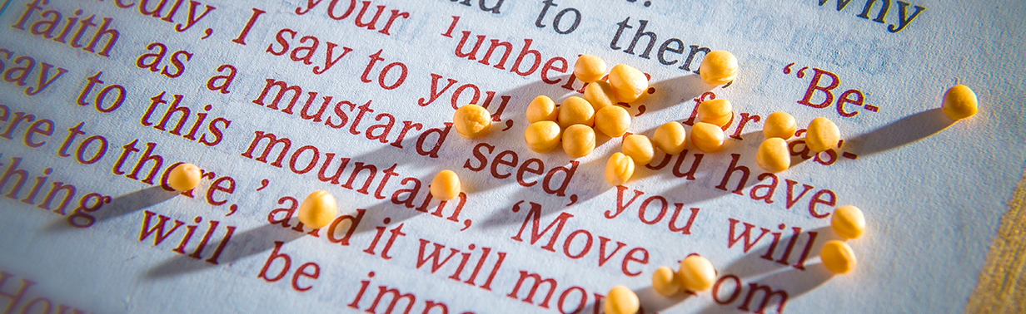
Faith Is Not Idle
James 2:17, 24 Faith by itself is dead
2 Peter 1:5 In your faith supply
Matthew 17:20-21 Faith grows

Slide 7
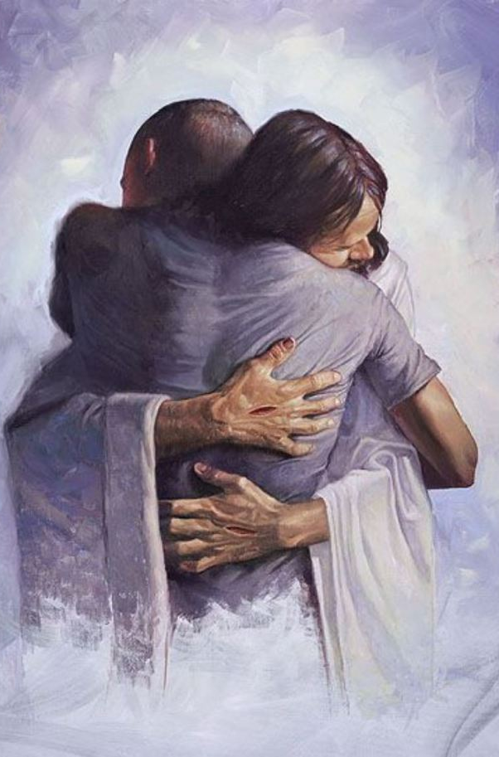
Faith Loves God Without Limits
John 12:3 Mary then took a pound of very costly perfume of pure nard, and anointed the feet of Jesus and wiped His feet with her hair; and the house was filled with the fragrance of the perfume.
300 Denarii for the perfume
Poured it all on Jesus feet
Wiped Jesus feet with her hair
Matthew 26:13

Slide 8
The Significance of
Faith is the basis for our salvation, and the first step in following Christ into eternity.

