Slide 1
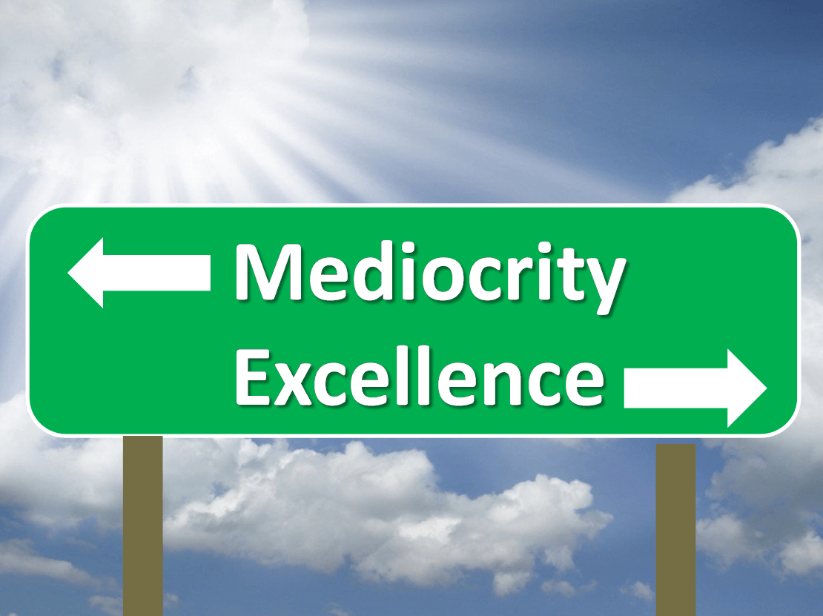
Settling for Mediocrity
Notes:
You feel like you have to settle for what life has given you.
Personally, I have struggled with this my entire life off and on.
Goal is to examine why we might settle for mediocrity in the way we serve God in this life. Why do we feel like where I’m at is good enough or all I’m ever going to achieve?

Slide 2
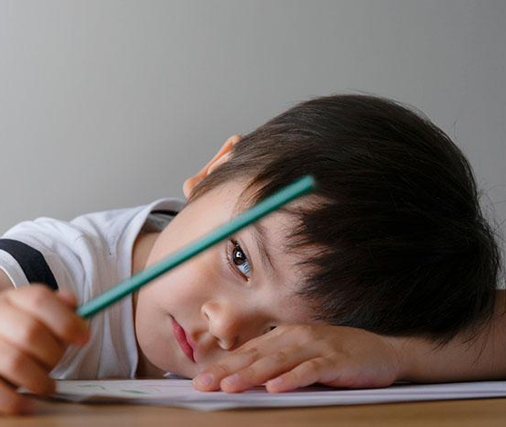
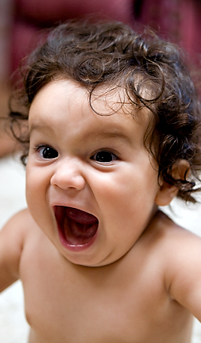
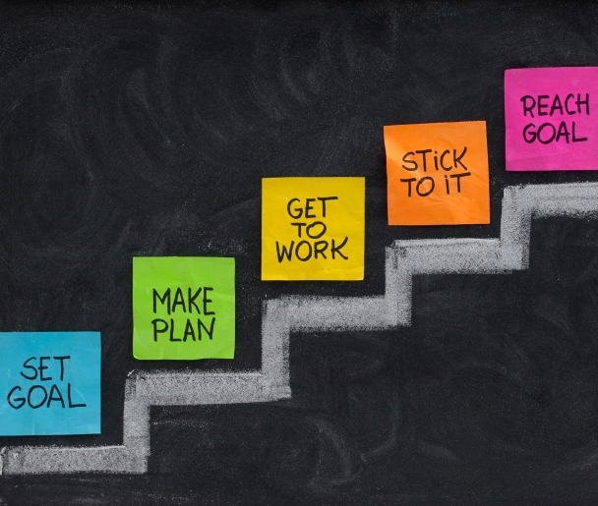

Slide 3
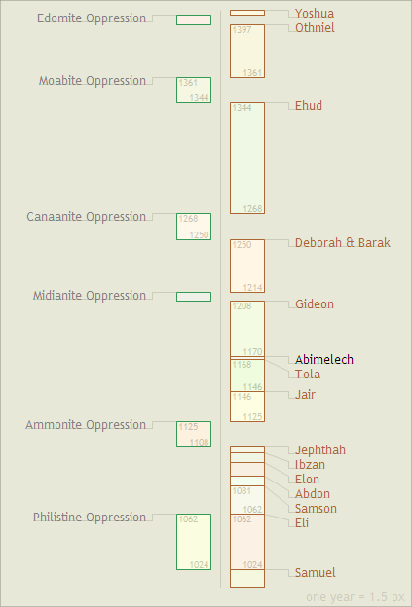

Slide 4
1) We get stuck and stay the course
Settling for Mediocrity

Slide 5
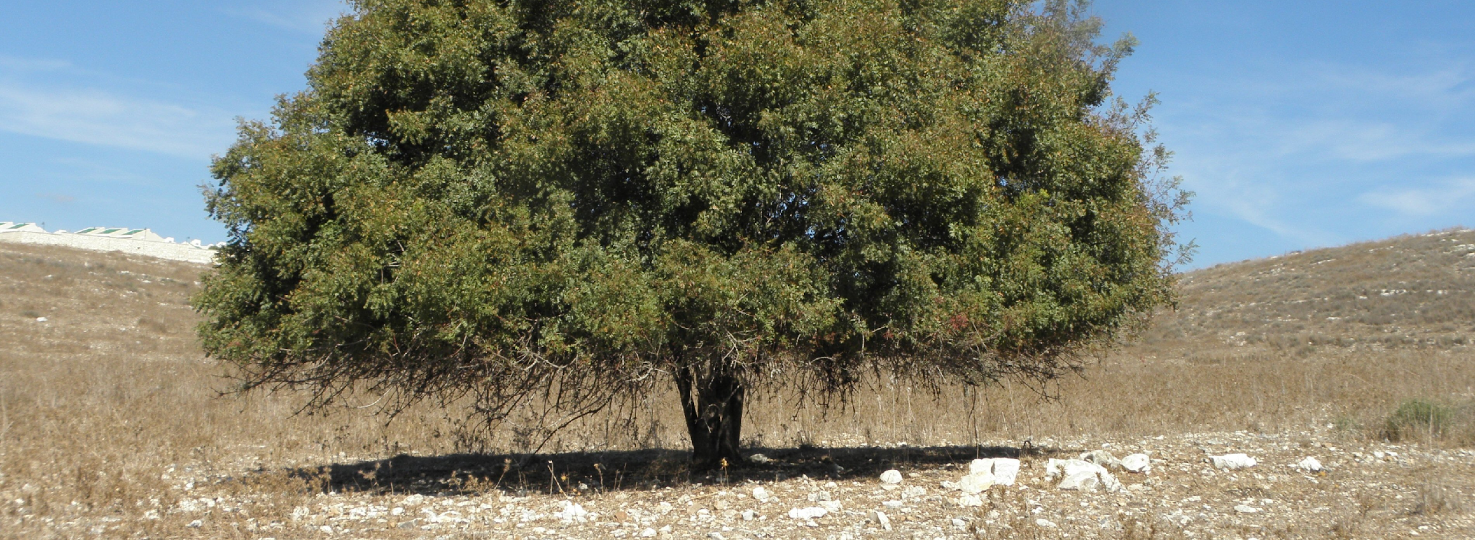
~ Judges 6:11, ESV
11 Now the angel of the Lord came and sat under the terebinth at Ophrah, which belonged to Joash the Abiezrite, while his son Gideon was beating out wheat in the winepress to hide it from the Midianites.

Slide 7
~ 1 Corinthians 4.3-4
3 But with me it is a very small thing that I should be judged by you or by any human court. In fact, I do not even judge myself. 4 For I am not aware of anything against myself, but I am not thereby acquitted. It is the Lord who judges me.

Slide 8
~ Galatians 6.9
9 And let us not grow weary of doing good, for in due season we will reap, if we do not give up.

Slide 9
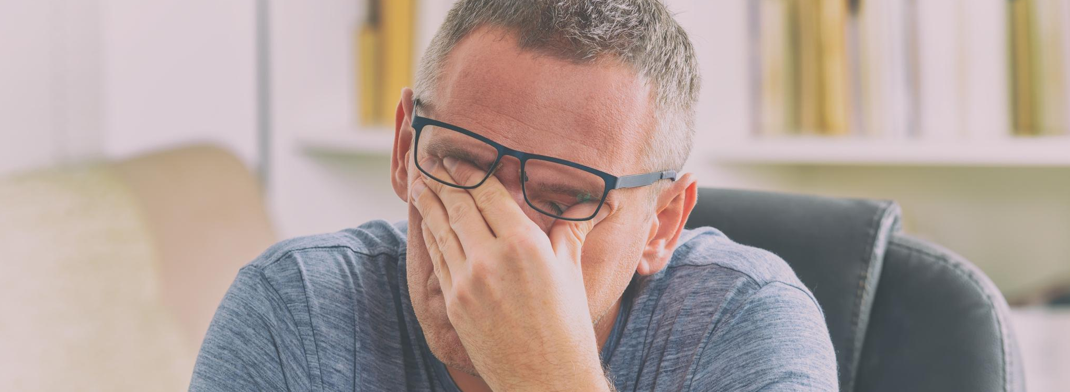
~ 2 Thessalonians 3.13
13 As for you, brothers, do not grow weary in doing good.

Slide 10
~ 1 Thessalonians 4.1
1 Finally, then, brothers, we ask and urge you in the Lord Jesus, that as you received from us how you ought to walk and to please God, just as you are doing, that you do so more and more.

Slide 11
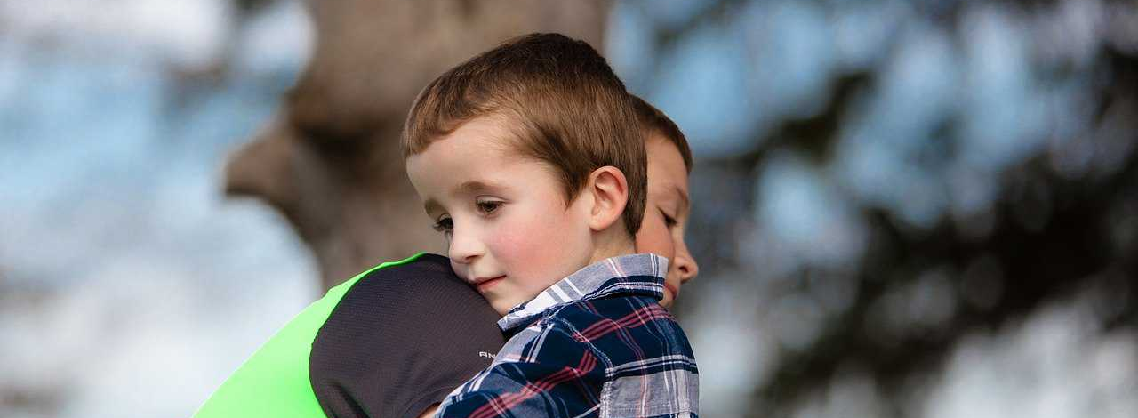
~ 1 Thessalonians 4.10
10 for that indeed is what you are doing to all the brothers throughout Macedonia. But we urge you, brothers, to do this more and more,

Slide 12
~ Revelation 3.14-18
17 For you say, I am rich, I have prospered, and I need nothing, not realizing that you are wretched, pitiable, poor, blind, and naked.

Slide 13
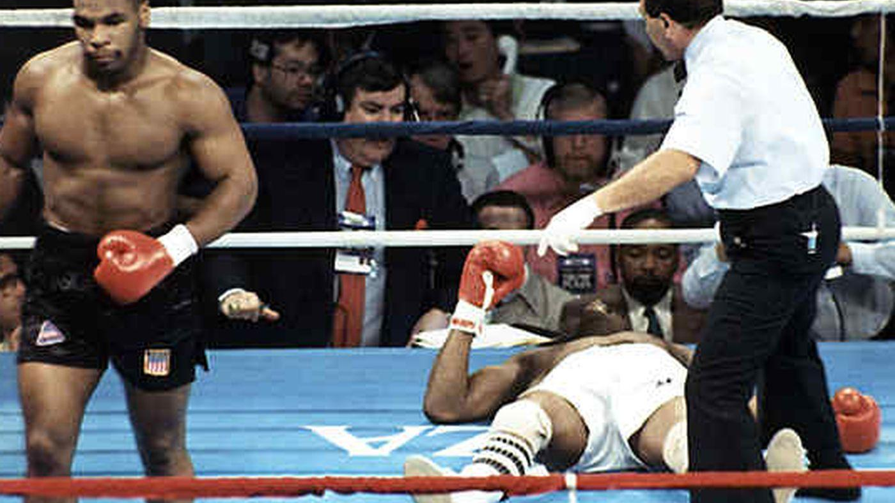
16 for the righteous falls seven times and rises again, …
~ Proverbs 24:16

Slide 14
1) We get stuck and stay the course
We believe in judgements from others and ourselves
We get tired and weary
We forget we can go faster – excel more and more
We have no problems on the outside, so the inside must be good as well.
Settling for Mediocrity

Slide 15
2) We don’t see our true potential
Settling for Mediocrity

Slide 16
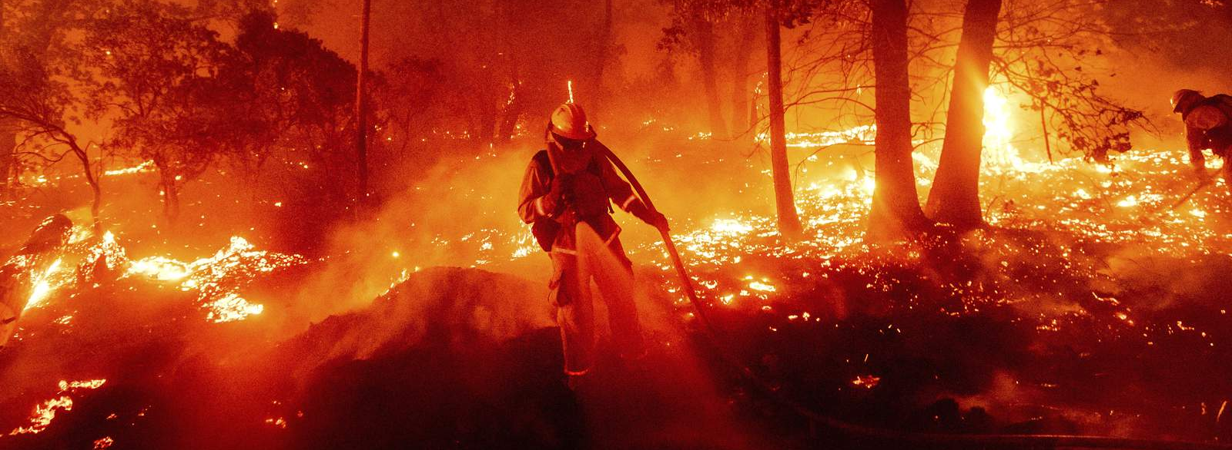
~ Judges 6.12
12 And the angel of the LORD appeared to him and said to him, “The LORD is with you, O mighty man of valor.”

Slide 17
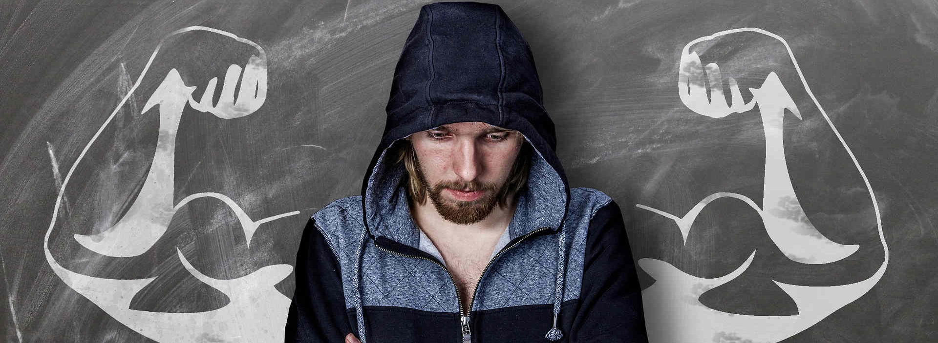
~ Judges 6.14-16
14 And the LORD turned to him and said, “Go in this might of yours and save Israel from the hand of Midian; do not I send you?” 15 And he said to him, “Please, Lord, how can I save Israel? Behold, my clan is the weakest in Manasseh, and I am the least in my father’s house.” 16 And the LORD said to him, “But I will be with you, and you shall strike the Midianites as one man.”

Slide 18
~ Psalm 139.13-15
13 For you formed my inward parts; you knitted me together in my mother’s womb. 14 I praise you, for I am fearfully and wonderfully made. Wonderful are your works; my soul knows it very well. 15 My frame was not hidden from you, when I was being made in secret, intricately woven in the depths of the earth.

Slide 19
~ Genesis 1.31
31 And God saw everything that he had made, and behold, it was very good. And there was evening and there was morning, the sixth day.

Slide 20
~ Psalm 139.16
16 Your eyes saw my unformed substance; in your book were written every one of them, the days that were form for me, when as yet there was none of them.

Slide 21
Our Potential
(-)
(+)
Us
God
“Weakest in Manasseh”
“Least in my father’s house”
“O mighty man of valor”
“Go in this might of yours”

Slide 22
2) We don’t see our true potential
God has confidence in us
Watched us as we were being formed
Created everything good
Knew our substance (personality, mind, gifts, talents, and dreams)
Placed us in time, family, country
Settling for Mediocrity

Slide 23
3) We rely on our own understanding
Settling for Mediocrity

Slide 24
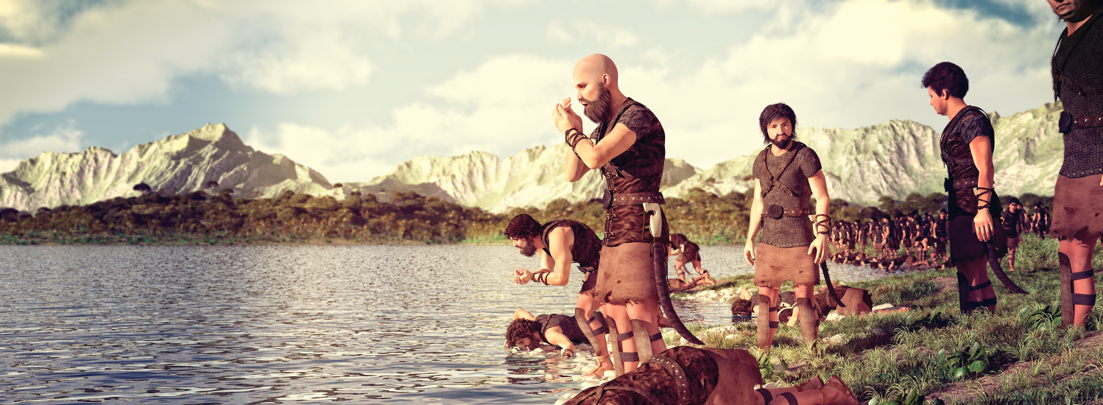
~ Judges 7.10
10 But if you are afraid to go down, go down to the camp with Purah your servant.

Slide 25
~ Proverbs 3.5-6
5 Trust in the LORD with all your heart, and do not lean on your own understanding. 6 In all your ways acknowledge him, and he will make straight your paths.

Slide 26
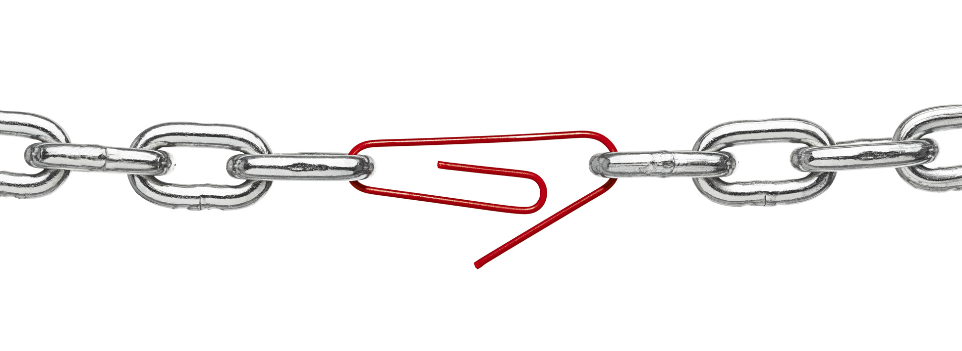
~ 1 Corinthians 1.25
25 For the foolishness of God is wiser than men, and the weakness of God is stronger than men.

Slide 27
~ 1 Corinthians 13.12
12 For now we see in a mirror dimly, but then face to face. Now I know in part; then I shall know fully, even as I have been fully known.

Slide 28
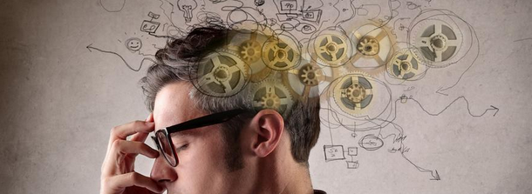
~ Isaiah 55.8-9
8 For my thoughts are not your thoughts, neither are your ways my ways, declares the LORD. 9 For as the heavens are higher than the earth, so are my ways higher than your ways and my thoughts than your thoughts.

Slide 29
3) We rely on our own understanding
Trust in the Lord and don’t draw conclusions
Smartest person is a fool compared to God
We don’t understand what God has in store
Gods ways and thoughts are different than ours
Settling for Mediocrity

Slide 30
~ Judges 8.28
28 So Midian was subdued before the people of Israel, and they raised their heads no more. And the land had rest forty years in the days of Gideon.

Slide 31
Think, Write, Pray, Talk
What does God want from me in this life?
What should I be doing to serve You in the fullest possible way?
What am I afraid of doing?
How are you going to protect me when I’m scared?
What is my full potential?
What purpose did you have for me?
What talent and gifts did you give me?
How can you help me discover my gifts and talents?
How do I rely on your understanding and not my own?
Settling for Mediocrity

