Slide 1
What are you willing to do?
Hebrews 10:34-39

Slide 2
Pandemic Response
Close a business
Interrupt church services
Change how we buy food (wash groceries)
Learn to do online classes
Cancel vacations
Cancel planned sporting and social events
Change routines of life

Slide 3
Pandemic Response
Search for information and try to educate others of risks and prevention
Have uncomfortable or confrontational conversations
Pray more
Avoid exposure at the cost of fun or comfort
Change personal interactions
Be outspoken on social media
Accept change, discomfort, learning

Slide 4
Pandemic Response
Emphasize “what is the loving thing to do”
Flatten the curve
Eat out less
Stay home with children
Cancel medical proceedures
Take children out of school
Contemplate the well being of people you know and reach out to them

Slide 5
Pandemic Response
How many conversations have you had about this?
Have you corrected someone for poor practices?
Have you made sure your family knows basic prevention?
Have you said “I’m not worried but I don’t want to spread it to others”
Can people tell if you take it seriously

Slide 6
The Pandemic Of Sin
Romans 3:23
for all have sinned and fall short of the glory of God,
Romans 3:10–12
as it is written, “There is none righteous, not even one; There is none who understands, There is none who seeks for God; All have turned aside, together they have become useless; There is none who does good, There is not even one.”
Notes:
We have already decided what you are willing to do in response to a pandemic.
What will you do to help save the souls of others?
Genesis 2:16–17
The Lord God commanded the man, saying, “From any tree of the garden you may eat freely; but from the tree of the knowledge of good and evil you shall not eat, for in the day that you eat from it you will surely die.”

Slide 7
Being God’s Servant
Isaiah 20
Jeremiah 12:5-6
Hosea 1:2
Ezekiel 4:4-5
Matthew 11:11
Hebrews 10:32-39
Notes:
Isaiah was called to preach in 742 BC
The year is currently 721 BC
After 20 years of preaching to a people who won’t listen the word of the Lord comes to Isaiah to give him a three year assignment.
Hosea 1:2
When the Lord first spoke through Hosea, the Lord said to Hosea, “Go, take to yourself a wife of harlotry and have children of harlotry; for the land commits flagrant harlotry, forsaking the Lord.”
Ezekiel 4:4–5
“As for you, lie down on your left side and lay the iniquity of the house of Israel on it; you shall bear their iniquity for the number of days that you lie on it. “For I have assigned you a number of days corresponding to the years of their iniquity, three hundred and ninety days; thus you shall bear the iniquity of the house of Israel.
Matthew 11:11
“Truly I say to you, among those born of women there has not arisen anyone greater than John the Baptist! Yet the one who is least in the kingdom of heaven is greater than he.

Slide 8
Lift Up Your Life
John 4:35
Behold, I say to you, lift up your eyes and look on the fields, that they are white for harvest.
Notes:
Use it for something greater
Give it to God for His purpose
Rise to the calling of God

Slide 9
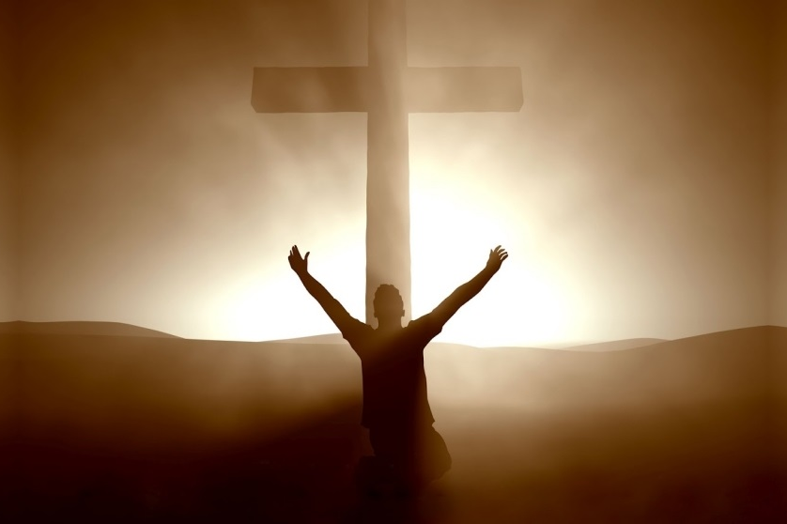
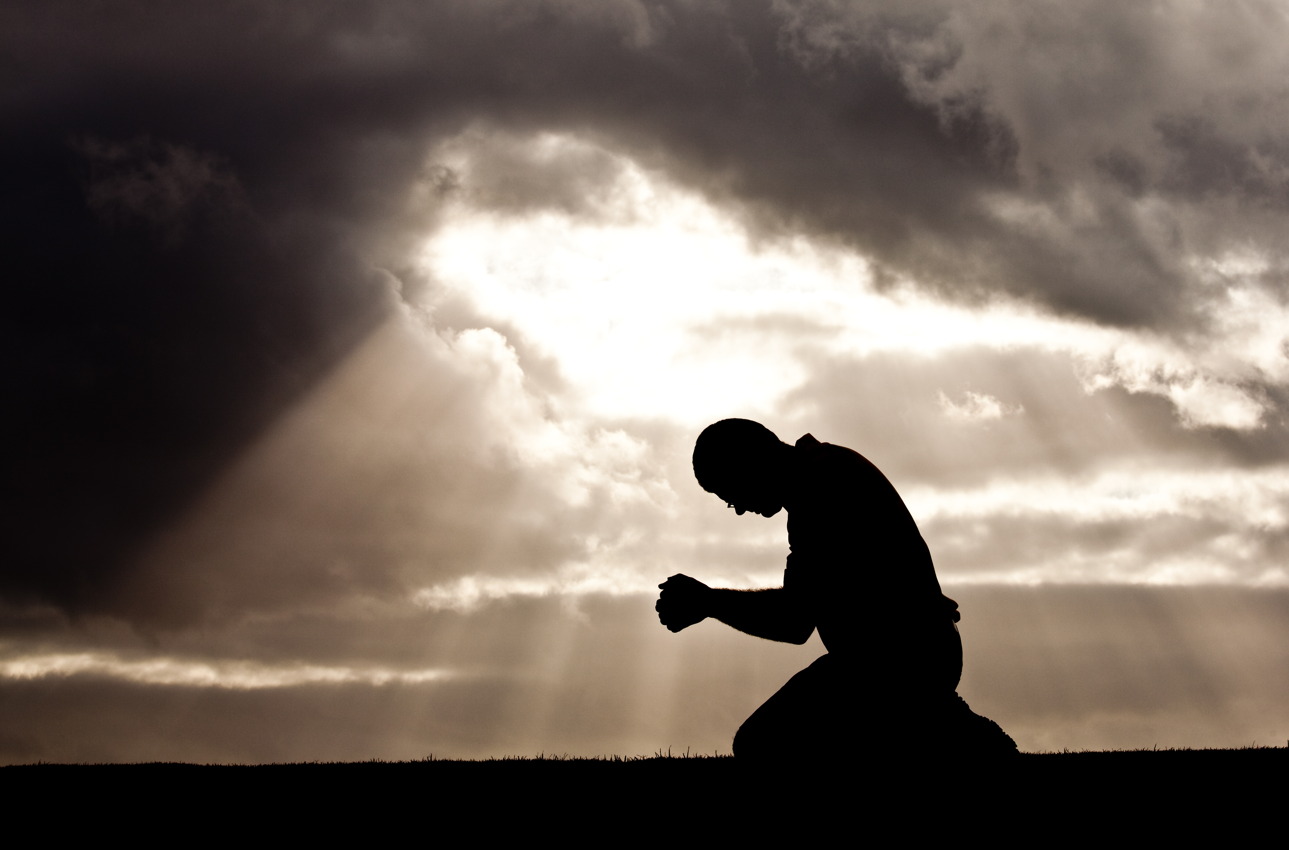
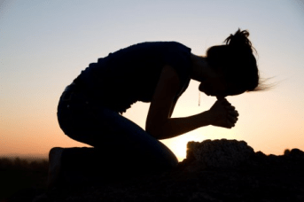
Lift Up Your Life
2 Corinthians 8:9 He became poor
1 Peter 3:18 the just for the unjust
1 Peter 2:22-24 Healed by His wound
Colossians 3:1–3 Therefore if you have been raised up with Christ, keep seeking the things above, where Christ is, seated at the right hand of God. Set your mind on the things above, not on the things that are on earth. For you have died and your life is hidden with Christ in God.
Notes:
Use it for something greater
Give it to God for His purpose
Rise to the calling of God

Slide 10
Will you do for the soul what you have done for the body?
Notes:
Will you do for the body of Christ what you have done for the body of flesh?

