Slide 1
Preparing To Teach
PowerPoint Illustration Class Management

Slide 2
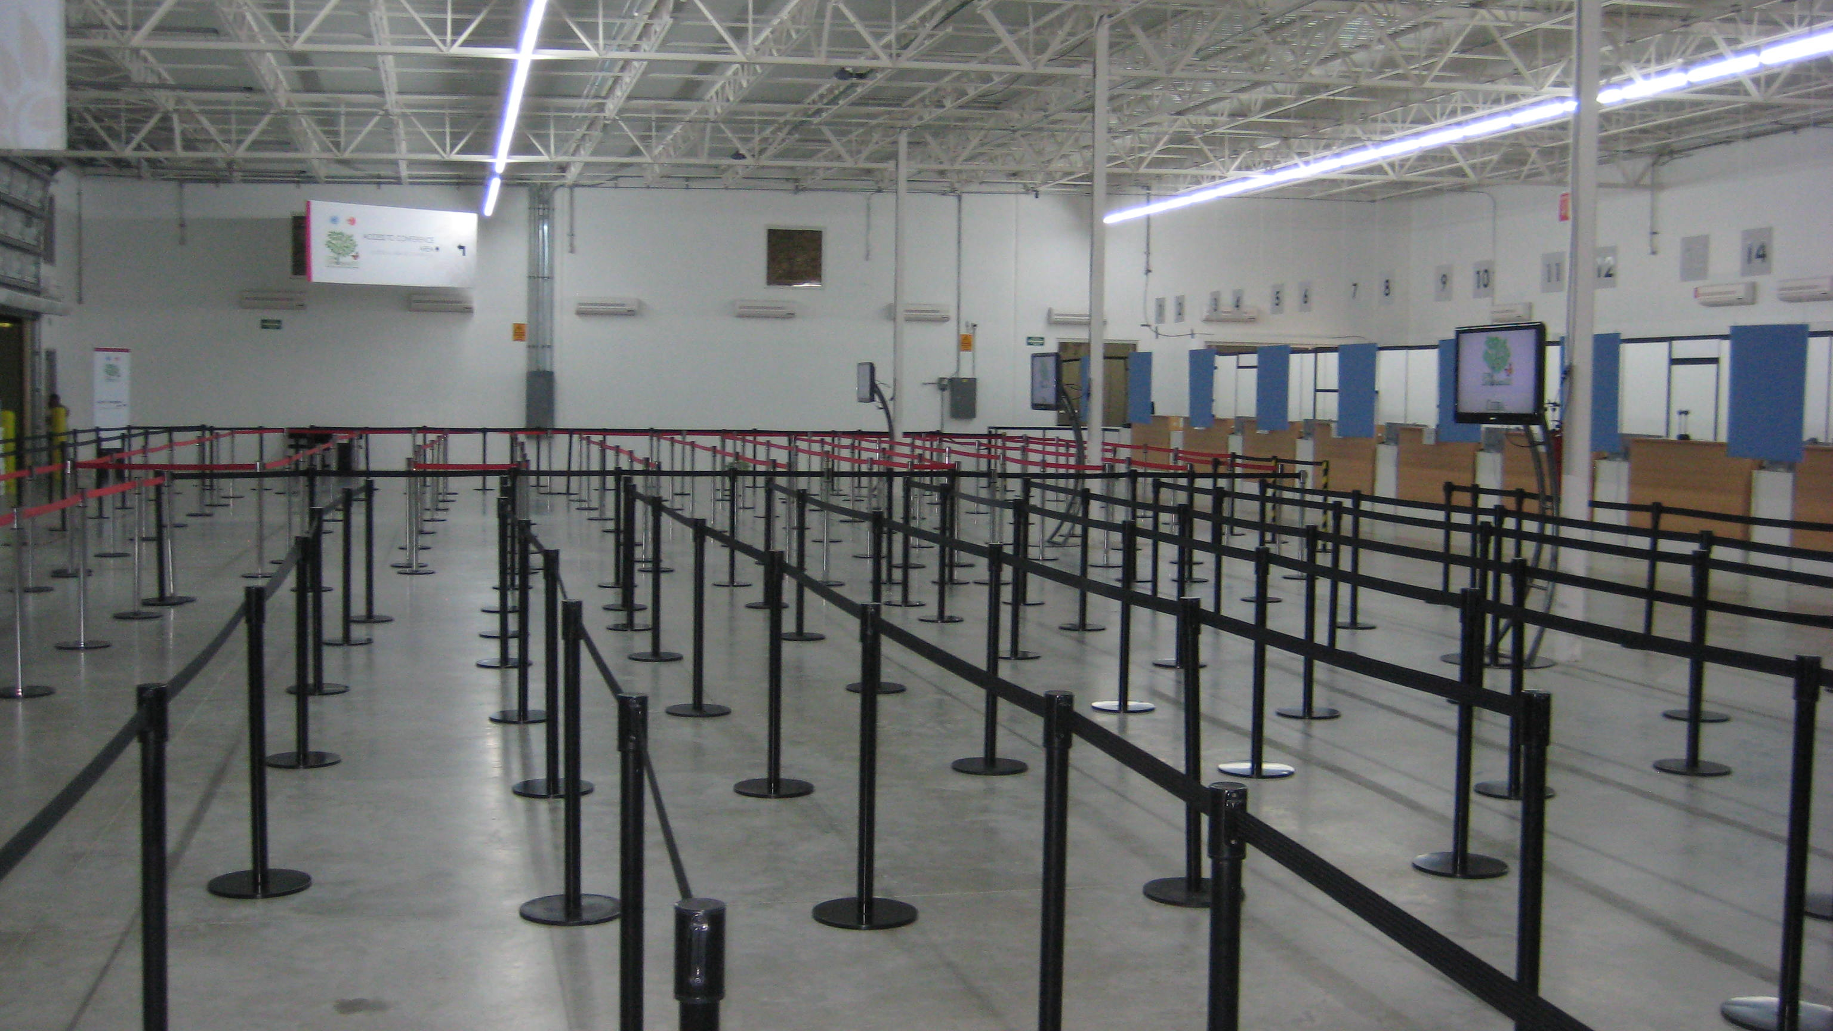
Guidelines

Slide 3
Class Management
1 Corinthians 14:40 But all things must be done properly and in an orderly manner.
It is ok if you don’t know something.
Mirroring – taking a similar tone and disposition as the person commenting
Class Problems Oversharing, Controversy, Out of line
Taking Control of the Class.

Slide 4
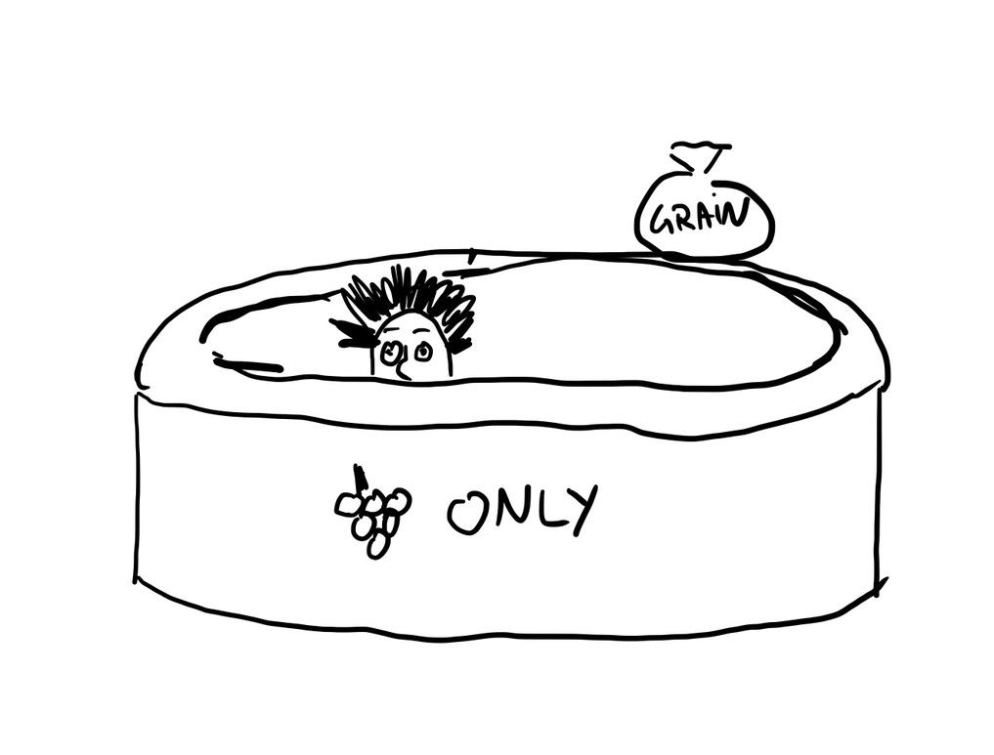
Illustration
An effective illustration will add color, understanding, and be remembered.
On offensive illustration will never be forgotten
Notes:
I know a preacher who put a photo of people on a roller coaster on his slideshow. He didn’t look closely at the photo and it turns out that it was a roller coaster of topless women. He put it on the projector in a sermon before someone else realized what he was showing to the congregation.

Slide 5
Don’t discredit your bible teaching by using fake or false illustrations.

Slide 6
Cliché
Jargon
Stereotypes
People will fill in their own meaning instead of hearing you.
Only the initiated will understand. Leaves people behind.
The exceptions will not go along with you.

Slide 7
Personal Illustrations
You
Scars NOT Wounds
Get Permission
Others

Slide 8
Vulgar language – don’t use or allude to vulgar, crass, or other inappropriate terms or sayings
Beware of movie quotes
Don’t use terms that will offend or detract from your message. Controversial, political, hot-button, church problems, personal grievance

Slide 9
Formatting A Presentation
Two Fonts
< 32 Pt
16:9 Wide High Contrast
Color Theme
Matching Colors
Sports Teams & Logos
Don’t Use Templates
NO Transitions
Limit Animation

Slide 10
Formatting A Presentation
Two Fonts
< 32 Pt
16:9 Wide High Contrast
Color Theme
Matching Colors
Sports Teams & Logos
Don’t Use Templates
NO Transitions
Limit Animation

