Slide 1
Men’s Training
Preparing Your Presentation

Slide 2
How will you present the material you have discovered during your research?

Slide 3
What tone or feeling do you want to present your material in?

Slide 4
Warning!
The Tone Of A Sermon Changes The Message
Notes:
You might do all the work it takes to teach the word of God and if you teach in the wrong tone your sermon will fall on def ears

Slide 5
Outline
Title:
Scripture:
Thesis:
Introduction:
1.
2.
3.
Conclusion:
Thesis:
1. Main Topic 1 – related to thesis
a. Related to main topic 1
i. addition to RLM1
ii. addition to RLM1
b. Related to main topic 1
2. Main Topic 2
Notes:
You might do all the work it takes to teach the word of God and if you teach in the wrong tone your sermon will fall on def ears

Slide 6
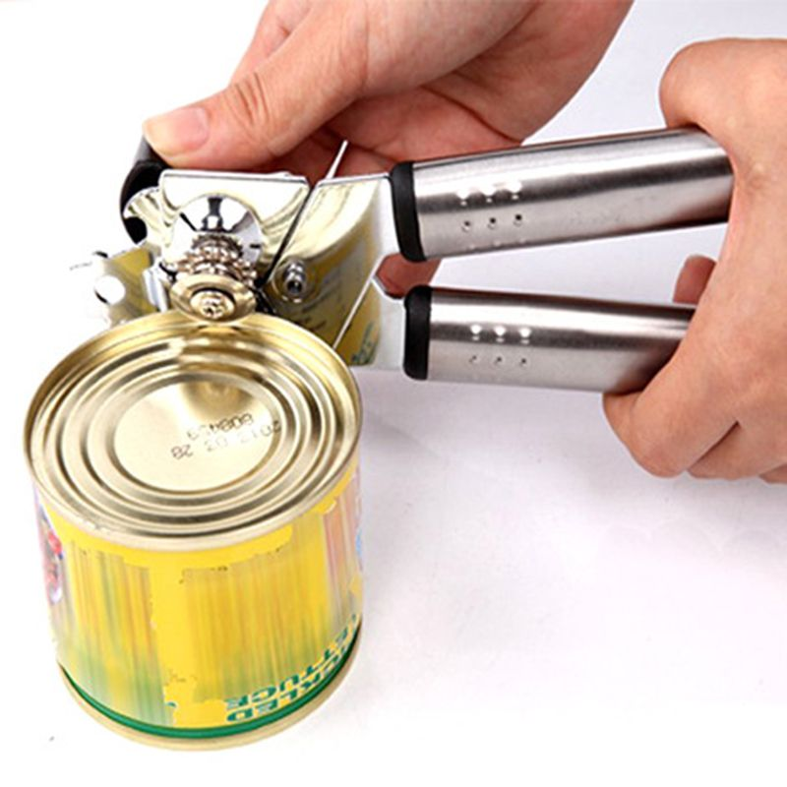
Outline
Thesis: You can open a sealed can with a can opener
1. The problems with sealed cans
a. They are made of metal
b. If you try to cut them open with normal tools it makes a mess
i. Saws-all – splatter mess
ii. Knife - slow
2. A can opener is made to open cans
a. It cuts metal clean and fast
b. Uses design of can to its advantage
Question: How do I open sealed cans?
Answer: With a can opener
Notes:
You might do all the work it takes to teach the word of God and if you teach in the wrong tone your sermon will fall on def ears

Slide 7
Why do I need to know this?
So What?
What difference does this make?
Application
Your telling me this because…
Who Cares?
Why are you telling me this?

