Slide 1
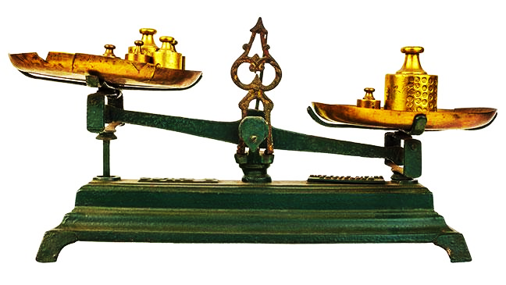
God’s Standard In the Home
Deuteronomy 6:5-9, 12

Slide 2
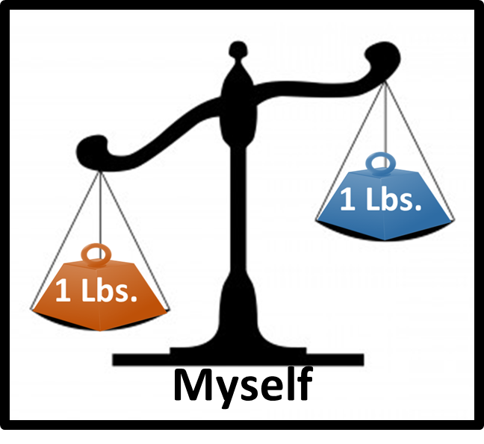
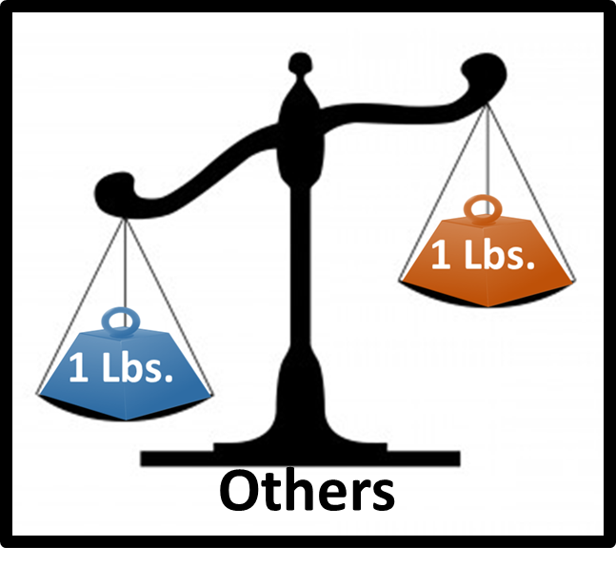
Where there is a double standard love cannot exist.

Slide 3
Bureau Of Weights & Measures
It is illegal and punishable by law…
Possess an incorrect weight or any device or instrument used to or calculated to falsify any weight or measure
Sell anything with “less the quantity he represents”
As a buyer to take more than the quantity he represents when providing the means of measure
Notes:
It is unjust to possess and use or misrepresent weights and measures.
Benefiting yourself at the expense of others or you are benefiting others at the expense of yourself in a dishonest way

Slide 4
Deuteronomy 25:13–14
13 “You shall not have in your bag differing weights, a large and a small.
14 “You shall not have in your house differing measures, a large and a small..
Notes:
Deuteronomy 25:15
“You shall have a full and just weight; you shall have a full and just measure, that your days may be prolonged in the land which the Lord your God gives you.

Slide 5
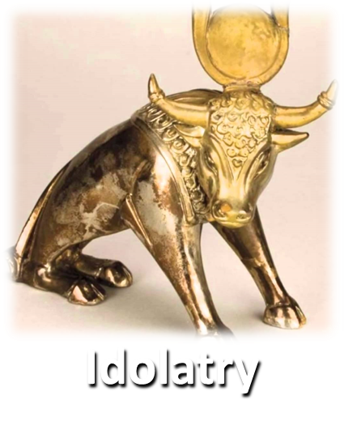
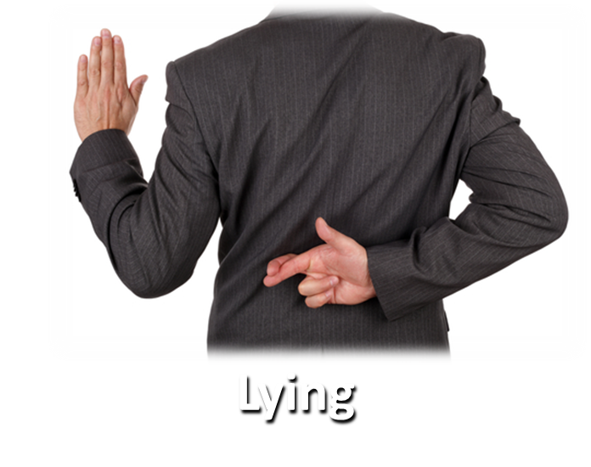
God’s Standard of Measure
Deuteronomy 25:16
16 “For everyone who does these things, everyone who acts unjustly is an abomination to the LORD your God.
Deuteronomy 7:25-26, 12:31 • Proverbs 12:22 • Ezekiel 8:12

Slide 6
God’s Standard of Measure
Genesis 18:19 God’s Way
Luke 10:27 God’s Law
Matthew 7:12 (1-6)
Love

Slide 7
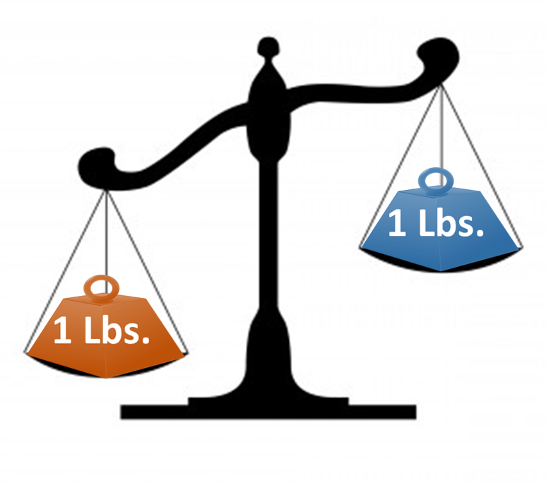
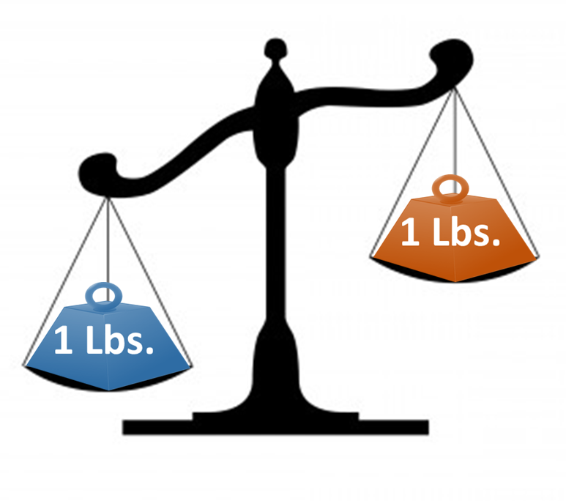
Jesus Defines the Standard
Matthew 7:1-6
Myself
Others
Deut. 25:13 Large and Small Weight
Matthew 7:1-2 Benefits you at the expense of others
Matthew 23:1-4 Unwilling to lift what I bind to others
Notes:
The weight for me is read because it benefits me at that expense of others

Slide 8
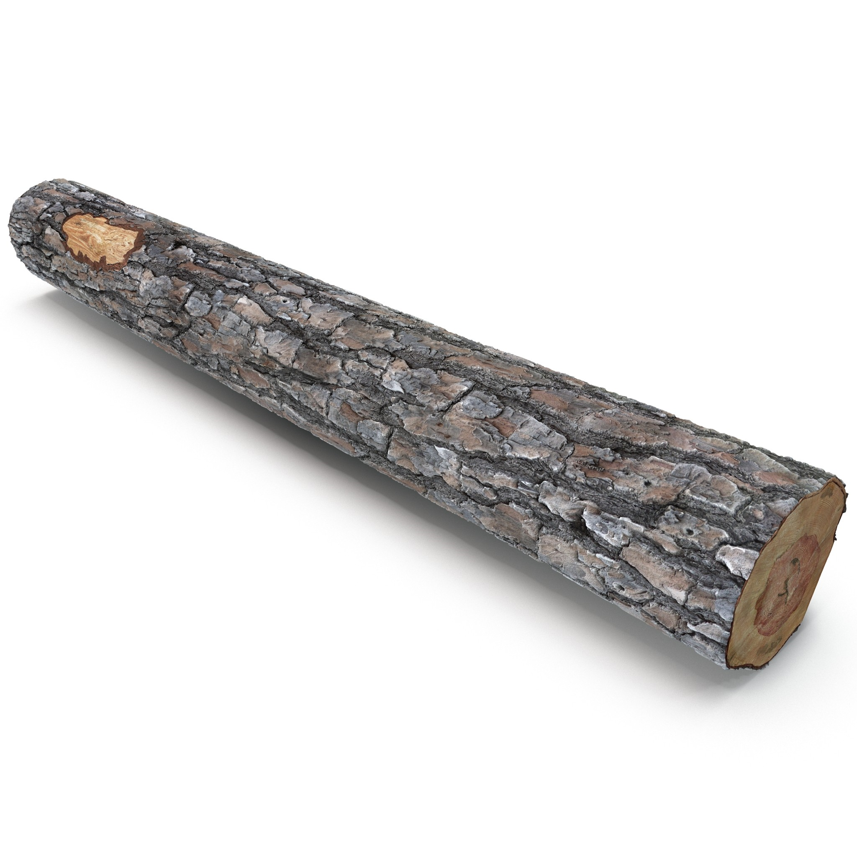
Logs, Hogs, Specks & Dogs
Matthew 7:1-6
Matthew 7:12 “In everything, therefore, treat people the same way you want them to treat you, for this is the Law and the Prophets.

Slide 9
If you have a false standard to benefit yourself over others it is unloving
If you have a false standard to benefit others over yourself it is unloving

Slide 10
Where there is a double standard love cannot exist.

