Slide 1
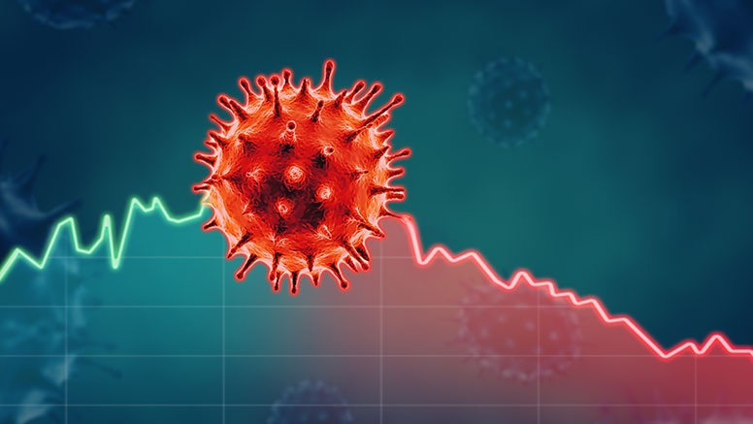
Loving Your Neighbor
-during a pandemic-

Slide 2
Healing The Sick
What role did healing the sick take in the ministry of Jesus and the apostles?
Matthew 9:35-36 • Matthew 14:13-17 • Acts 5:14-16 • Acts 11:12
Matthew 25:34-36

Slide 3
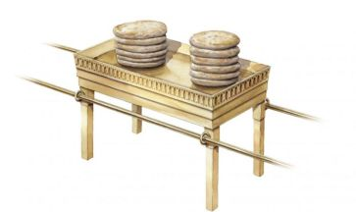
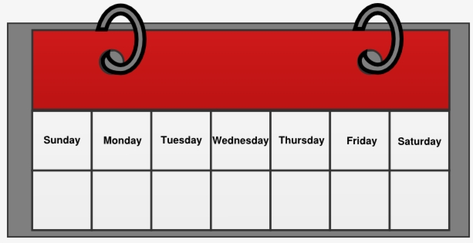
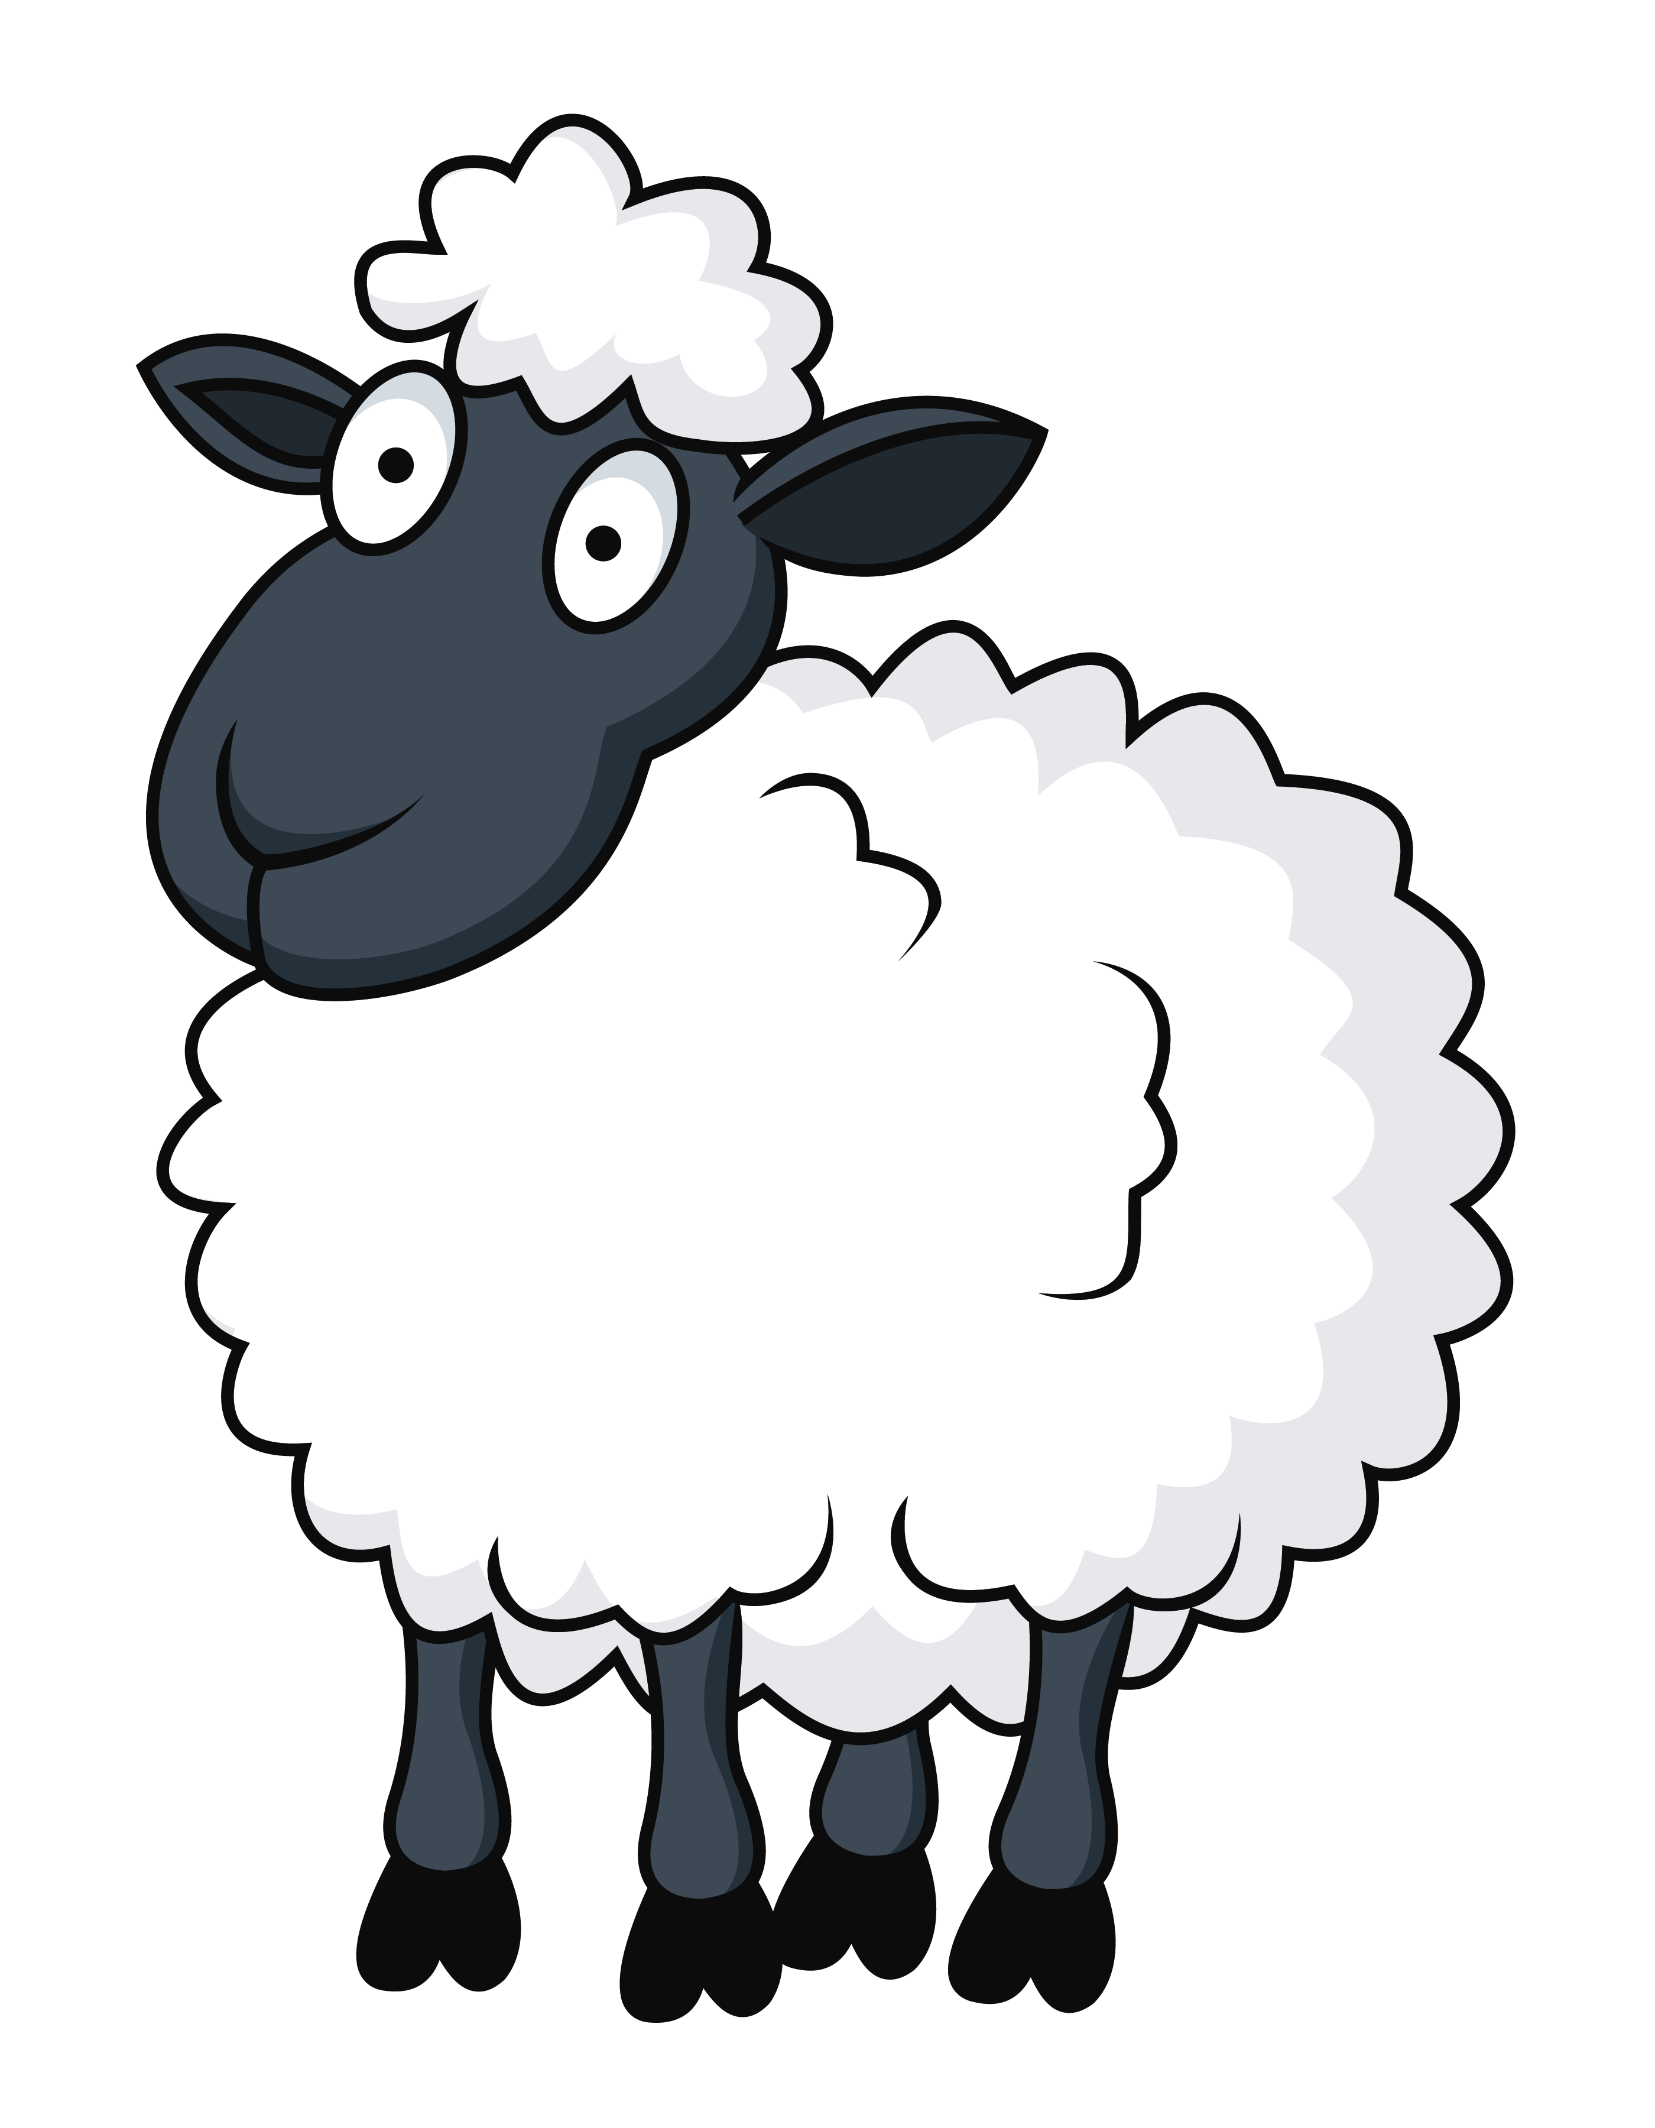
Healing On The Sabbath
David Eats Unlawful Bread
Matthew 12:1-14
Luke 6:1-11, 13:11-17, 14:3-6
Mark 2:24-28, 3:2-4
Matthew 9:13
Hosea 6:6 Compassion Not Sacrifice
Sheep In A Hole
Days To Do Good
?
Notes:
1 Sam 21 David was on a mission in service to the king of Israel and the priest saw that as a reason to give what was not lawful under normal circumstances to David (and his men) as provisions. Holiness was the other requirement.
Is it lawful to do good on the sabbath?
You circumcise on the sabbath, priest give offerings on the the sabbath, you will spare the life of an animal or you son on the sabbath. The sabbath was not intended to excuse a man from his obligation to love but be an expression of love.
Sheep in a hole -
If you will take a sheep, ox, or son out of a hole on the sabbath day how can you forbid me from healing one tormented by Satan on the sabbath day?

Slide 4
God’s Expectation Of His Shepherds
Ezekiel 34:16–17
“I will seek the lost, bring back the scattered, bind up the broken and strengthen the sick; but the fat and the strong I will destroy. I will feed them with judgment. “As for you, My flock, thus says the Lord God, ‘Behold, I will judge between one sheep and another, between the rams and the male goats.
Healed The Sick • Taught God’s truth Jesus cared of their physical and spiritual well being

Slide 5
God’s Expectation Of His Shepherds
Acts 20:28
“Be on guard for yourselves and for all the flock, among which the Holy Spirit has made you overseers, to shepherd the church of God which He purchased with His own blood.

Slide 6
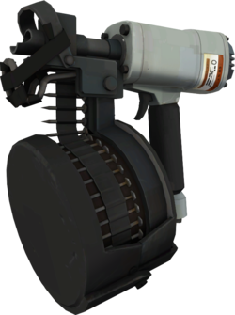
Reasonable Worship
Romans 12:1, 6-21
Romans 12:6
Since we have gifts that differ according to the grace given to us, each of us is to exercise them accordingly:
…USE THEM

Slide 7
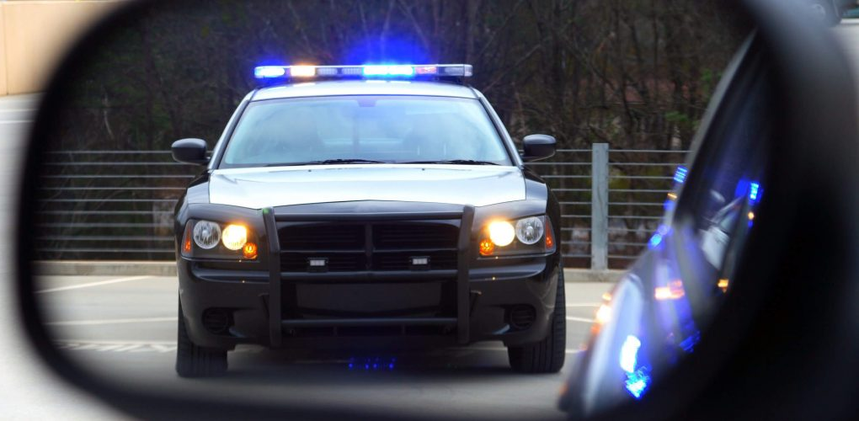
Obey The Law
Romans 13:1-3 1 Peter 2:13-17
John 19:10-11
Romans 13:3
For rulers are not a cause of fear for good behavior, but for evil. Do you want to have no fear of authority? Do what is good and you will have praise from the same;

Slide 8
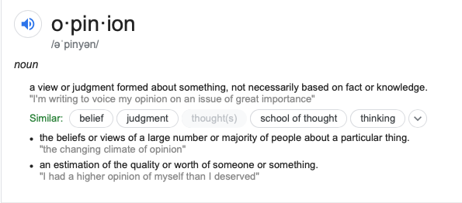
Respect & Opinions
Romans 14:1-5
A view or judgment formed about something, not necessarily based on fact of knowledge

Slide 9
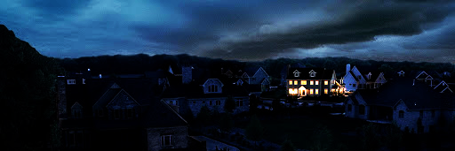
Exodus 10:21-23
Exodus 10:23
They did not see one another, nor did anyone rise from his place for three days, but all the sons of Israel had light in their dwellings.

