Slide 1
Family
Built On The Rock
Notes:
This is a two part series to define the role a parent plays in the faith of their children. It is not meant as a salve for bad decisions, it is meant to reveal the reality of God’s involvement in the life of your children while they are children and the reality that it is God alone who calls your child to faith and redemption through the blood of Christ. It is your child who has to make the decision to believe and will bear their own guilt.

Slide 2
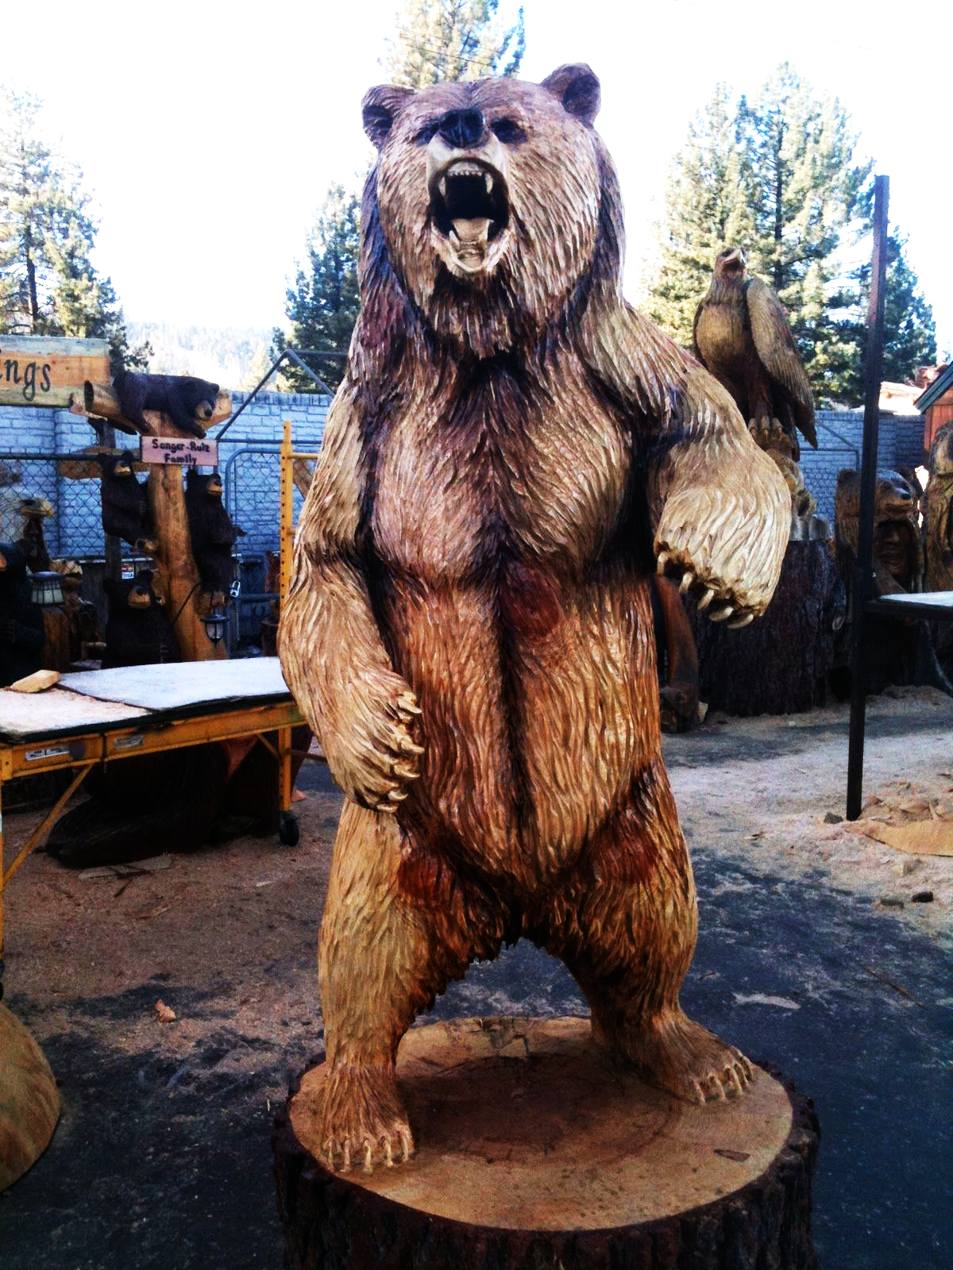
God guides, protects and calls our children to faith.
Faithful parents prepare their children to answer God’s call

Slide 3
You Are Raising Sinners
Genesis 8:21 Evil from youth
Romans 3:23 All sin
Sinners need to know God, and how to repent and seek forgiveness
Romans 6:23, Exodus 12:26-27
Isaiah 66:1-2, Hebrews 12:5-6 James 4:6-7
Romans 10:17

Slide 4
The Way Of The World
A generation that does not know God Judges 2:10 • 2 Timothy 3:1-5 Parents failed to instruct their children as sinners 1 Samuel 4:28-29 • 2 Tim 3:14-17
Notes:
The parents failed to tell their children about God’s salvation, His ways, and how they could have repentance and forgiveness through His mercy
Eli took something from his children that belonged to God and was condemned by God and the blessing of his family was removed from him.

Slide 5
Stewardship or Ownership
Mark 12 – They rejected God and His servants because they did not acknowledge Him as the owner of the vineyard
2 Corinthians 2:8 Failed to understand
God’s Purpose For Parents
Stewards NOT Owners
Psalm 127:3 • Ephesians 6:1-3, 4

Slide 6
Sinners Than Need Grace
Grace: “Everything God does for us that we cannot do for ourselves”
Equip your child with what they need to live as a sinner who needs God’s grace
Parents: Live as sinners who need God’s grace and you children will benefit
Notes:
Example:
Did Tiger Woods benefit from his father teaching him to play golf from a very young age?
My dad didn’t watch sports or teach me about them. I joined football and the only position I knew about was right guard because my dad told me he was a right guard. I didn’t want to be a lineman and didn’t know anything so that is what I did. I would have wanted to be a linebacker or tight end because I was fast and strong but didn’t know to ask about that. If I stuck with it I may have become a good player but my upbringing did not set me up for success.

Slide 7
Conclusion:
God will call your children to faith. It is our responsibility as stewards and servants of the Lord to prepare our children to hear and know how to respond to that call.
This will be the foundational premise for the rest of this series on family.

