Slide 1
Family
Built On The Rock
Notes:
The best time to plant a tree was twenty years ago, the next best time is now. – Chinese Proverb
The best time to establish a tradition of faith in your family was three generations ago, the next best time is now – Chinese proverb modified by someone.
a brother in Christ who passed away recently. His father was an elder in the church of Christ, He was an elder in the church of Christ, His son is an elder, and His daughter is married to an elder in the church of Christ, their daughter is married to a deacon and a good man who will likely be an elder in the church of Christ, and they are raising a young son who Lord willing will be an elder in the church of Christ. someone.

Slide 2
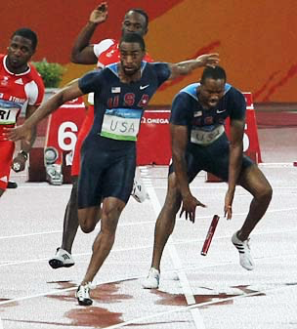
Judges 2:10
All that generation also were gathered to their fathers; and there arose another generation after them who did not know the Lord, nor yet the work which He had done for Israel.

Slide 3
Deuteronomy 6:4-5
YHWH is God, YHWH is One
Love God
Heart: Intellect, Moral Character, Decision
Soul: Inner Self, Emotion, Desire – Psalm 103:1
Strength: Without Reservation, Substance & Possessions
Notes:
This is a covenantal love anchored in a commitment to God.
When you know what is pleasing to someone who has done so much for you. You do the thing that pleases them.

Slide 4
Watch Yourself • Do Not Forget • God’s Salvation
Deuteronomy 6:12 • Mark 4:18-19 • Acts 20:28

Slide 5
You Shall
x13 • Deut. 6:5, 6, 18, 20
Notes:
Do what is right in the sight of the Lord…
Are you doing what is right and on what basis?
There is only one way to know if what you are doing is right with God.

Slide 6
Who Is My Family?
Mark 3:33-35
Whoever does the will of God…

