Slide 1
“Go In This Your Strength”
Judges 6:1-24

Slide 2
Israel Is “Brought Very Low”
Judges 6:1-6
Growing Crops
May – June Harvest the crops
Clear fields and sow seed
Plow the fields
Rainy season
Growing season

Slide 3
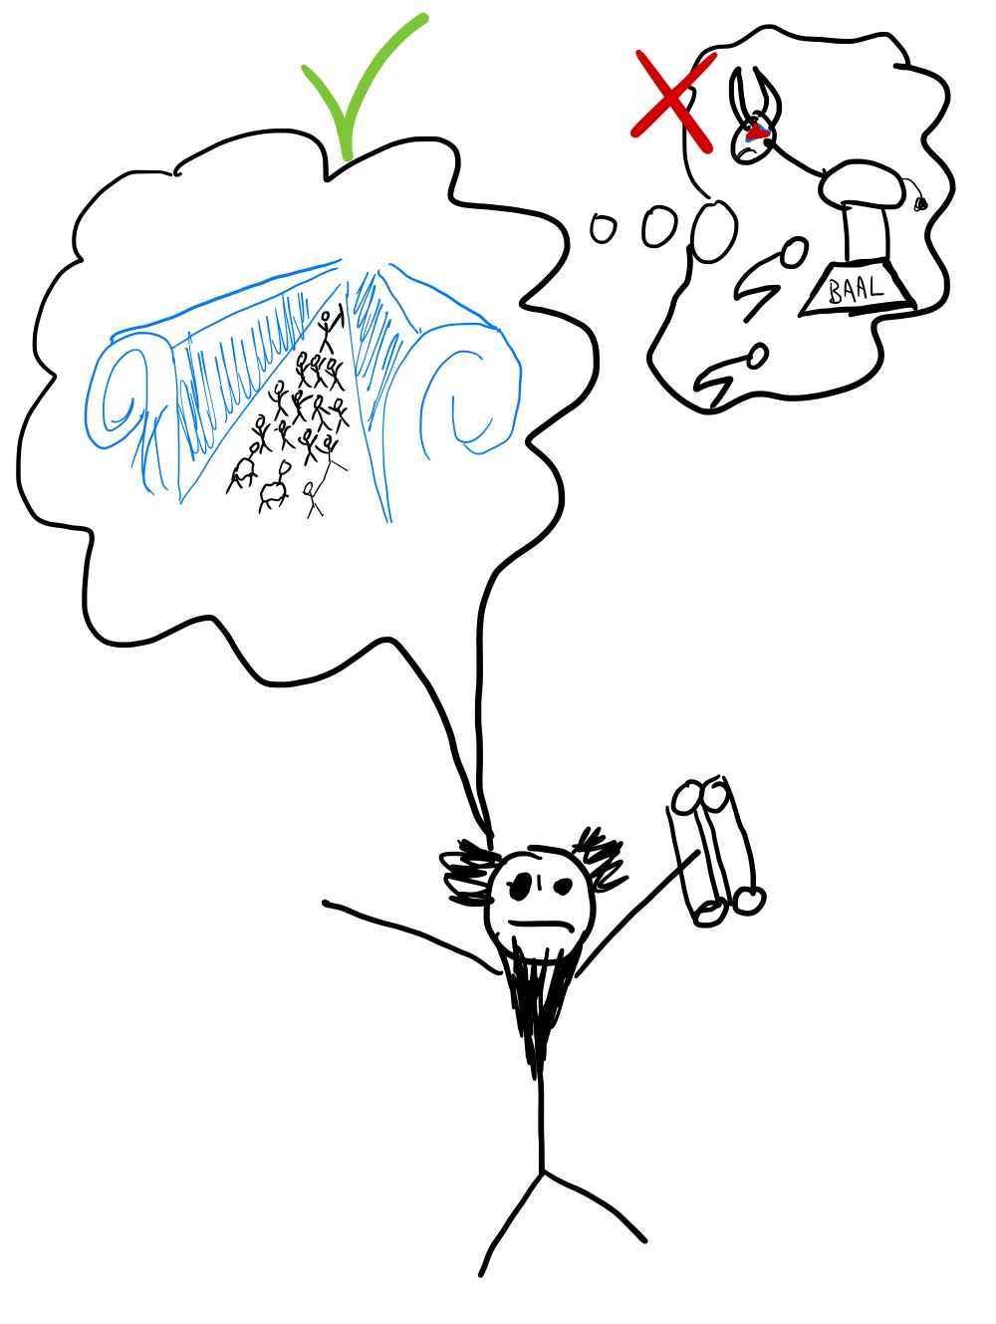
God Sends A Prophet
Judges 6:6-10
Vs. 10 Israel started worshipping idols and forgot about God
Vs. 7 Israel cried out to God
Vs. 8 God sent a prophet to tell about what God did for them

Slide 4
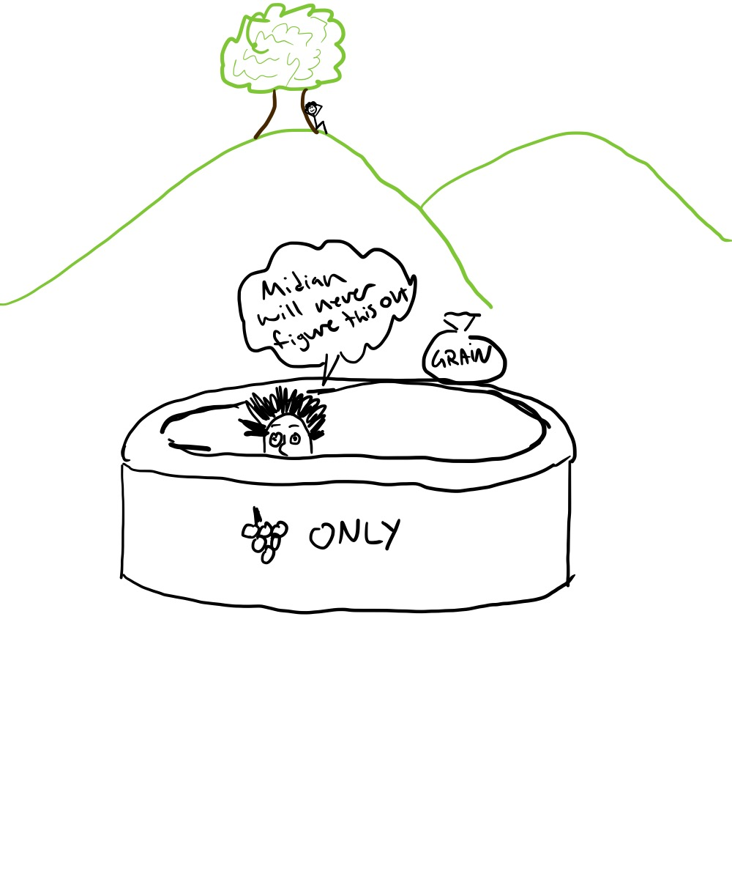
Gideon
Judges 6:11
Then the angel of the Lord came and sat under the oak that was in Ophrah, which belonged to Joash the Abiezrite as his son
Gideon was beating out wheat in the wine press in order to save it from the Midianites.

Slide 5
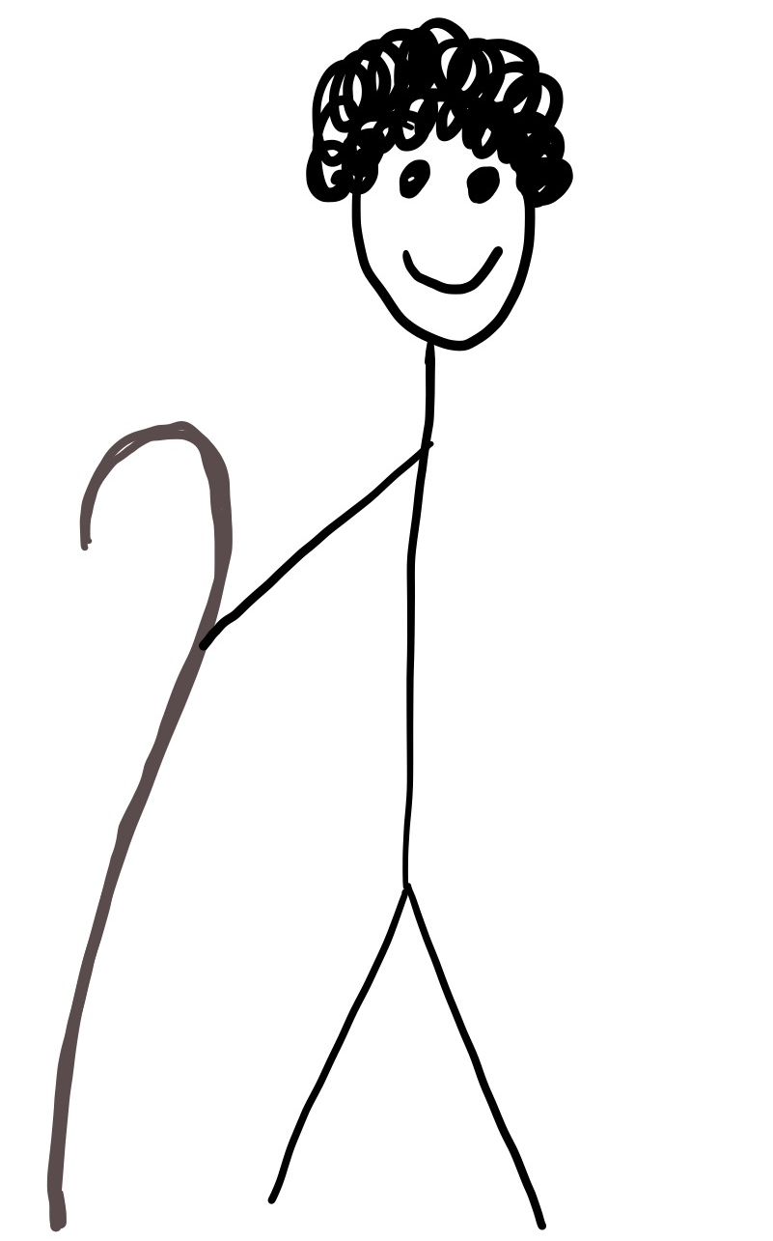
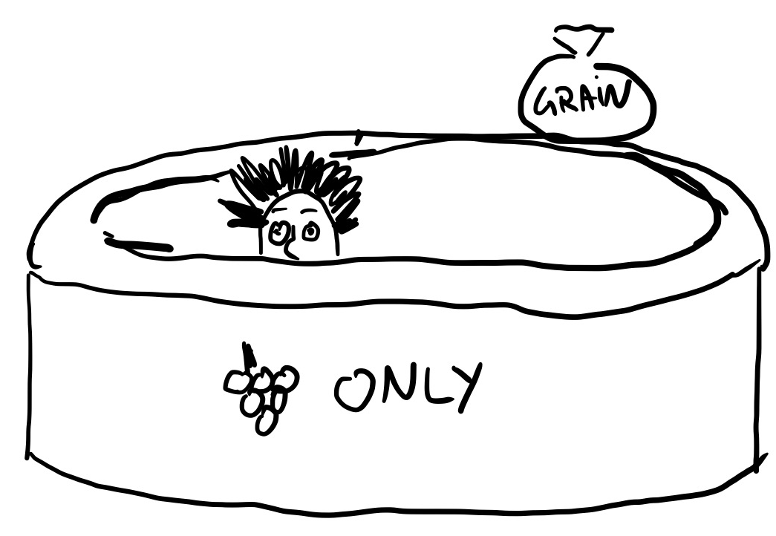
Providing food for his family –
a common observation about threshing in a wine press is “you are not going to produce a great volume of grain in that manner.”

Slide 6
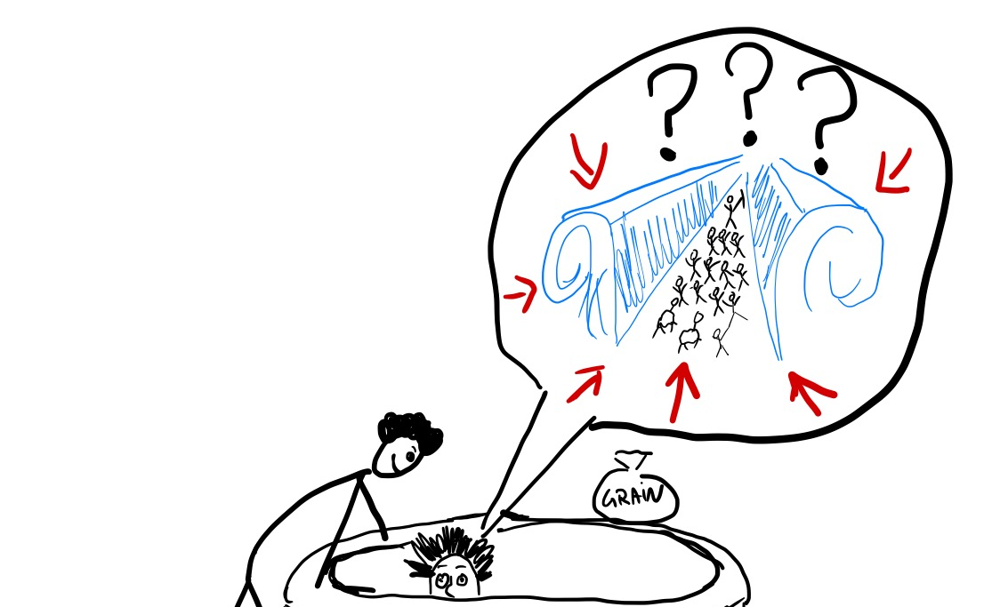
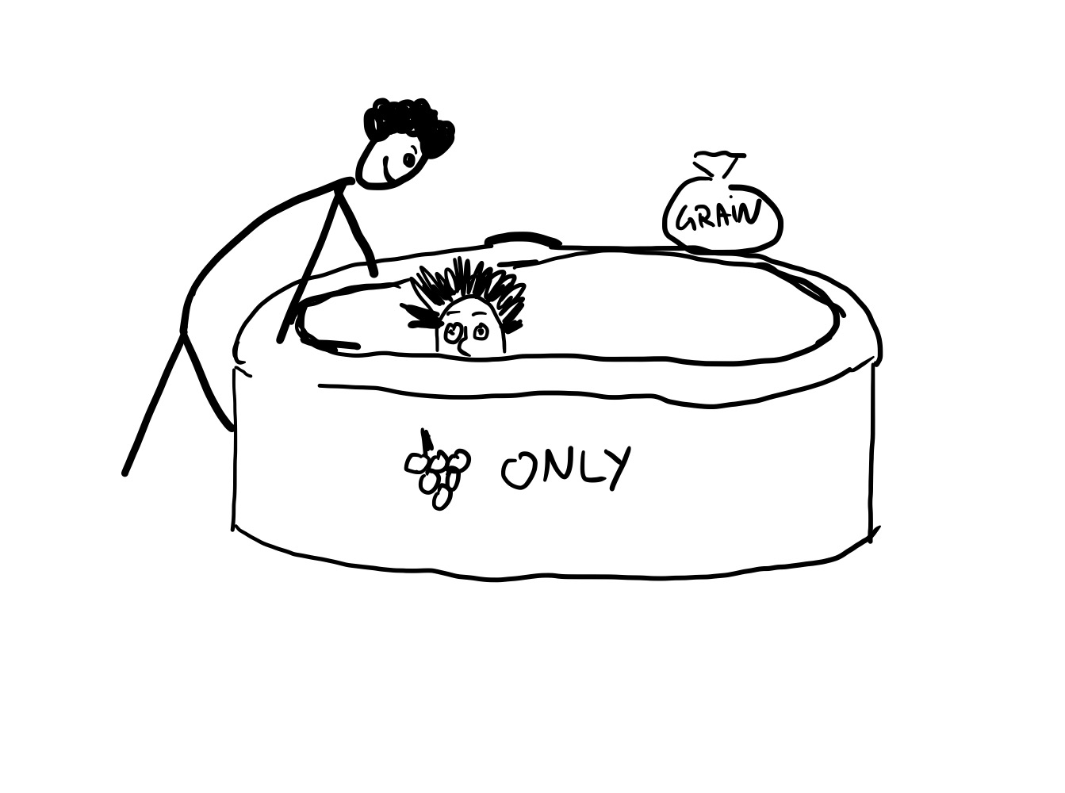
Go In This Your Strength
Judges 6:12-14
Judges 6:12 The angel of the Lord appeared to him and said to him, “The Lord is with you, O valiant warrior.”
Notes:
Is what the Lord said true

Slide 7
Go In This Your Strength
Judges 6:12-14
Judges 6:12 The angel of the Lord appeared to him and said to him, “The Lord is with you, O valiant warrior.”
Notes:
Is what the Lord said true

Slide 8
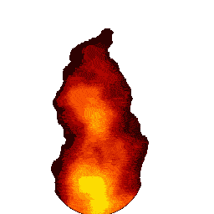
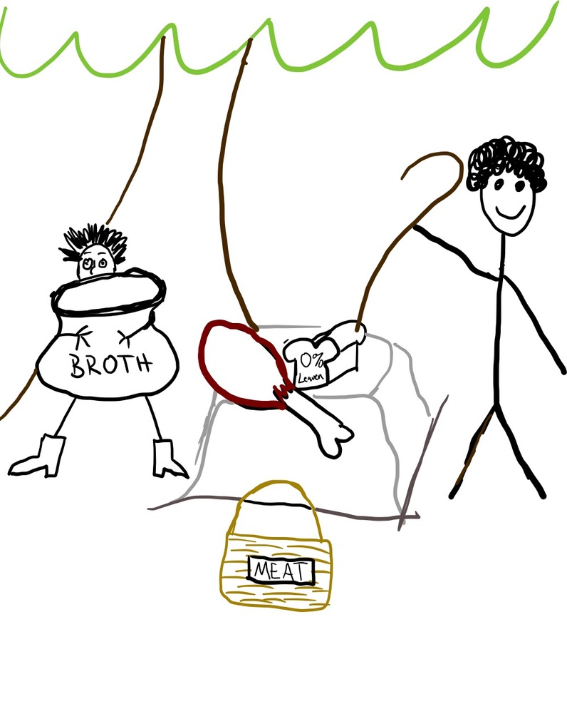
Gideon’s Offering
Judges 6:17-21
Ephah Of Grain = 40lbs
Young Goat = 20lbs
Broth = ?
This is a substantial offering made to this “messenger of God”

Slide 9
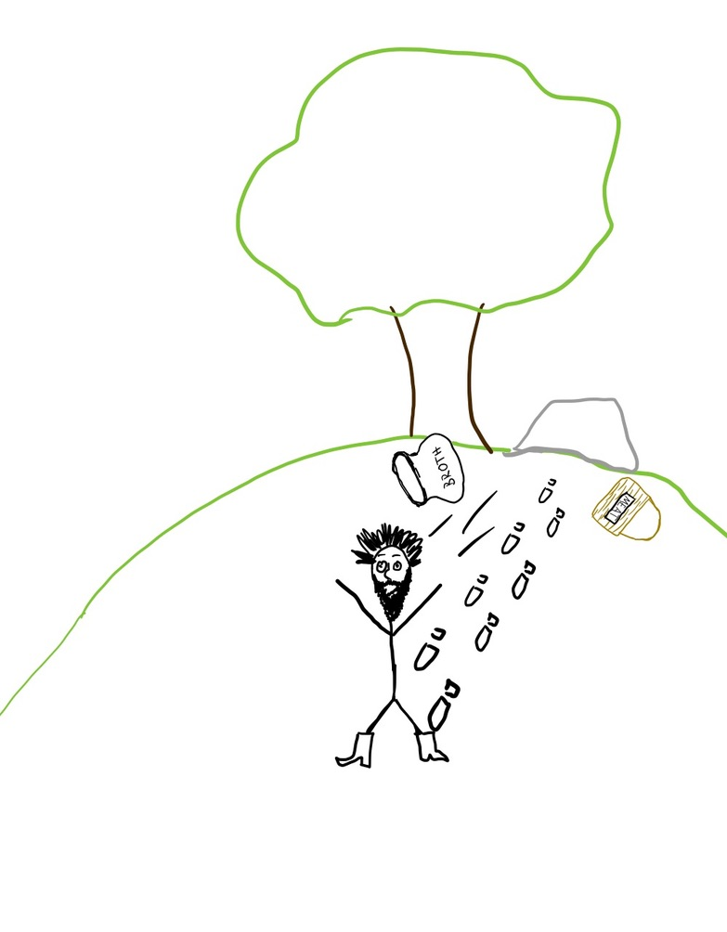
Seeing The Lord’s Face
Judges 6:22
When Gideon saw that he was the angel of the Lord, he said, “Alas, O Lord God! For now I have seen the angel of the Lord face to face.”

Slide 10
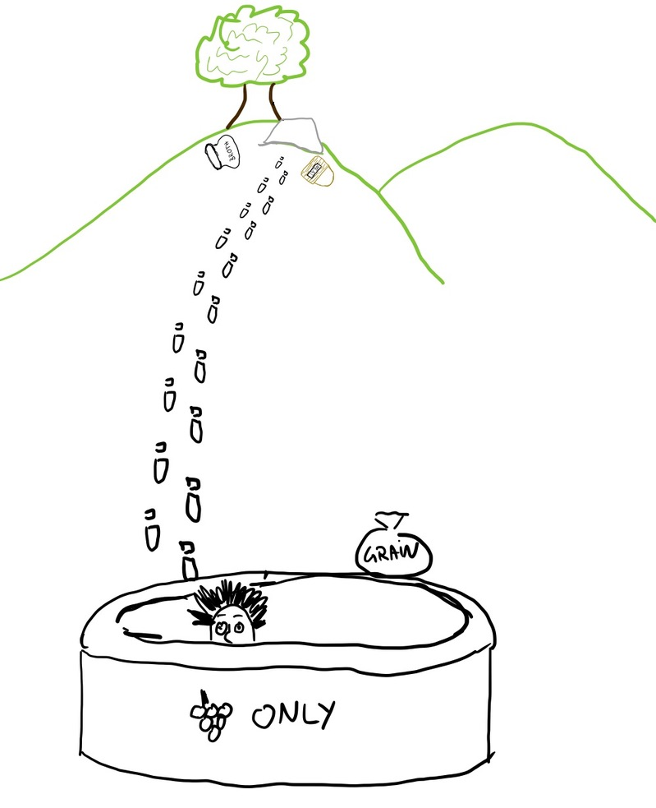
The Lord Is Peace
Judges 6:23-24
The Lord said to him, “Peace to you, do not fear; you shall not die.” Then Gideon built an altar there to the Lord and named it The Lord is Peace. To this day it is still in Ophrah of the Abiezrites.

