Slide 1




ARE YOU HAPPILY MARRIED?
28% said, “Yes!”
21% said, “No!”
41% said…
“It depends on what day you ask me.”

Slide 2
IS YOUR MARRIAGE IN A RUT?
75%
said, “Yes!”

Slide 3

Prescription for the BEST Marriage

Slide 4
Prescription for the BEST Marriage
B.E.S.T.
Blessing
Edification
Sharing
Touching

Slide 5
BLESSING
Blessing (Eulogia) = two Gk words:
  Eu = “Well”
  Logos = “Word”
  Speaking well about another

Slide 6
BLESSING
Paul admonishes:
Rom 12:14 “Bless those who persecute you; bless and do not curse.”
Rom 12:17 “Repay no one evil for evil.”

Slide 7
BLESSING
Jesus commands:
  Luke 6:28-29 “Bless those who curse you, and pray for those who spitefully use you.”

Slide 8
Summary: Bless your marriage
Good words
Kind actions
Thankful appreciation
Intercessory prayer

Slide 9
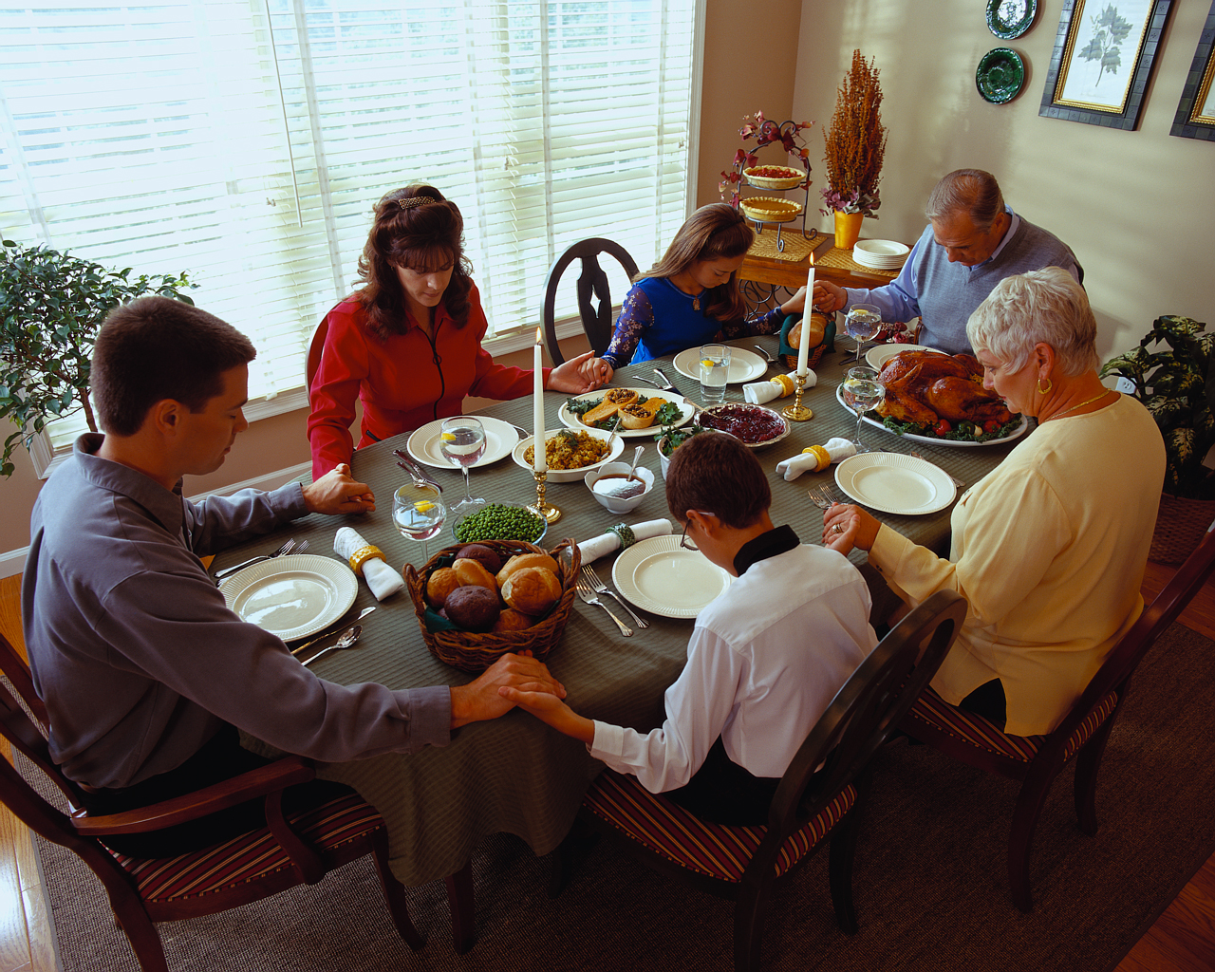
Pray as a family …
Rx for the BEST marriage

Slide 10

EDIFICATION
Lit: “To build up.”
Be his or her best cheerleader!

Slide 11

EDIFYING
Root: ”A hearth or fireplace.”

Slide 12
Three components:
Personal encouragement
Inner Strengthening
Peace and Harmony I Pet 3:9ff

Slide 13

Verses on Edifying
“Therefore encourage one another and build each other up..” I Thess 5:11
“Love builds up.” (Edifies) I Cor 8:1
Rx for the BEST Marriage

Slide 14
Verses on Edifying
“Eagerly pursue what makes for harmony and for the edification of one another” (Rm 14:19).
“Make it a practice to please your neighbor for his good; to edify, strengthen and build him up spiritually” (Rm 15:2).
Rx for a Superb Marriage

Slide 15
HOW DO YOU EDIFY?
Husband = Sincere specific praise.
Wife = Supportive loving response
Rx for a superb marriage

Slide 16
GENESIS 2:24-25
24 For this reason a man shall leave his father and his mother, and be joined to his wife; and they shall become one flesh.
25 And the man and his wife were both naked and were not ashamed. NASU
Severance
Permanence
Unity
Intimacy
Rx. for the BEST Marriage

Slide 17
GENESIS 2:24-25
24 For this reason a man shall leave his father and his mother, and be joined to his wife; and they shall become one flesh.
25 And the man and his wife were both naked and were not ashamed. NASU
Severance
Permanence
Unity
Intimacy
Rx. for the BEST Marriage

Slide 18
Sharing in Marriage
C. Sharing is a Growth process.
  Not just liking the same things.
  It is a willingness to blend your will with the will of your mate.

Slide 19

Look for mutual goals.
KEY: Seek to mold each other’s will into the will of God…then YOU become closer to GOD and each other!

Slide 20
Look for mutual goals.
God
KEY: Seek to mold each other’s will into the will of God…then YOU become closer to GOD and each other!
Wife
Husband

Slide 21
Look for mutual goals.
KEY: Seek to mold each other’s will into the will of God…then YOU become closer to GOD and each other!
God
Wife
Husband

Slide 22
Sharing . . .
“An intimate long- term marriage is not the involuntary result of fleeting emotion but the creation of time and will.”
  Dr. W.H. Auden
Rx for the BEST marriage

Slide 23
Sharing . . .
Intimacy begins when two people deliberately share the same world… time, interests, activities, feelings, thoughts, goals, ideals.
Rx for the BEST marriage

Slide 24
Sharing . . .
Both must communicate experiences, dreams, fears, and secrets.. Dr. Ed Wheat
Rx for the BEST marriage

Slide 25

Sharing . . .
Last time you shared a laugh?
Had fun? Date?
Prayed together?
Studied together?
Rx for the BEST marriage

Slide 26
Sharing . . .
Wife
Husband
Rx for the BEST marriage

Slide 27
Sharing . . .
Husband
Wife
Rx for the BEST marriage

Slide 28
Must be avoided . . .
Husband
Wife
Rx for a superb marriage

Slide 29


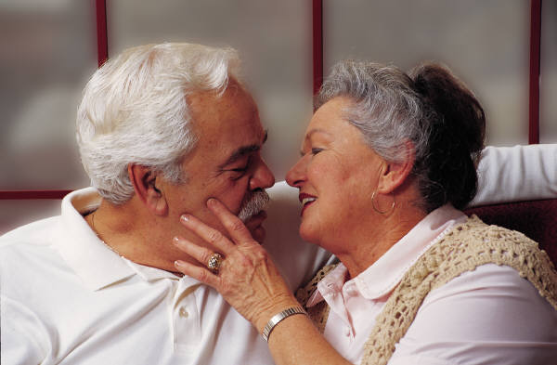
Touching . . .
Rx for the BEST marriage

Slide 30
Touching . . .
Jesus and the little children…Matt 19:13-15
13 Then children were brought to him that he might lay his hands on them and pray. The disciples rebuked the people; 15 And he began blessing them laying his hands on them.” RSV
Rx for the BEST marriage

Slide 31
Touching . . .
Jesus and the leper… Matt 8:2-3
  2 And, behold, there came a leper and worshipped him, saying, Lord, if thou wilt, thou canst make me clean. 3 And Jesus put forth his hand, and touched him, saying, I will; be thou clean.
Brethren: “Be kindly affectionate..” Rm 12:10
Rx for the BEST marriage

Slide 32
Benefits of Touching. Dr. Ed Wheat
“Absolutely essential in building emotional intimacy.”
“Establishes a good emotional climate of warmth, love and affection.”
Rx for the BEST marriage

Slide 33

Touching
Tender touch=“I care.”
Practice touching in all of its pleasant non-sexual forms.
  Hold hands often
  Sit close in church and at home.
  Caress each other
  Cuddle/”Snuggle”
Rx for the BEST marriage

Slide 34
UCLA study . Touch blesses by..
Raising the hemoglobin level in our blood, thus increasing the body’s ability to heal
Lowers blood pressure
Increases our life span
Increases our energy level
Makes people more positive about life
The average man or women needs 8 or 10 meaningful touches a day!
Rx for the BEST marriage

Slide 35

Touching
Three hugs a day keeps the marriage counselor away!
Rx for the BEST marriage

Slide 36
Prescription for the BEST Marriage
B.E.S.T.
Blessing
Edification
Sharing
Touching

Slide 37

Follow the B – E – S – T Rx
It works!
Rx for the BEST marriage

